Slide 1
Art workshop

Slide 2
Hannah Sawtell’s sketchbook process…
Before drawing, Hannah pre-prepares pages with washes of paint. She uses gouache, watercolour, and emulsion paints.
For some pages she makes a border using washi tape. Masking tape can also be used.
For the artwork Hannah uses a mixed media approach, using materials such as waterbased-colour pencils, neo-colour oil pastels, paint sticks, pastels, brush pens, and acrylic marker pens.
You can find out more about Hannah on her website: Hannah Sawtell Illustration

Slide 3
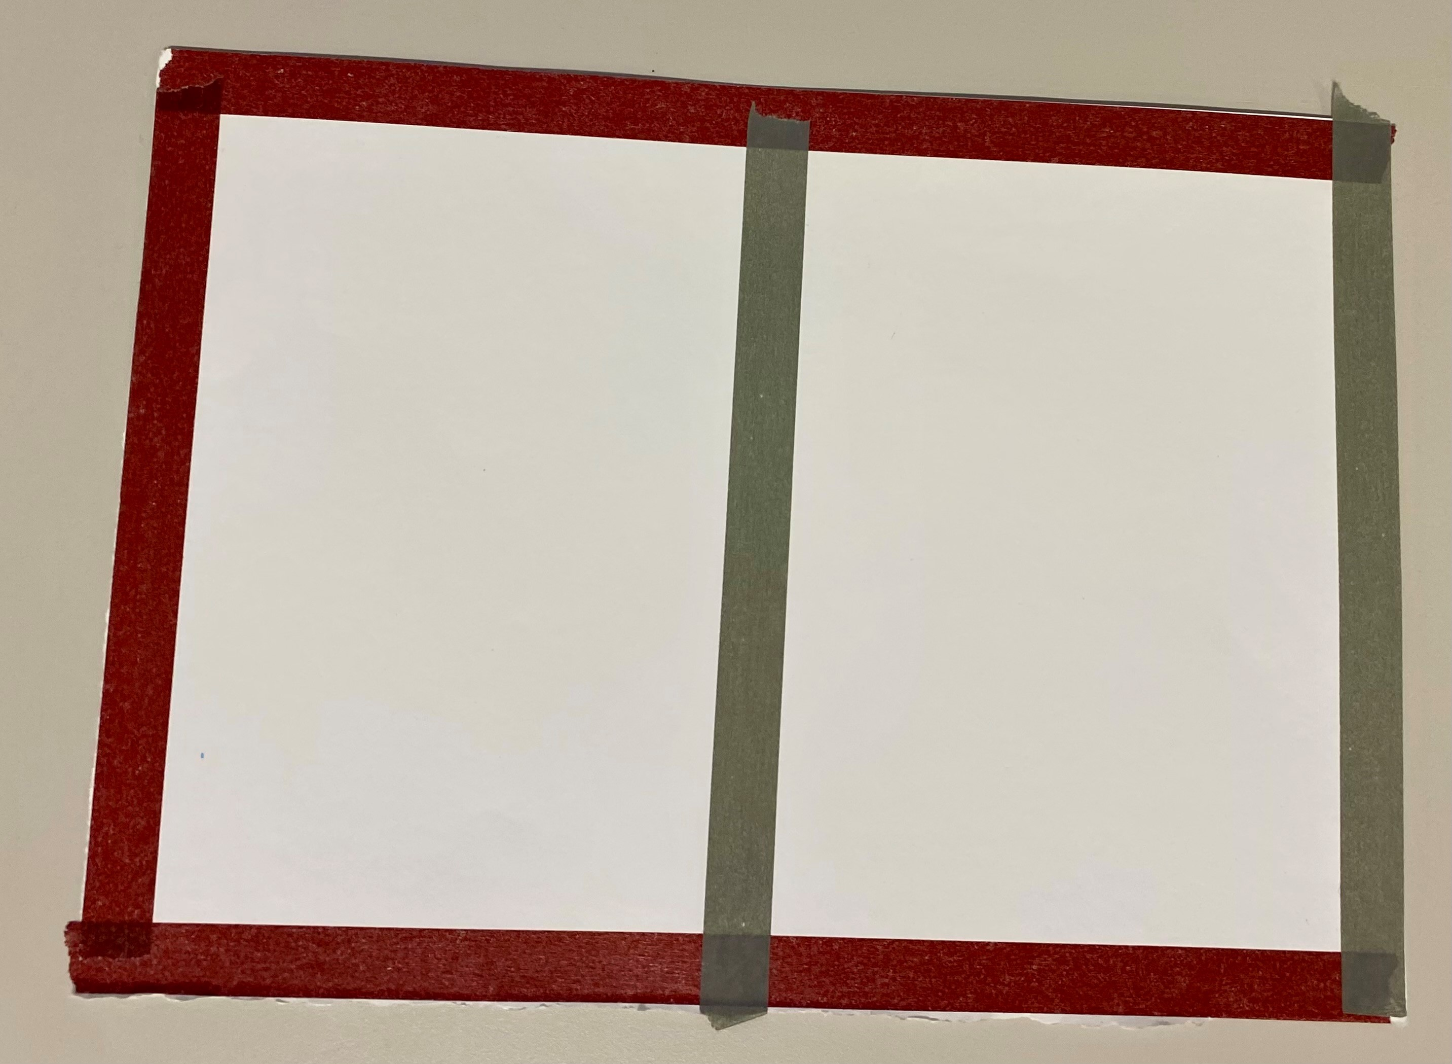
Hannah’s blank page

Slide 4
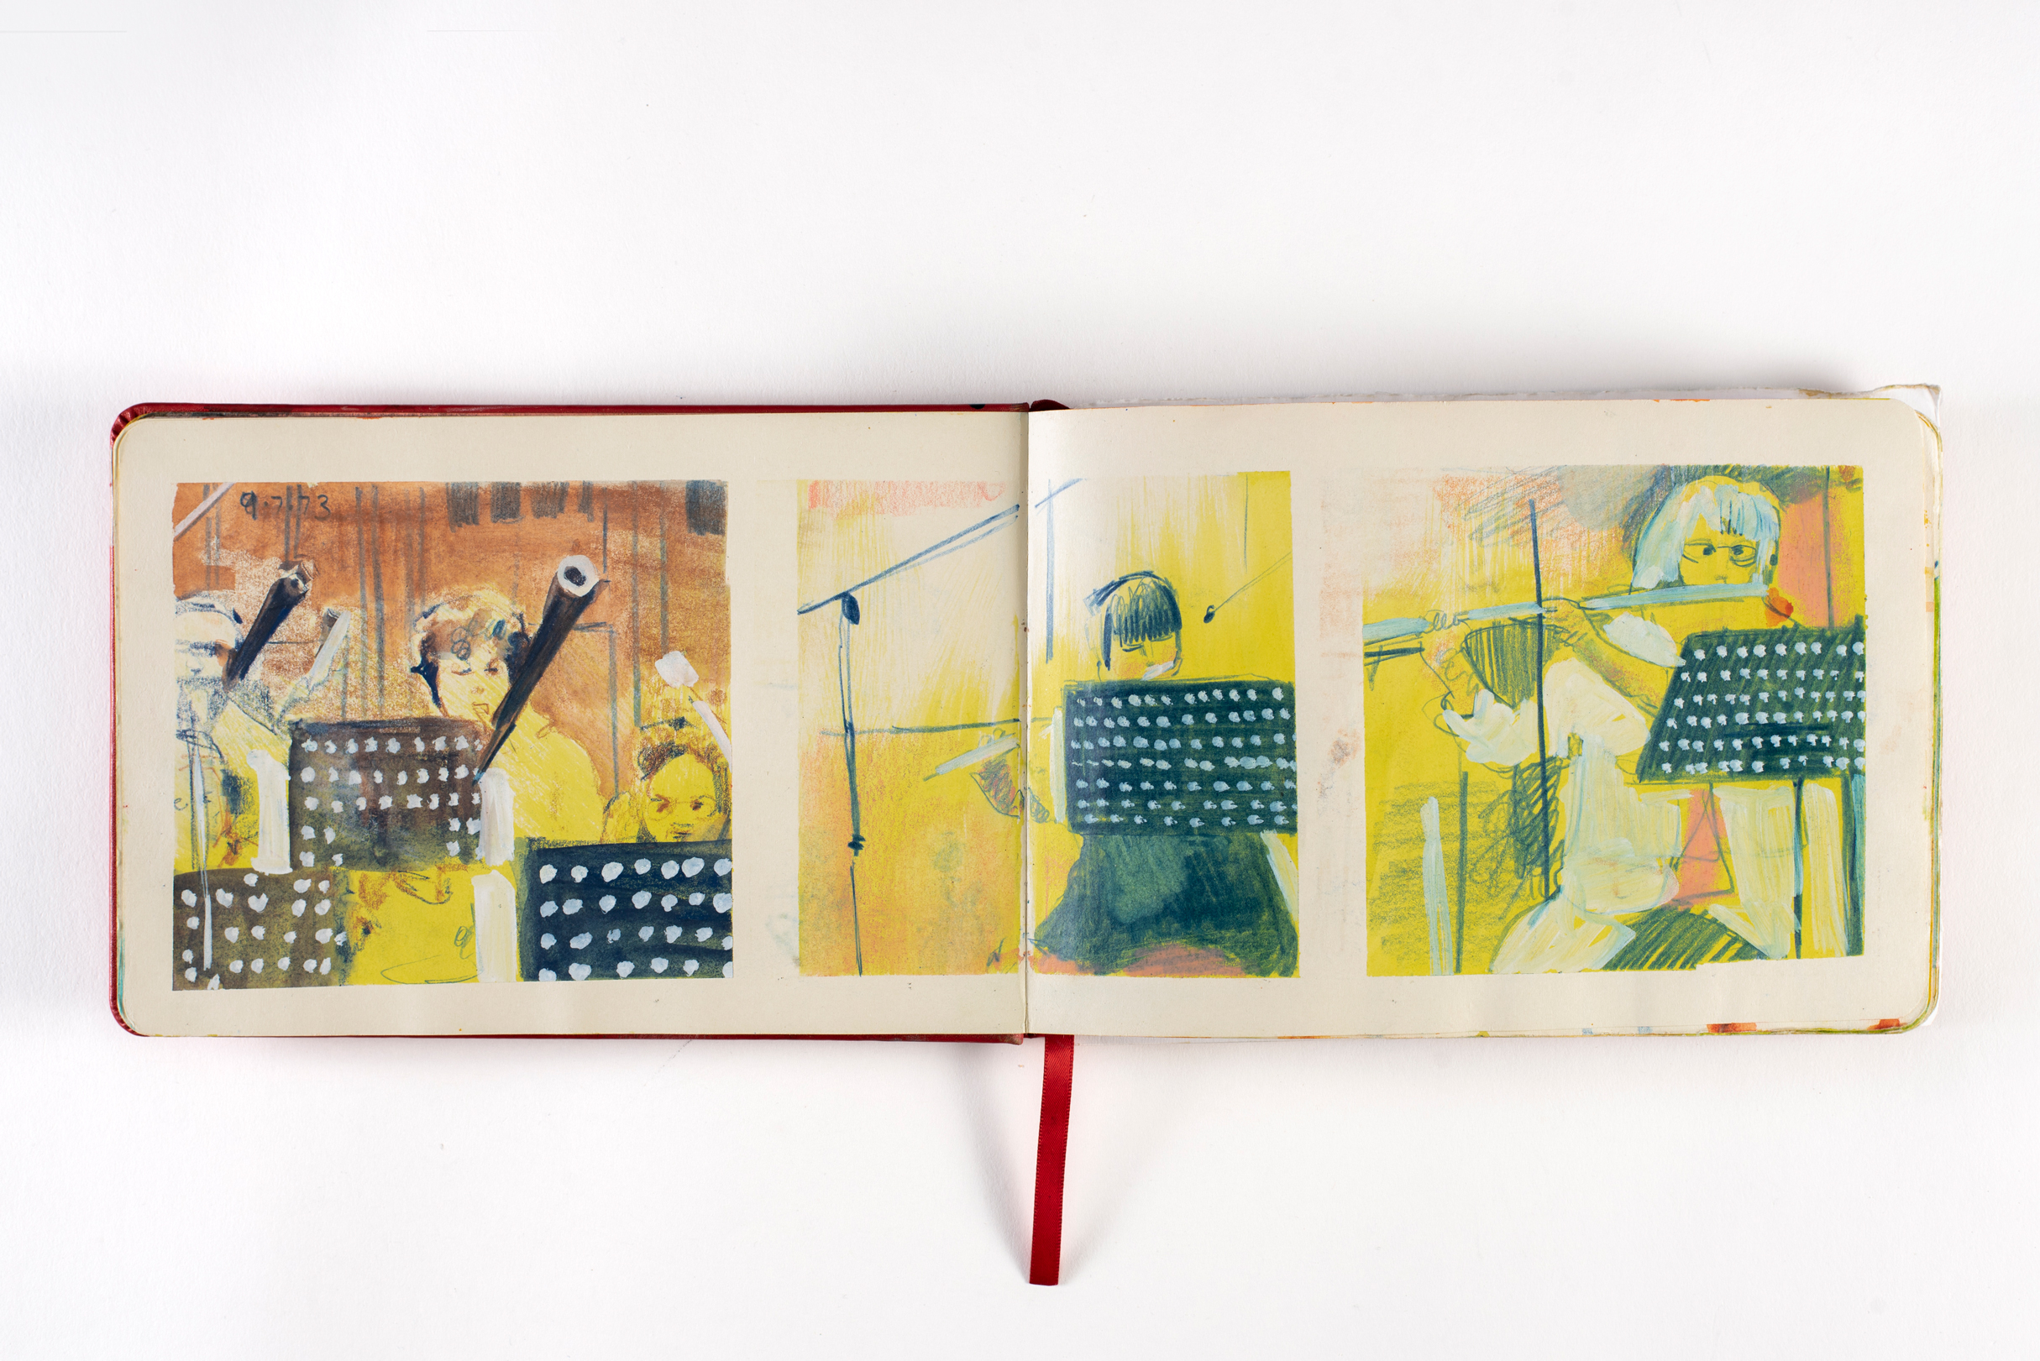
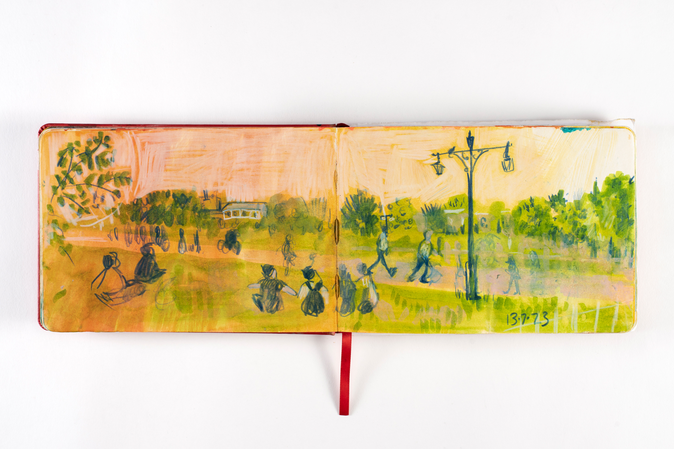
Hannah’s sketchbook

Slide 5
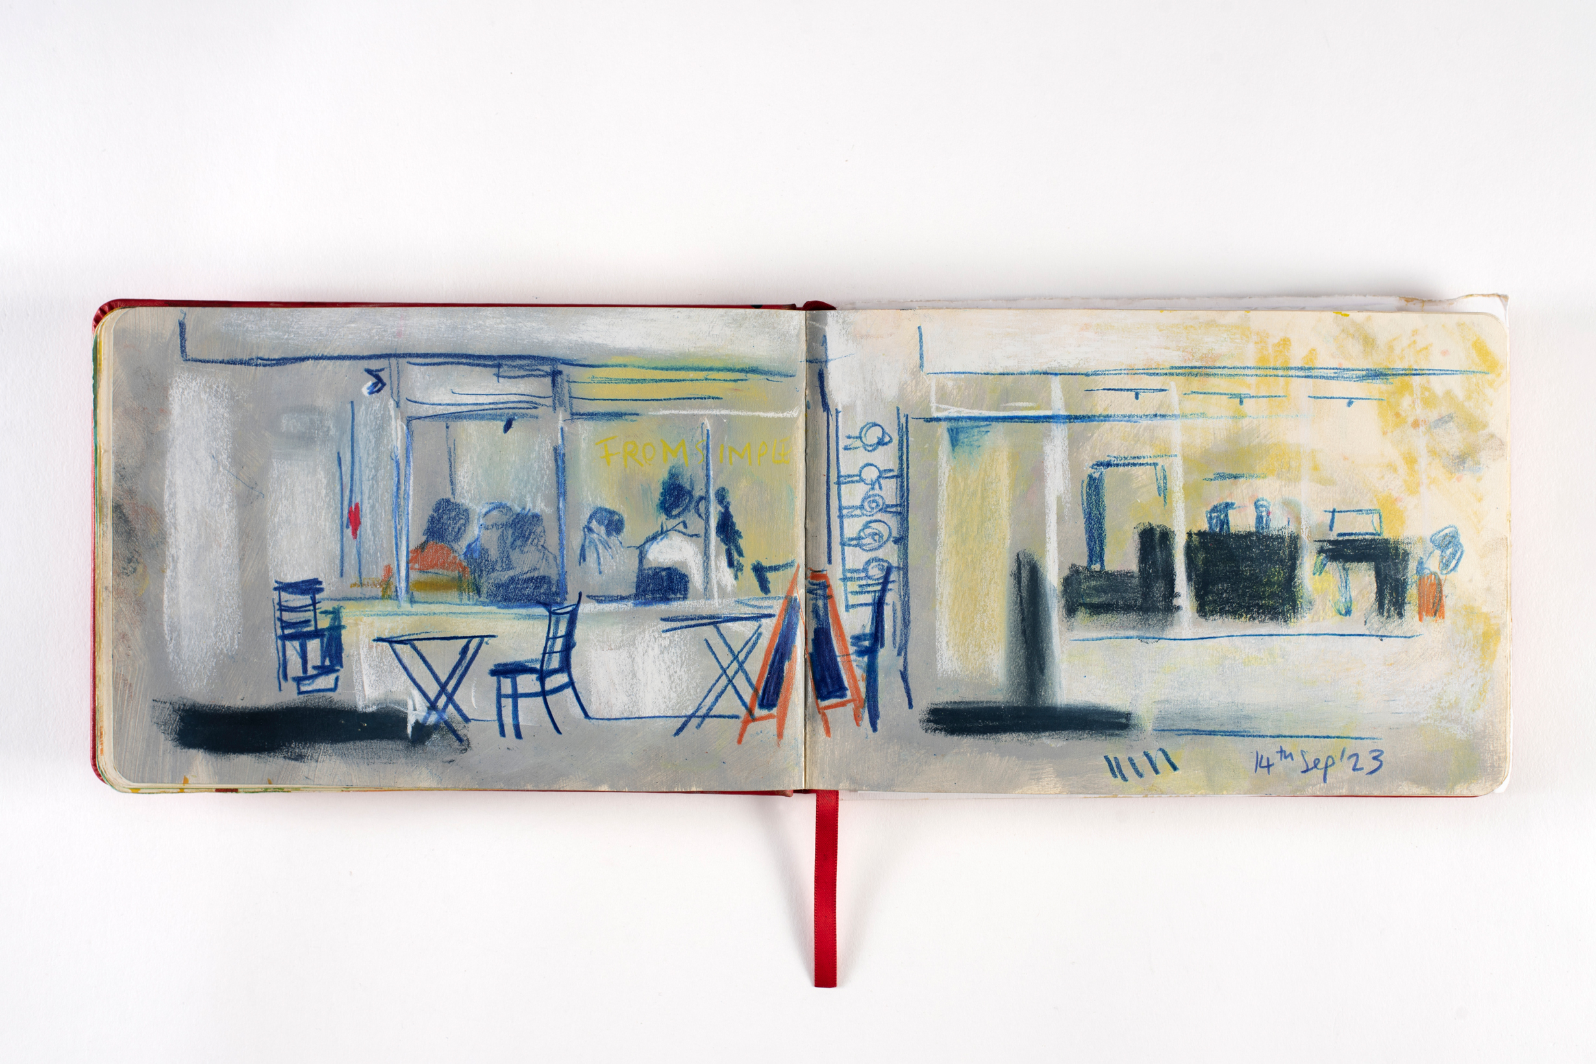
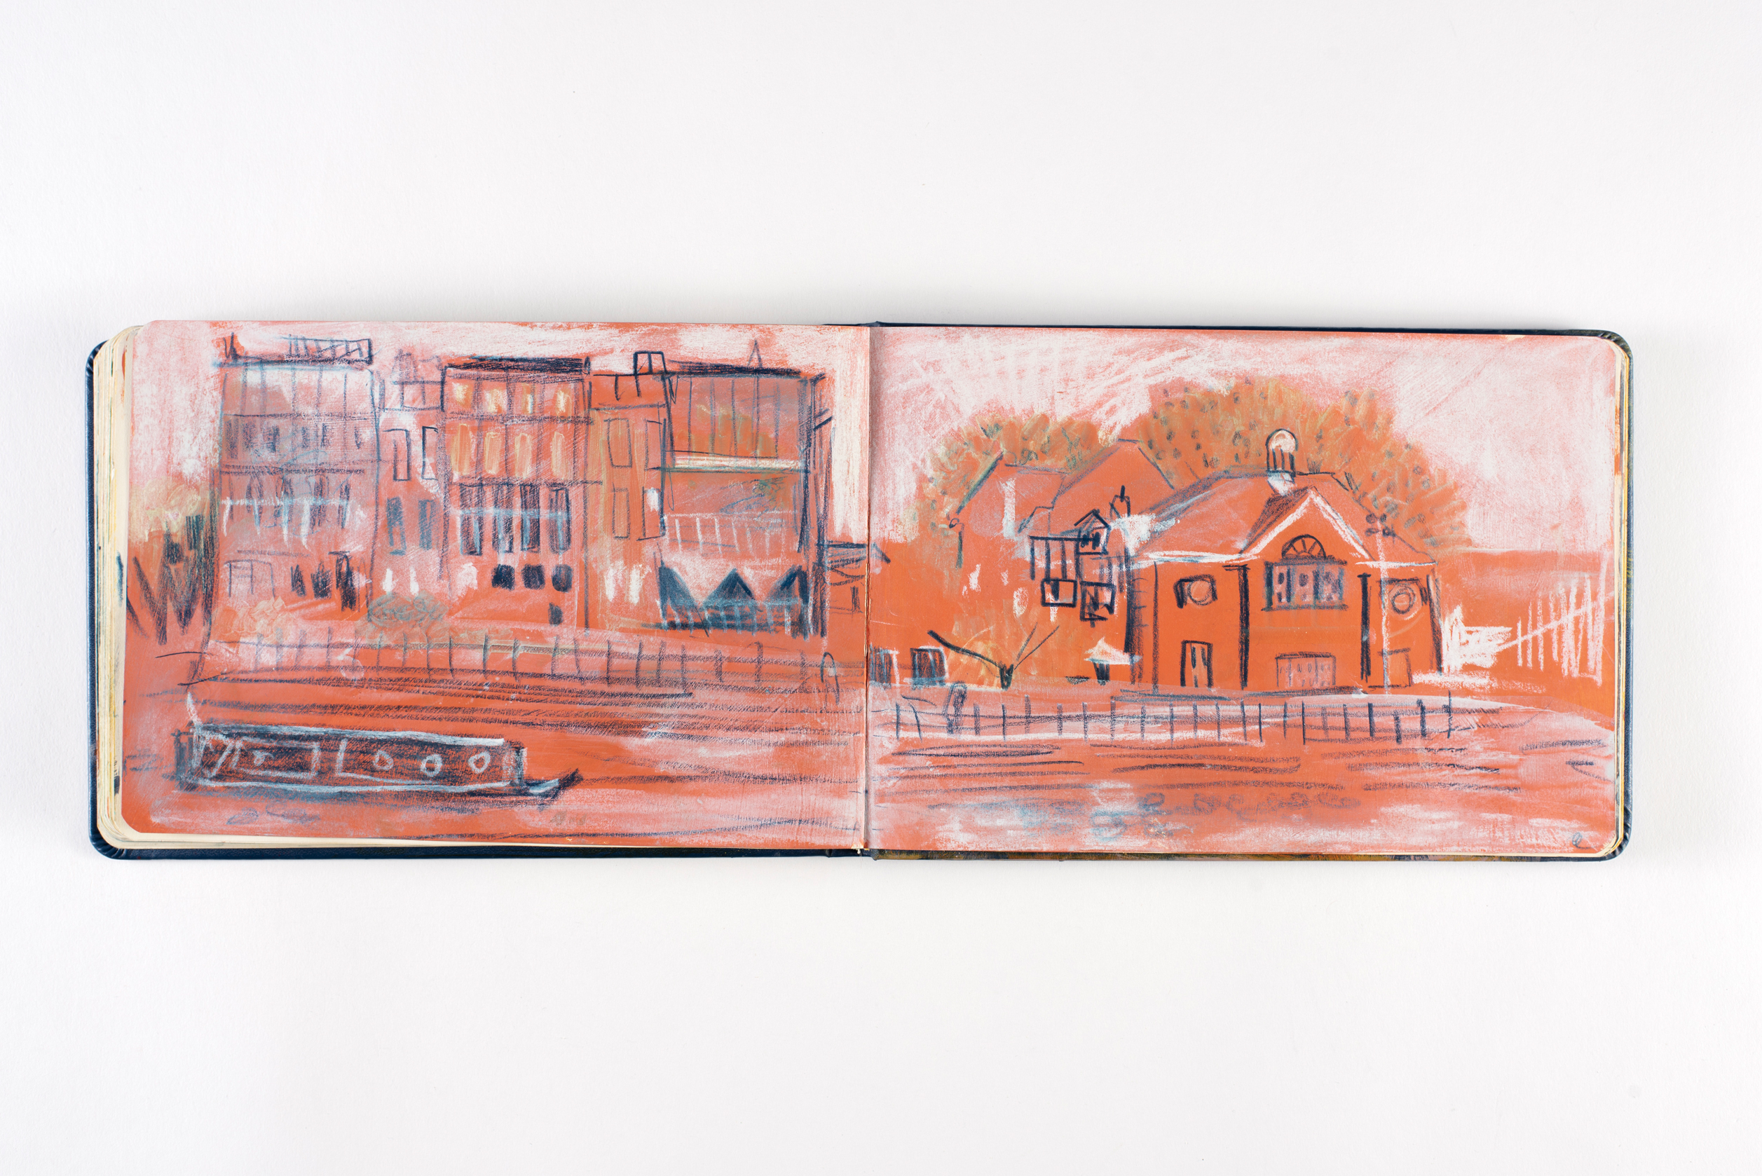
Hannah’s sketchbook

Slide 6
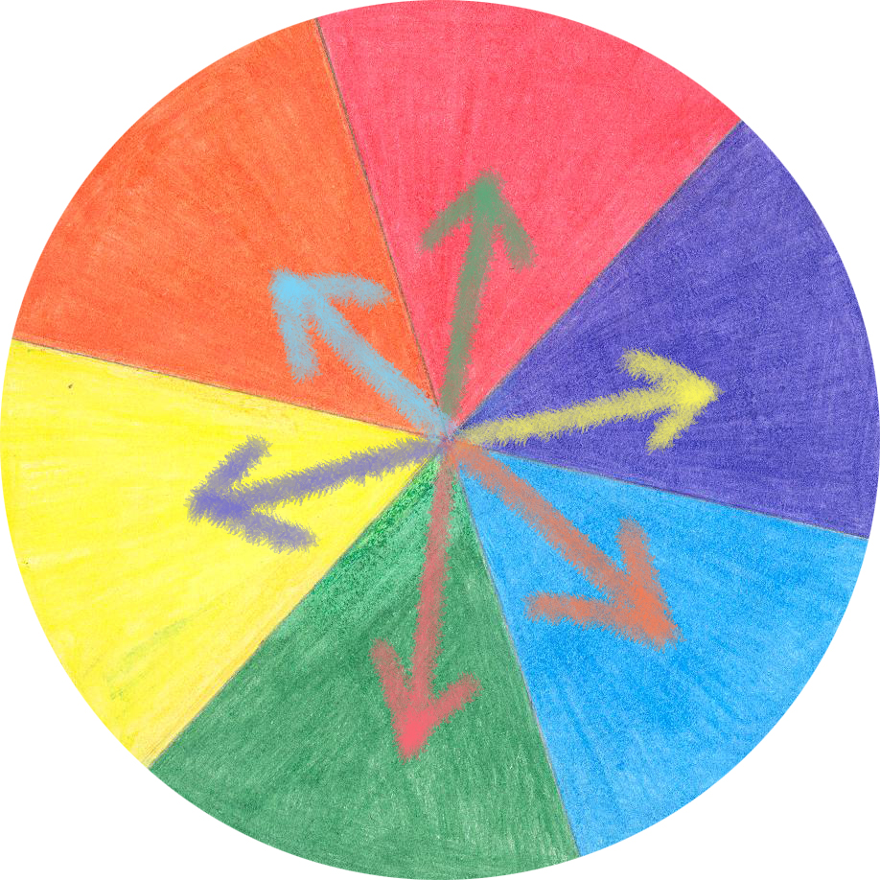
Complimentary colours/
Colour opposites

Slide 7
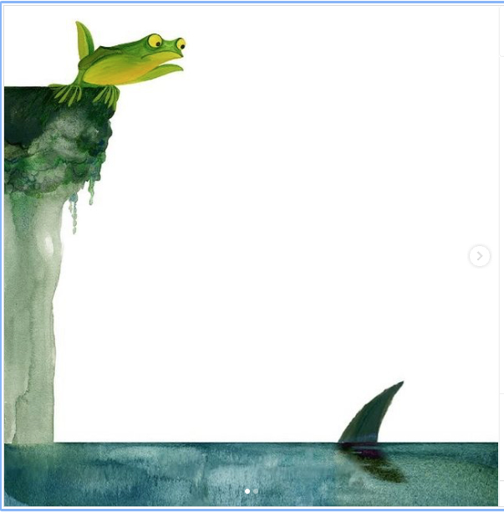
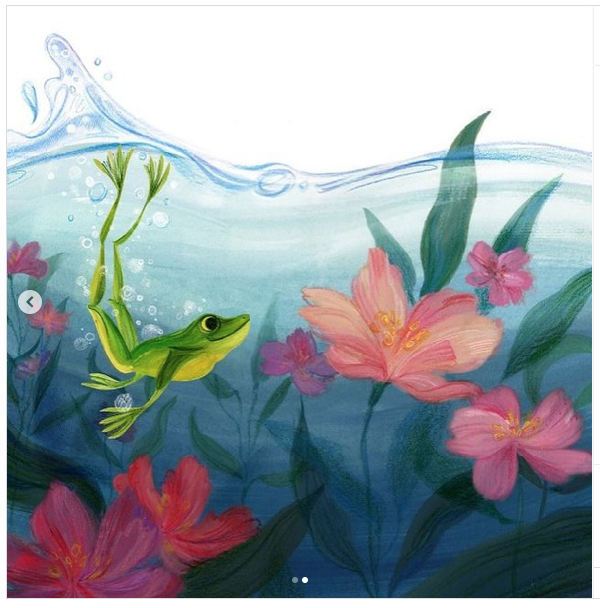
Picture Hooks Illustrations ‘Leap of Faith’ by Julia Morris
https://www.picturehooks.org.uk/new-picture-hooks-competition-with-a-twist-2/

Slide 8
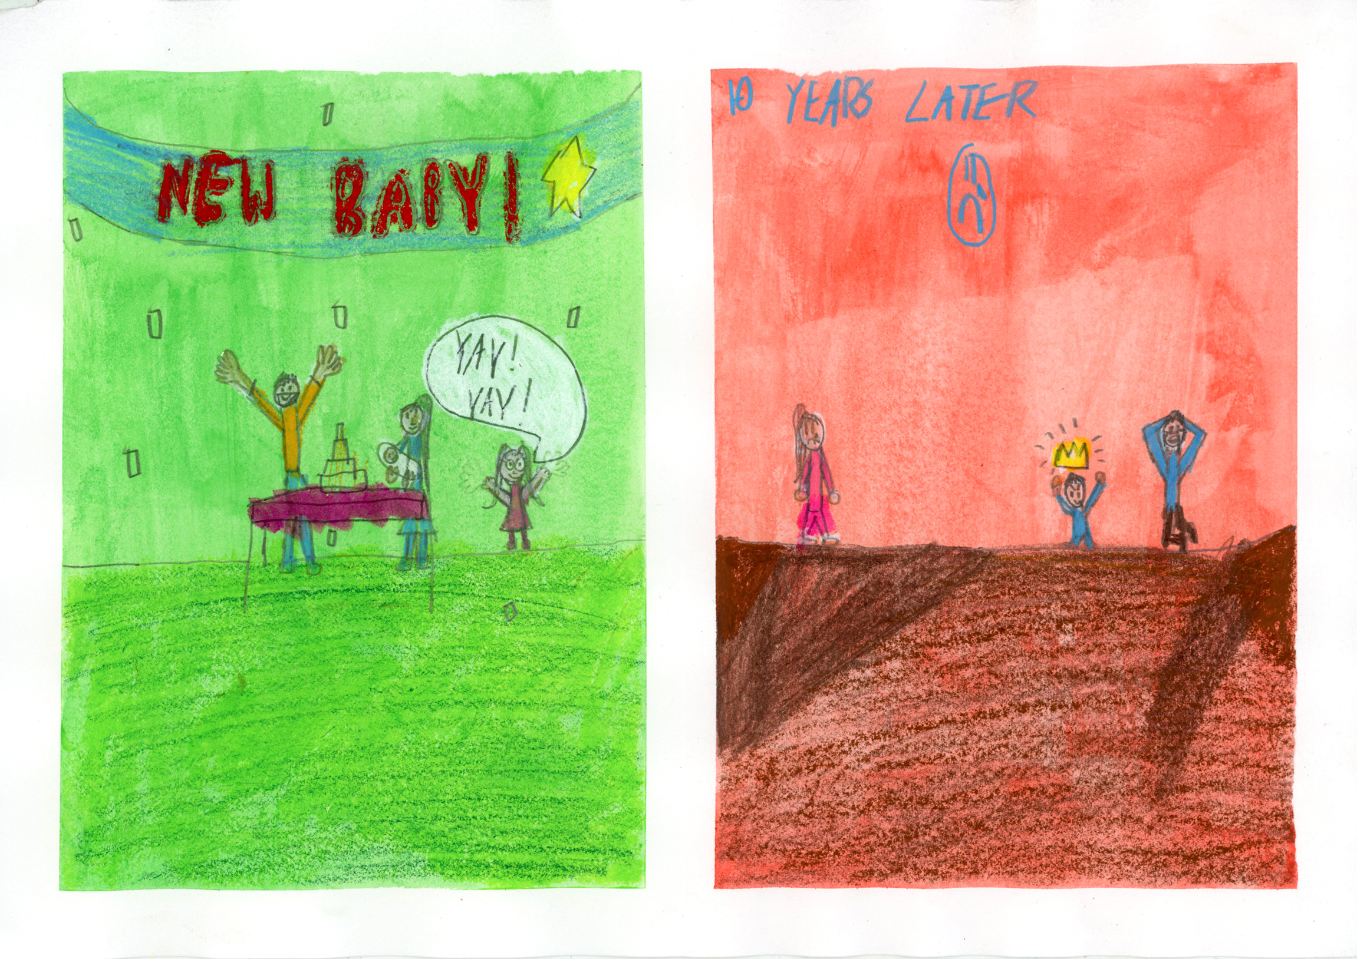
Examples of art-work made by children ‘Changing Families’

Slide 9
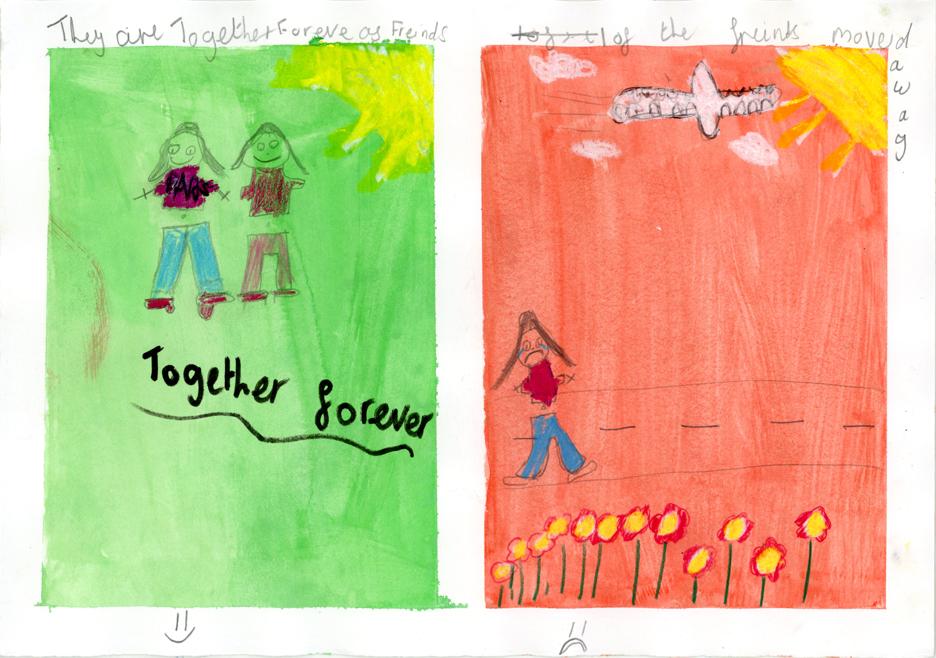
Examples of art-work made by children ‘Changing Friendships’

Slide 10
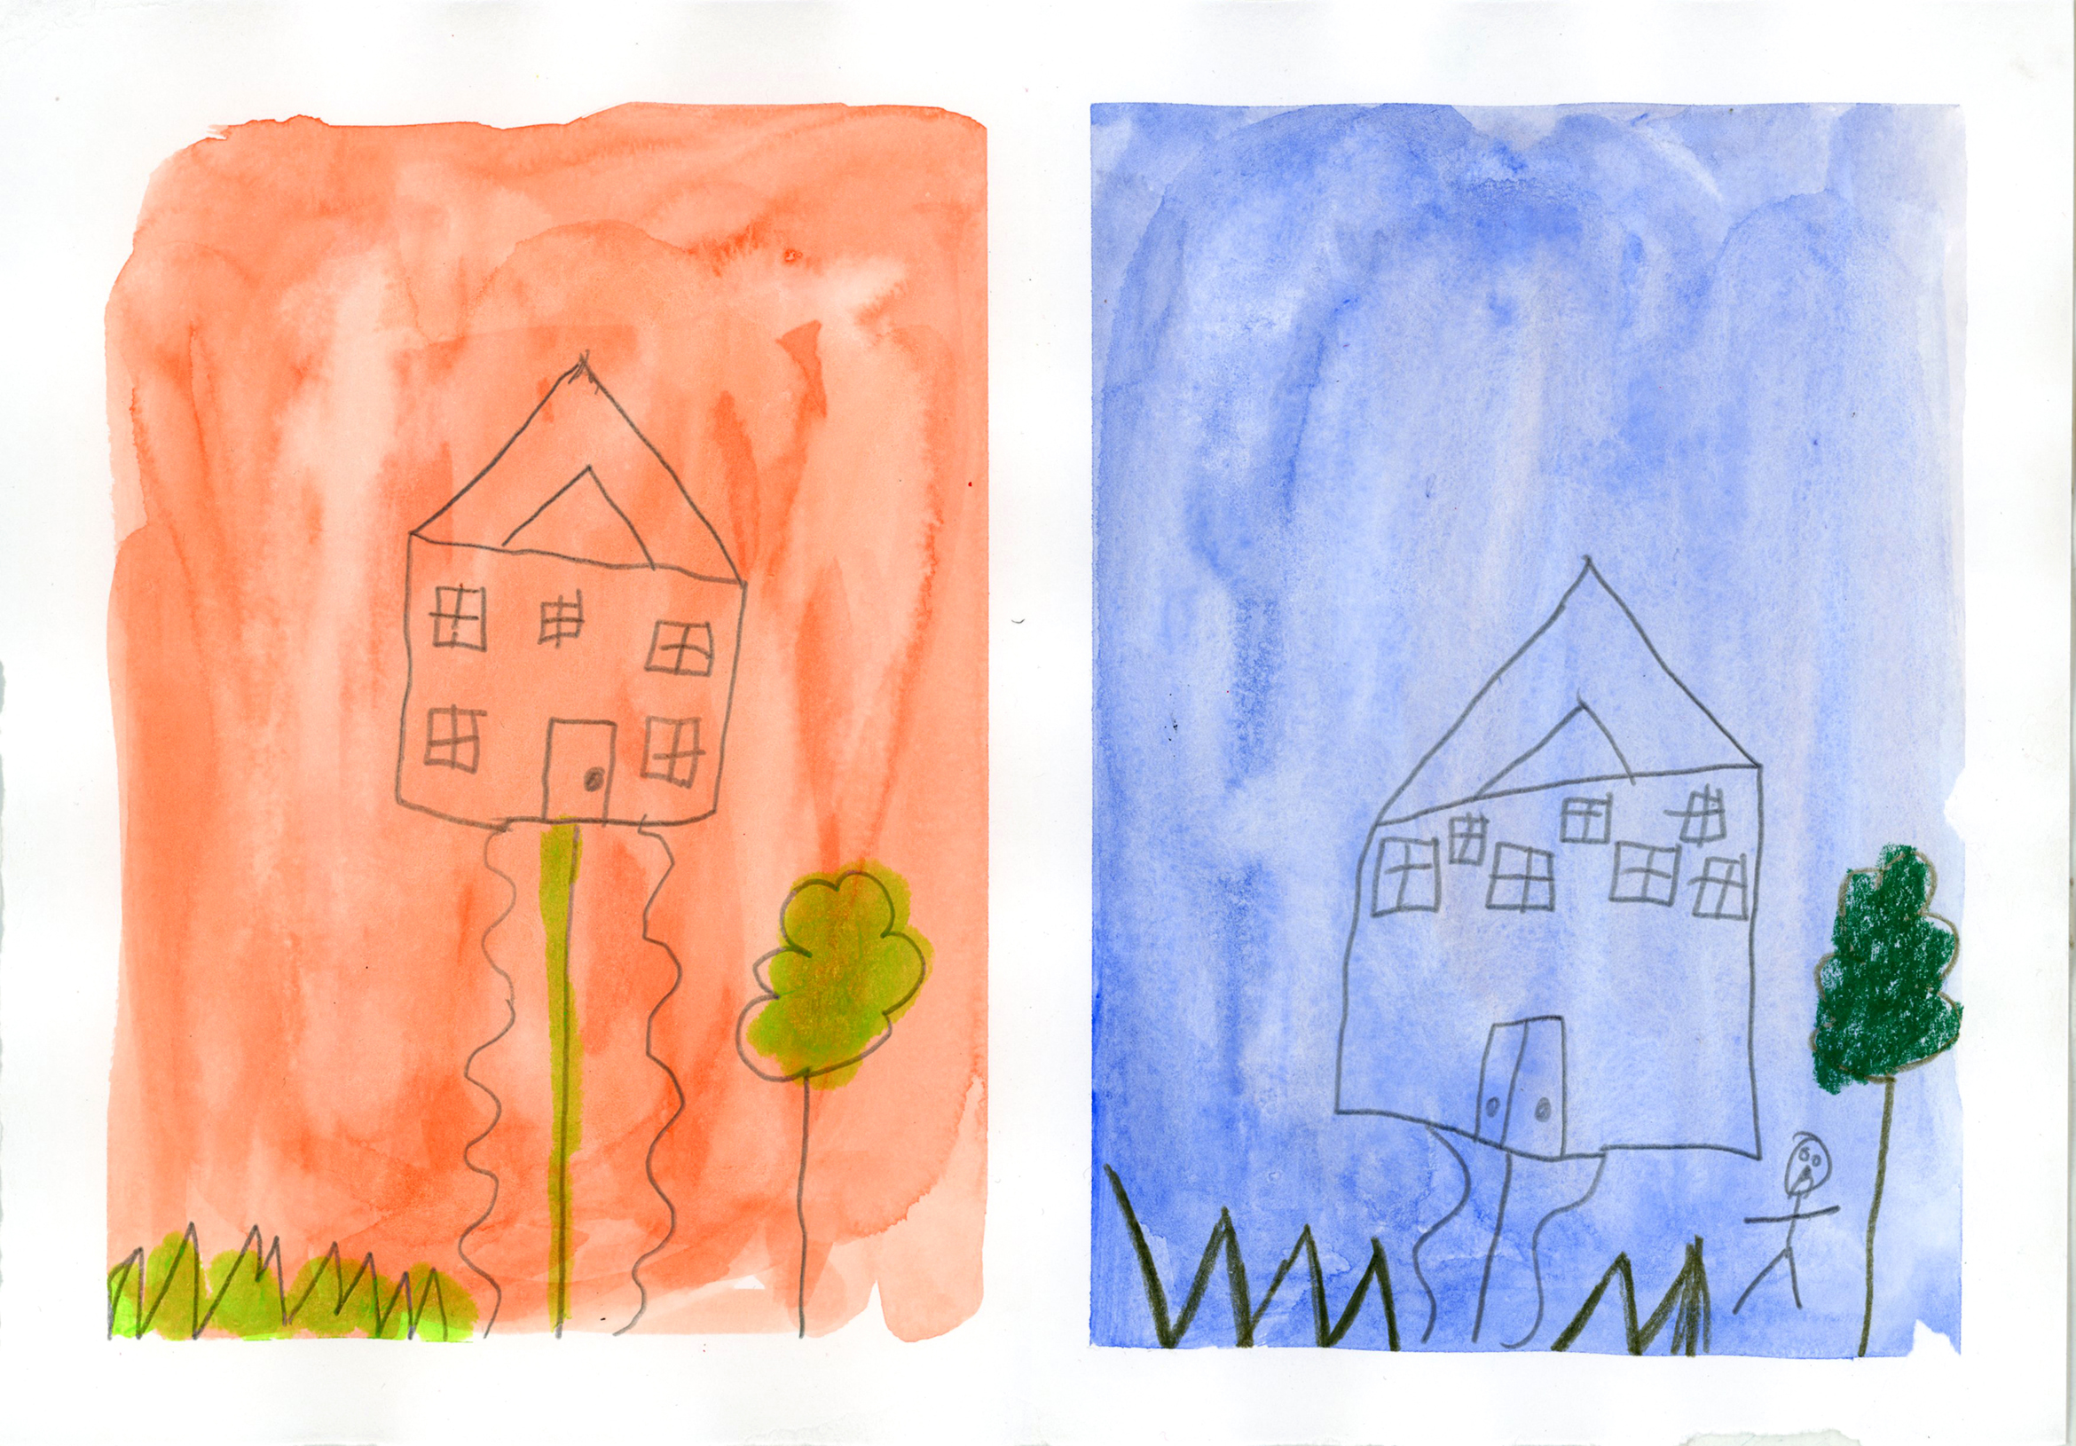
Examples of art-work made by children ‘Changing Homes’

Slide 11
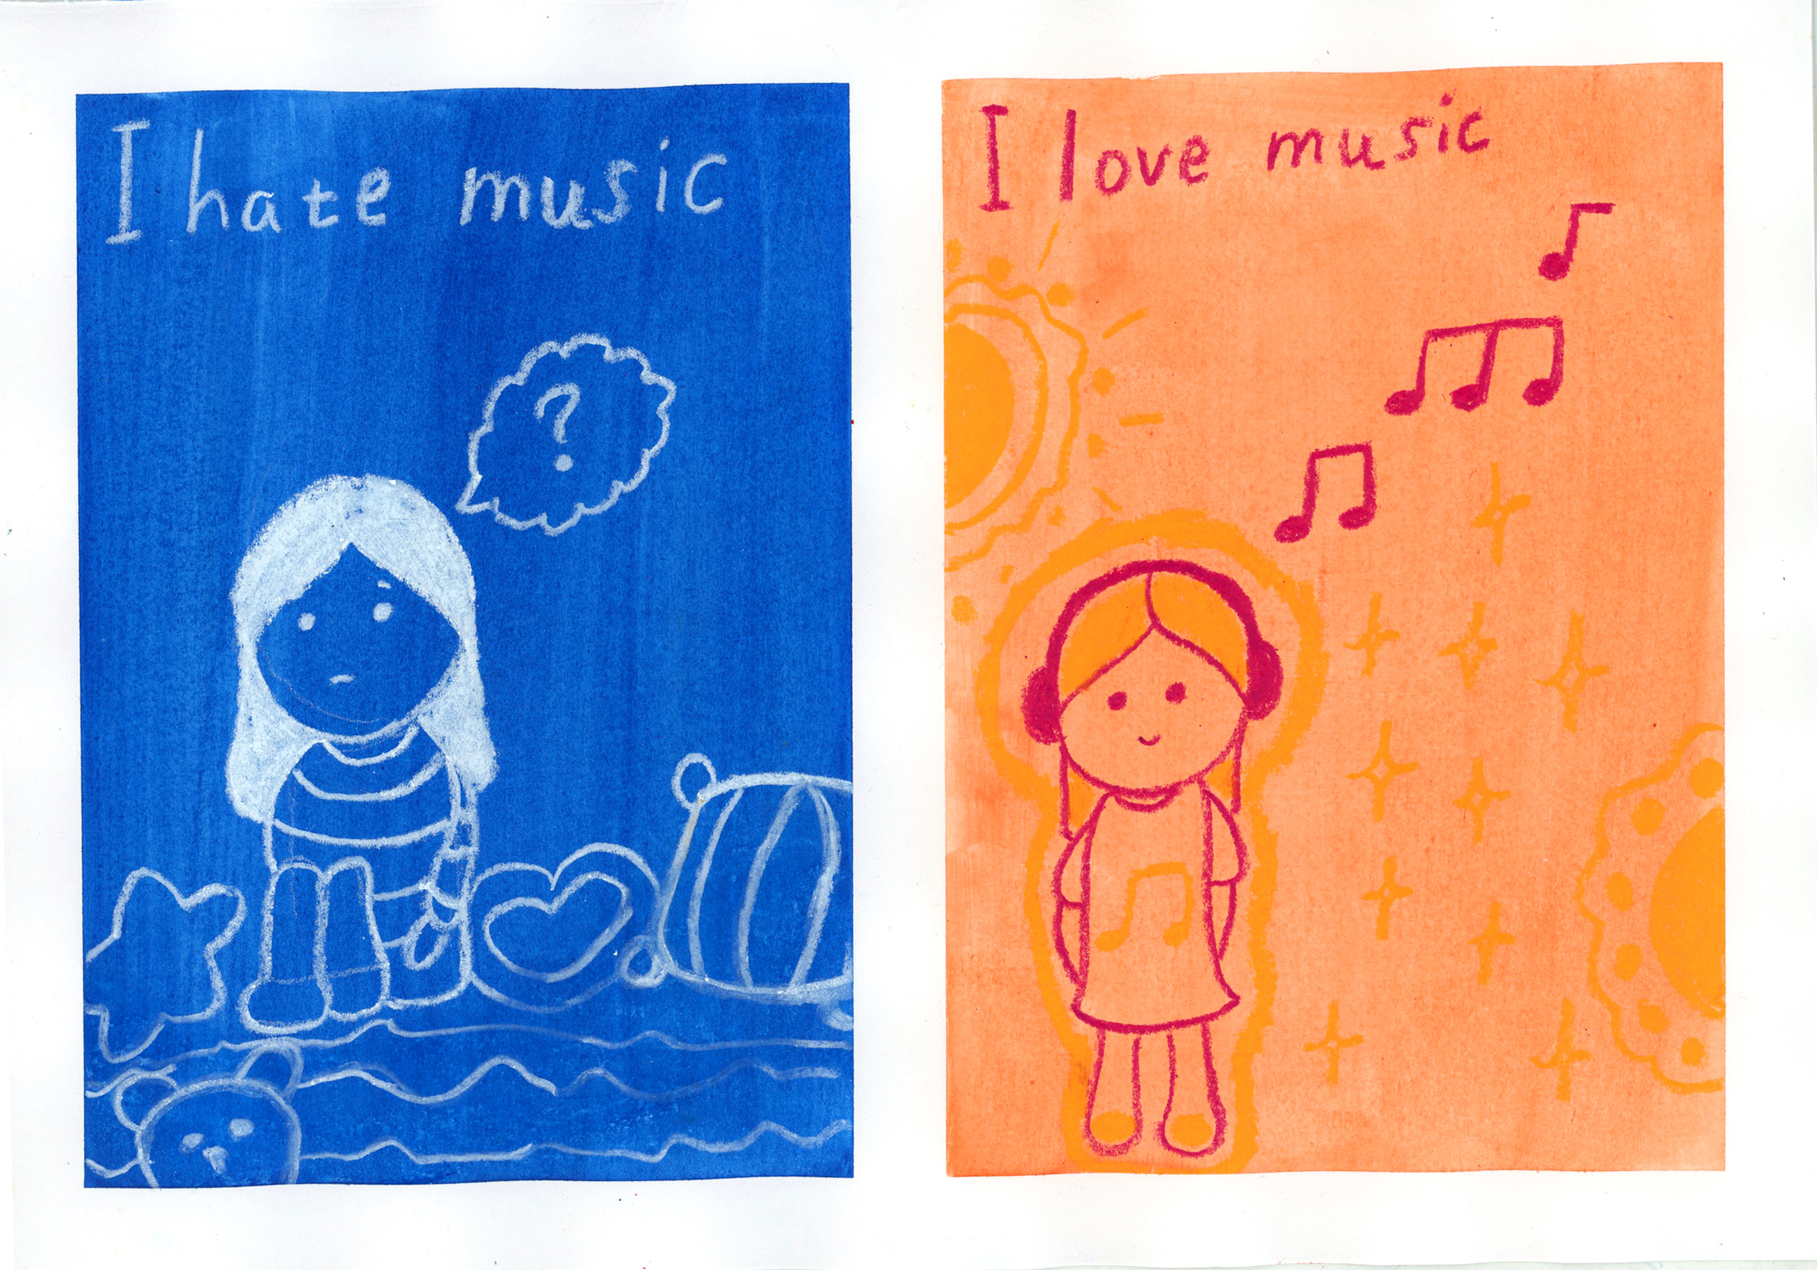
Examples of art-work made by children ‘Changing Minds’

Slide 12
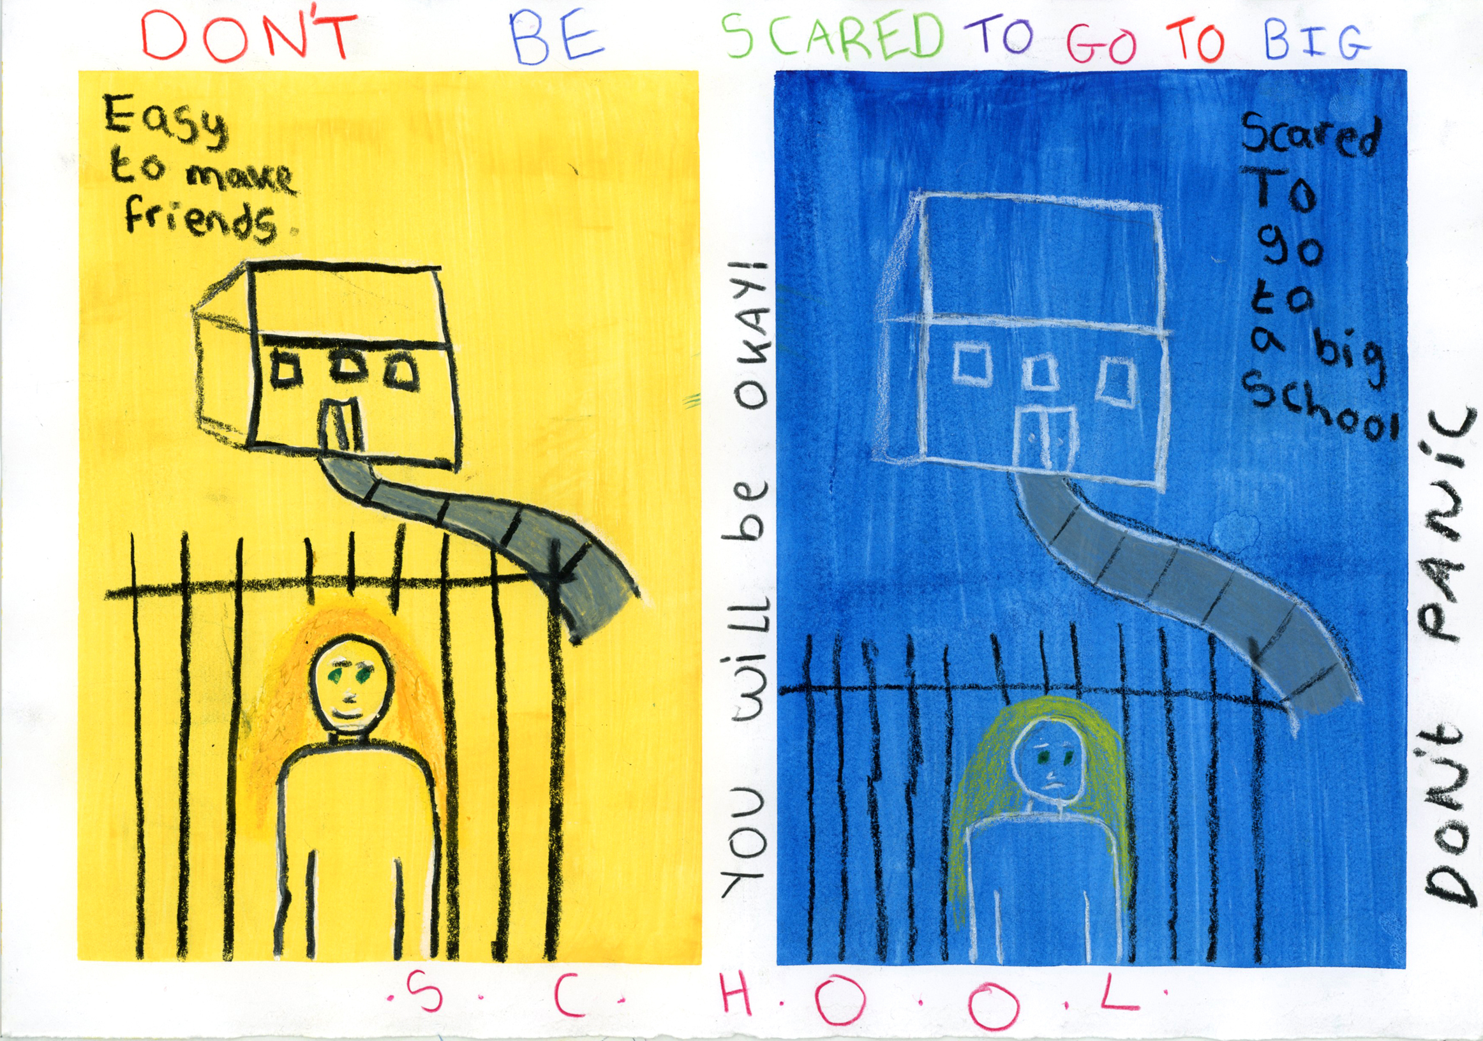
Examples of art-work made by children ‘Changing Schools’

Slide 13
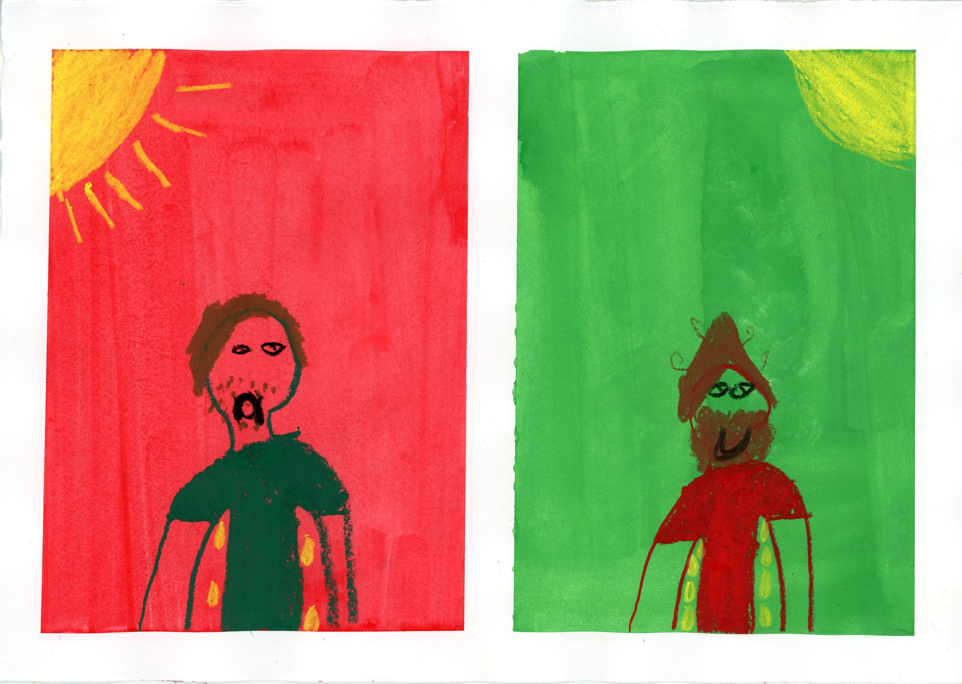
Examples of art-work made by children ‘Changing Bodies’

