Slide 1
Relationships and Sex Education (RSE) Day
Communicate
RSE DAY
26 June 2025
Consent Scenarios

Slide 2
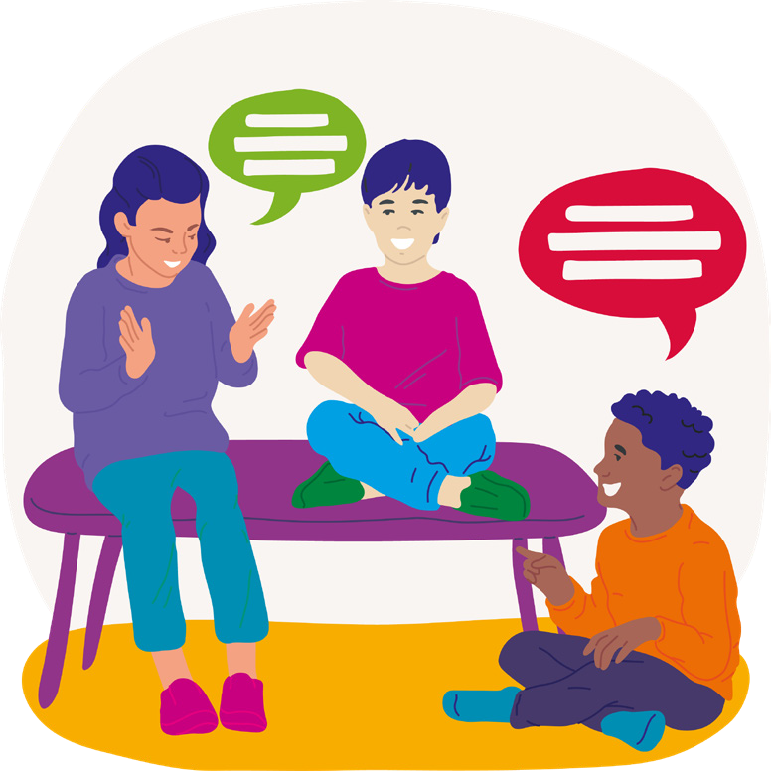
What do we think the word consent means?
It means, asking for permission, listening to what the person’s answer is and then respecting that answer (especially when the answer is “No”)

Slide 3
There are times we need to ask for consent and there are times where do not.
Let’s look at these scenarios together.
Do you think you need consent?
If so, why?
And if not, why not?

Slide 4
Borrowing a personal item
Example:
Asking to borrow a friend’s book, toy or piece of clothing
Yes, consent is needed
The item belongs to them and they have a right to decide if they want to lend it or not

Slide 5
Public spaces
Example:
Walking through a park or sitting on a bench
No, consent is not needed
Public spaces belong to everyone, and you don’t need permission to use them

Slide 6
Joining in classroom activities
Example:
Joining in a class discussion with the teacher
No, consent is not needed
The activity is part of the learning and is expected of everyone

Slide 7
Physical contact
Example:
Giving a hug to someone or holding someone's hand
Yes, consent is needed
Not everyone wants to be touched, so it’s important to ask their permission

Slide 8
Joining an activity that is already happening
Example:
Joining in a game or activity that other people are already doing
Yes, consent is needed
The activity might have teams or rules in place, and it’s respectful to ask if you can join

Slide 9
Using shared resources
Example:
Using pens, paper or books that are available to everyone
No, consent is not needed
The resources are to be shared and used by all

Slide 10
Greeting someone
Example:
Saying “Hello” or “Good Morning” to a friend or teacher
No, consent is not needed
Greetings are a part of polite society and don’t normally need permission

Slide 11
Sharing personal information
Example:
Telling a friend’s news or story to someone else
Yes, consent is needed
Personal information is private and it’s important to respect that

Slide 12
Participating in a public event
Example:
Joining in a school assembly or attending a public show
No, consent is not needed
These events are for everyone to join in

Slide 13
Taking photos and videos
Example:
Taking photos or videos of friends and family
Yes, consent is needed
People have the right to control how their image is used and shared

Slide 14
RSE DAY 26 June 2025
Now it’s your turn.
Think of three scenarios where it’s important you ask for consent or someone asks for your consent.
We will add this to the consent tree we are making.

