Slide 1
RSE Day Mural
RSE DAY
26 June 2025

Slide 2
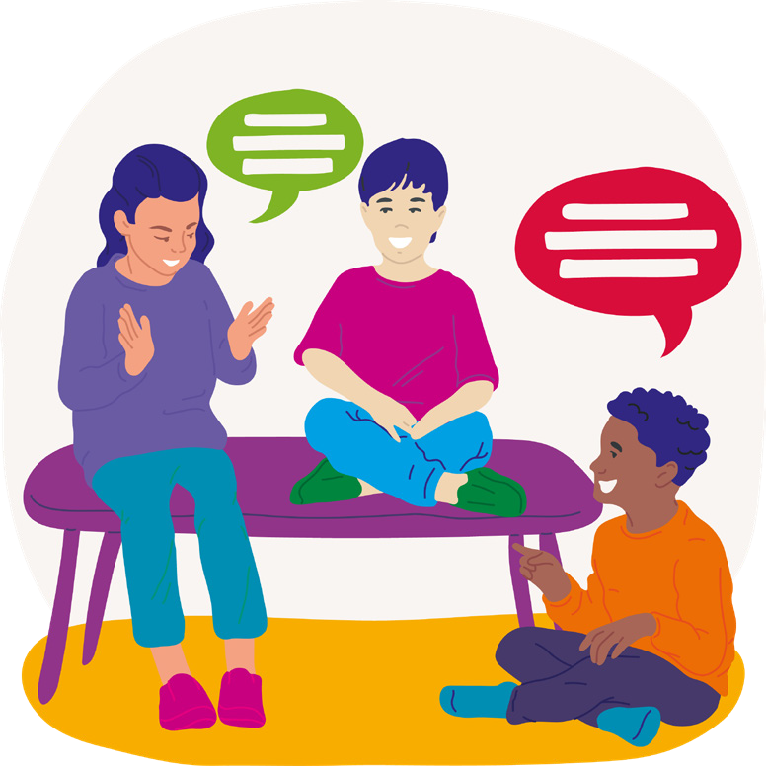
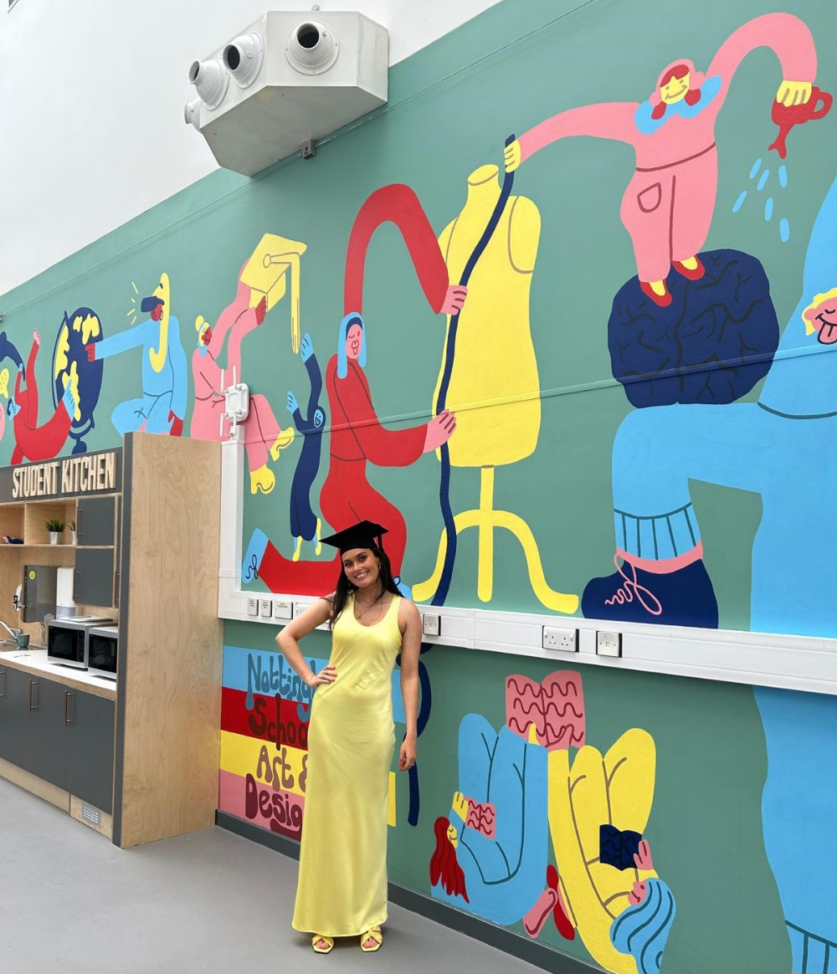
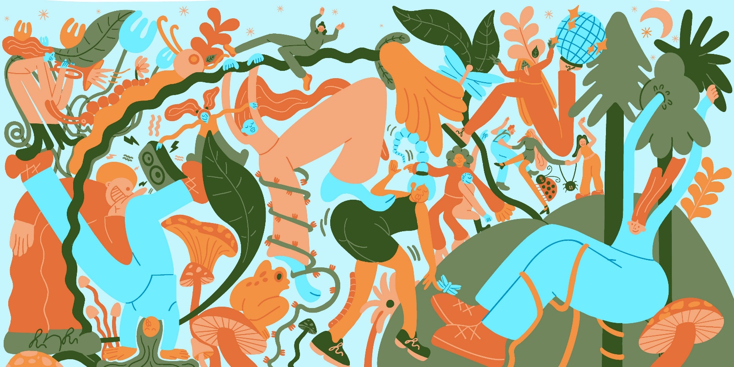
Introduction
Millie Yarwood is an illustrator who focuses on creating murals. Millie has a distinct style that consists of long-limbed funky characters that exist in their own unique scenes.

Slide 3
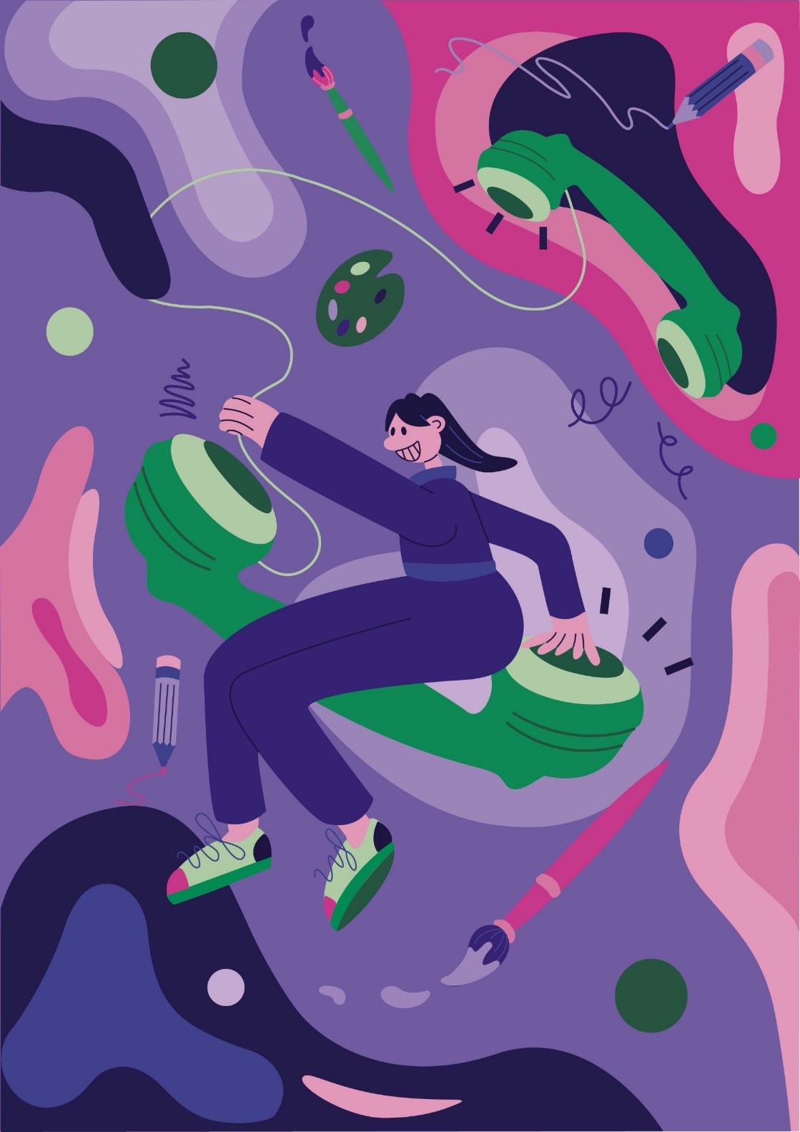
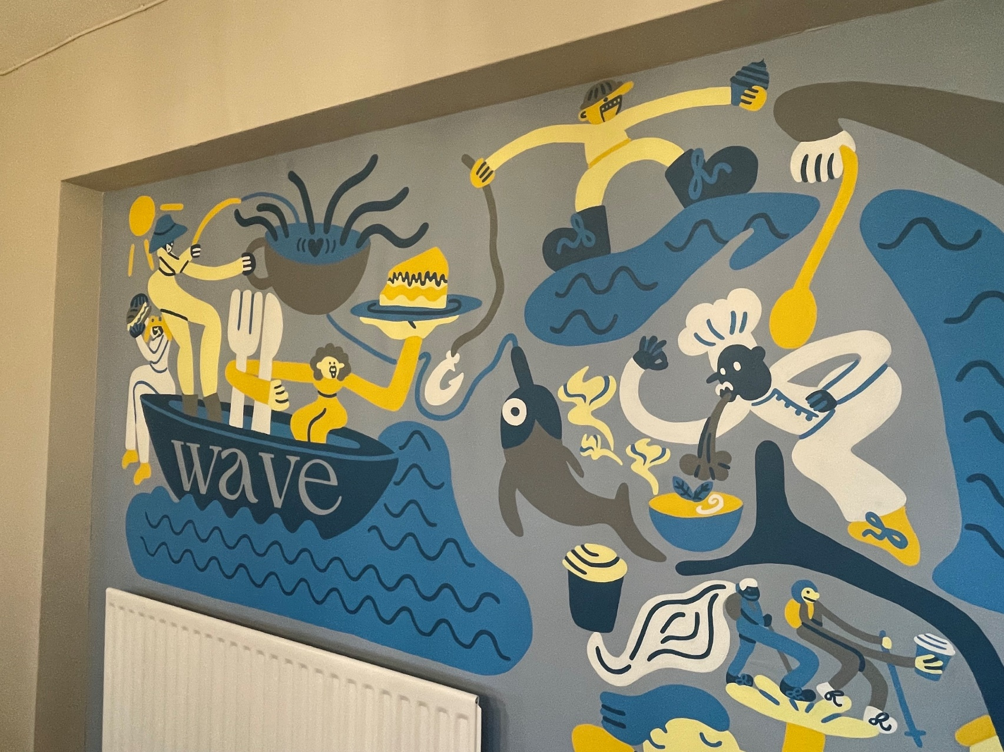

Slide 4
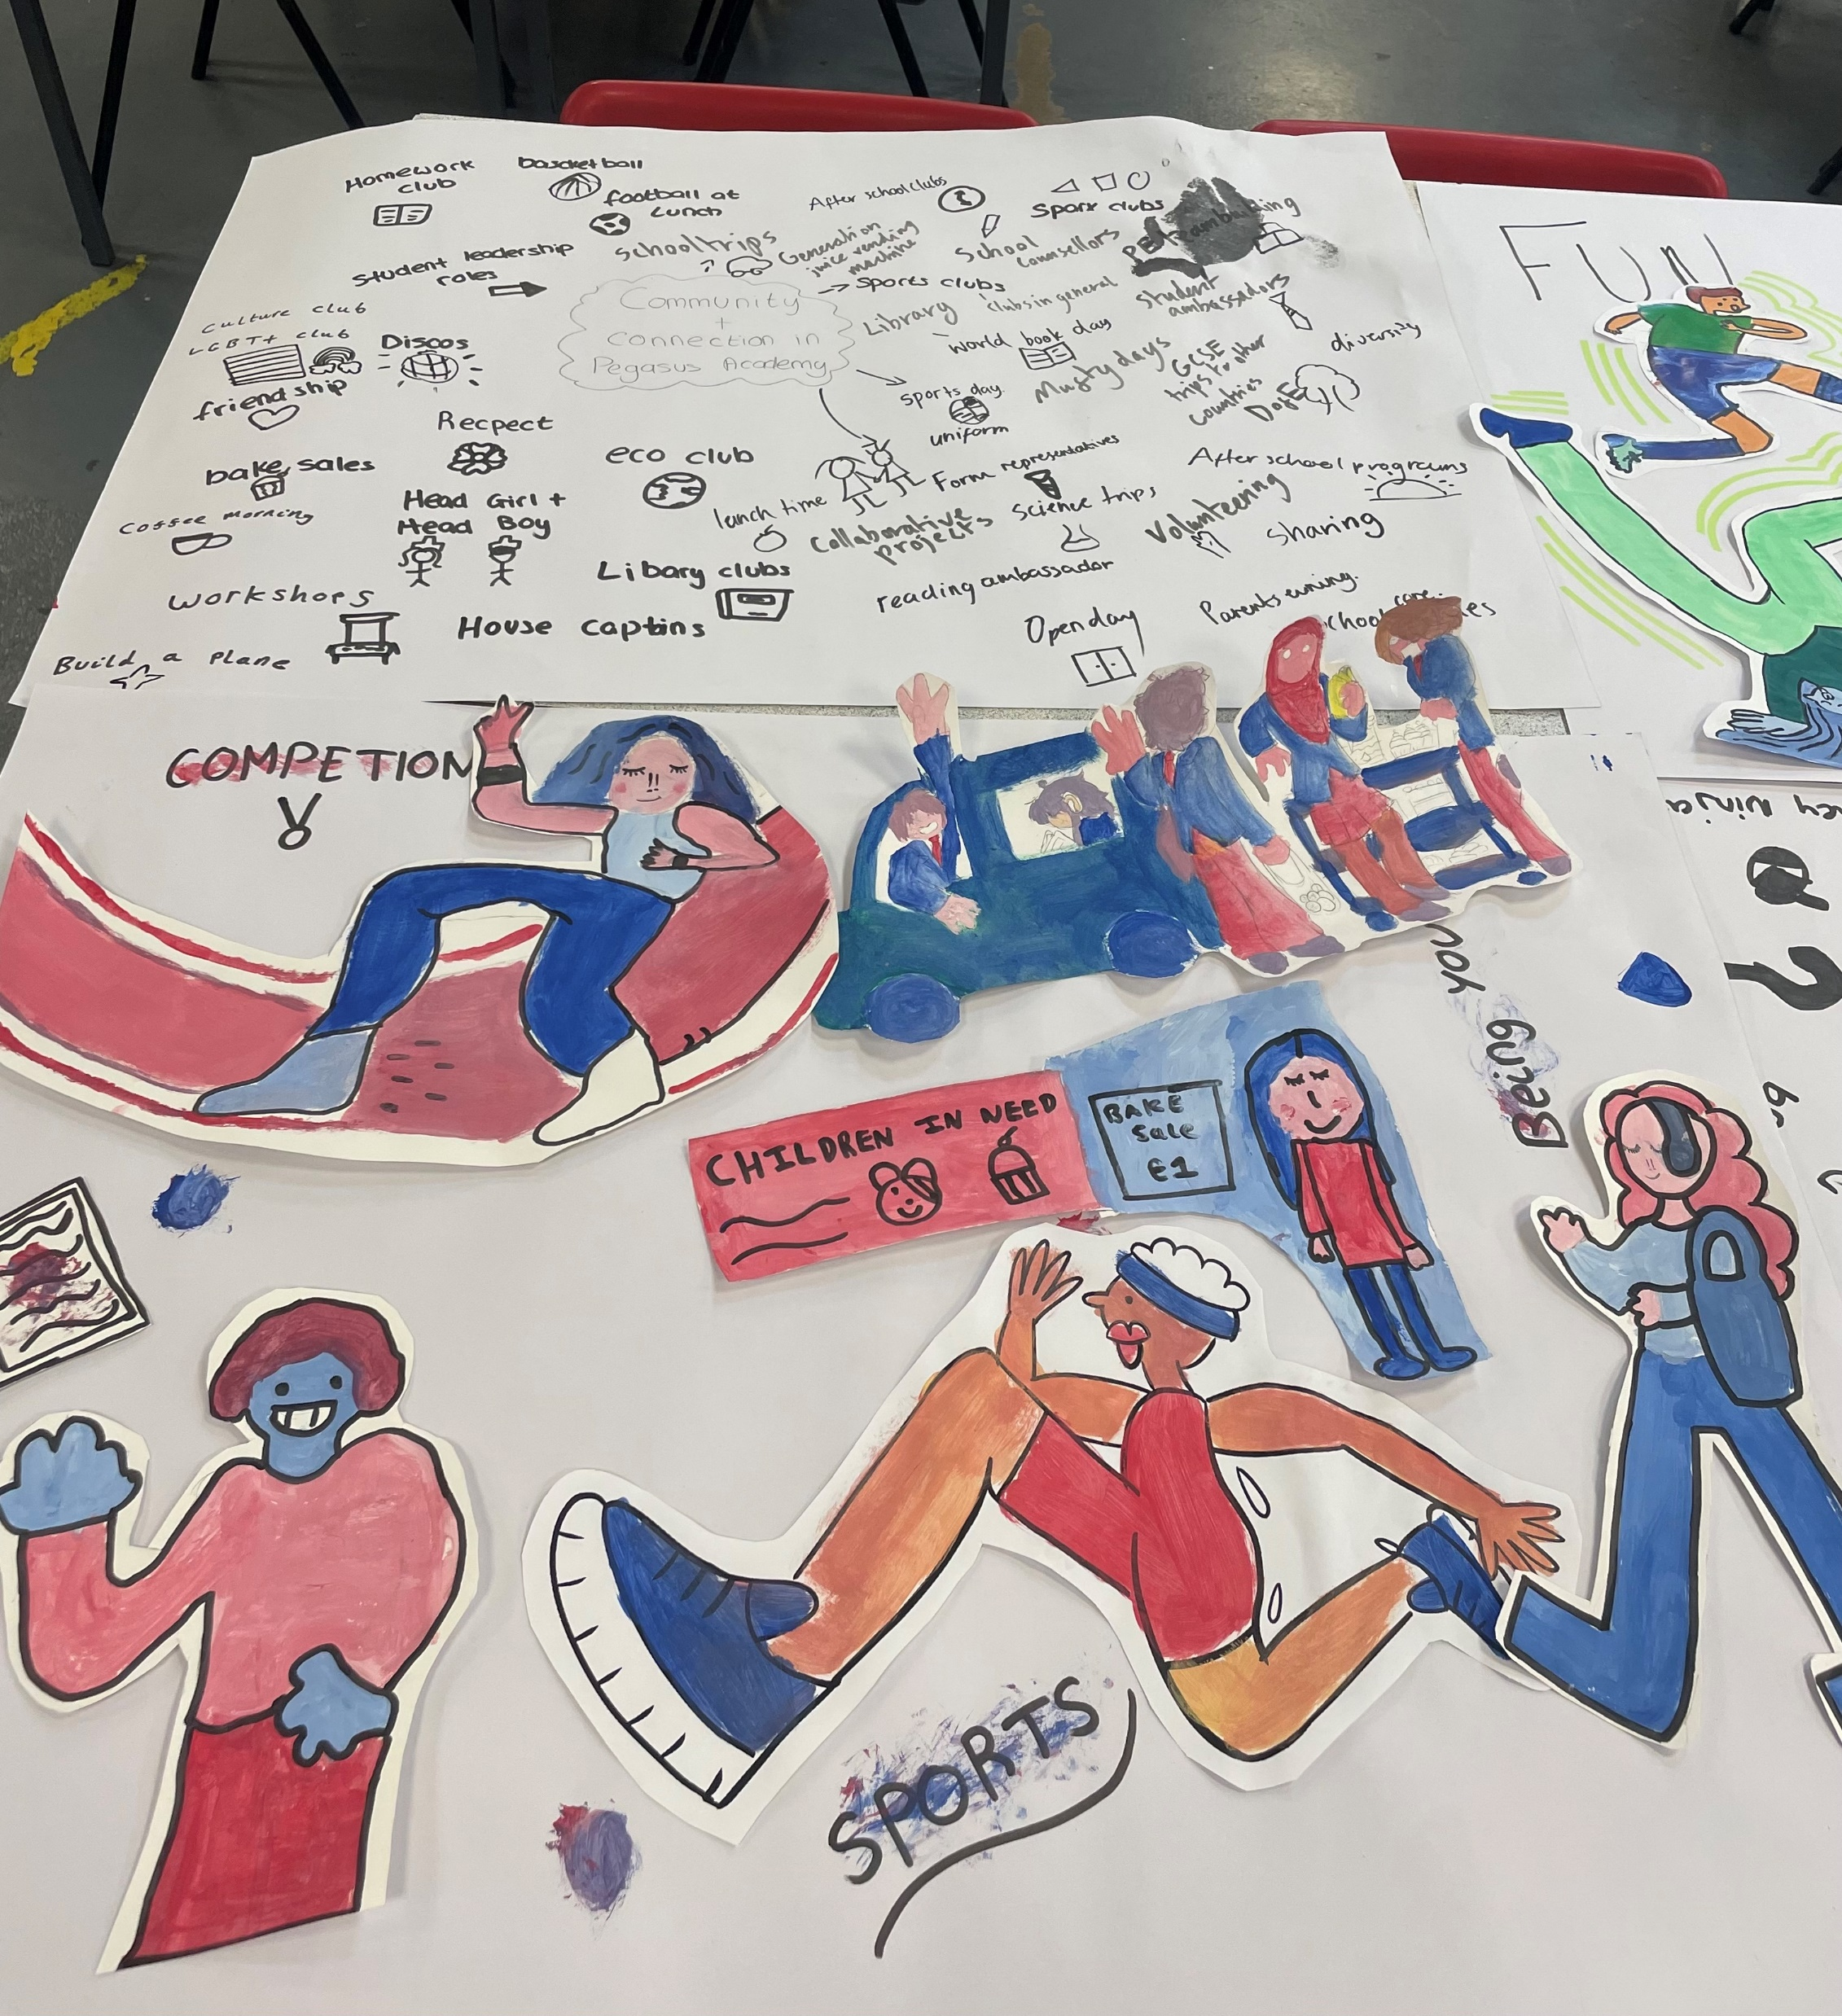
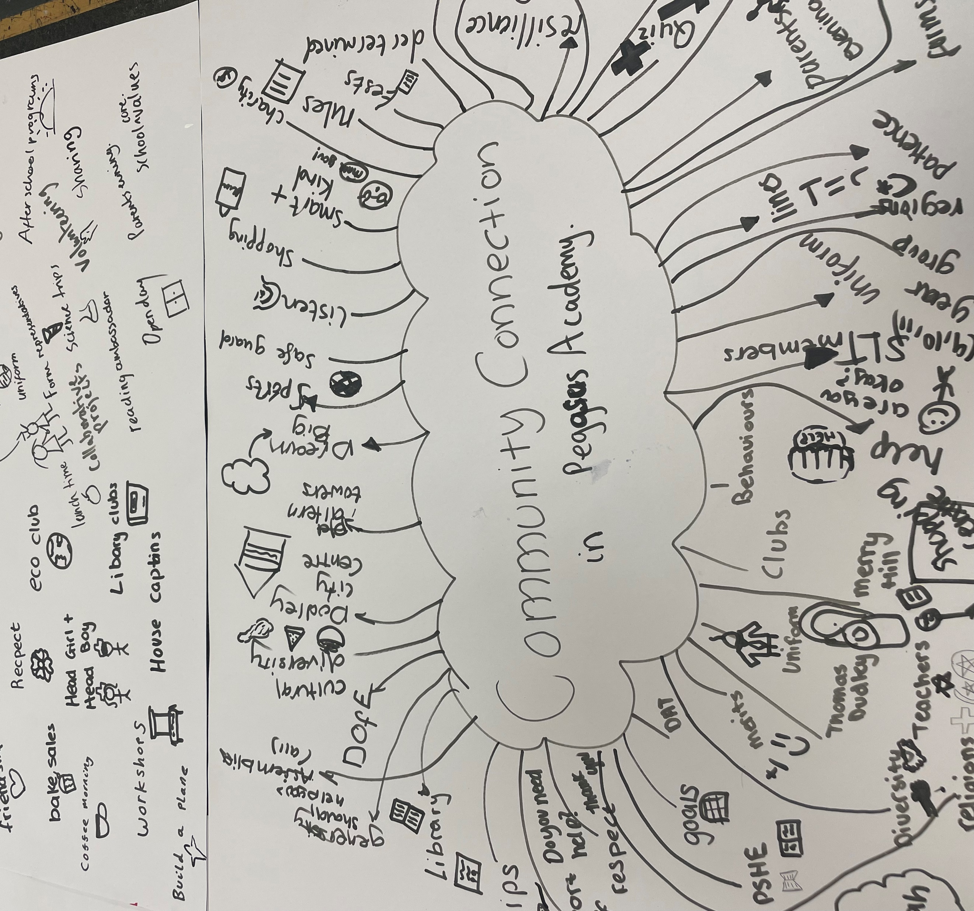
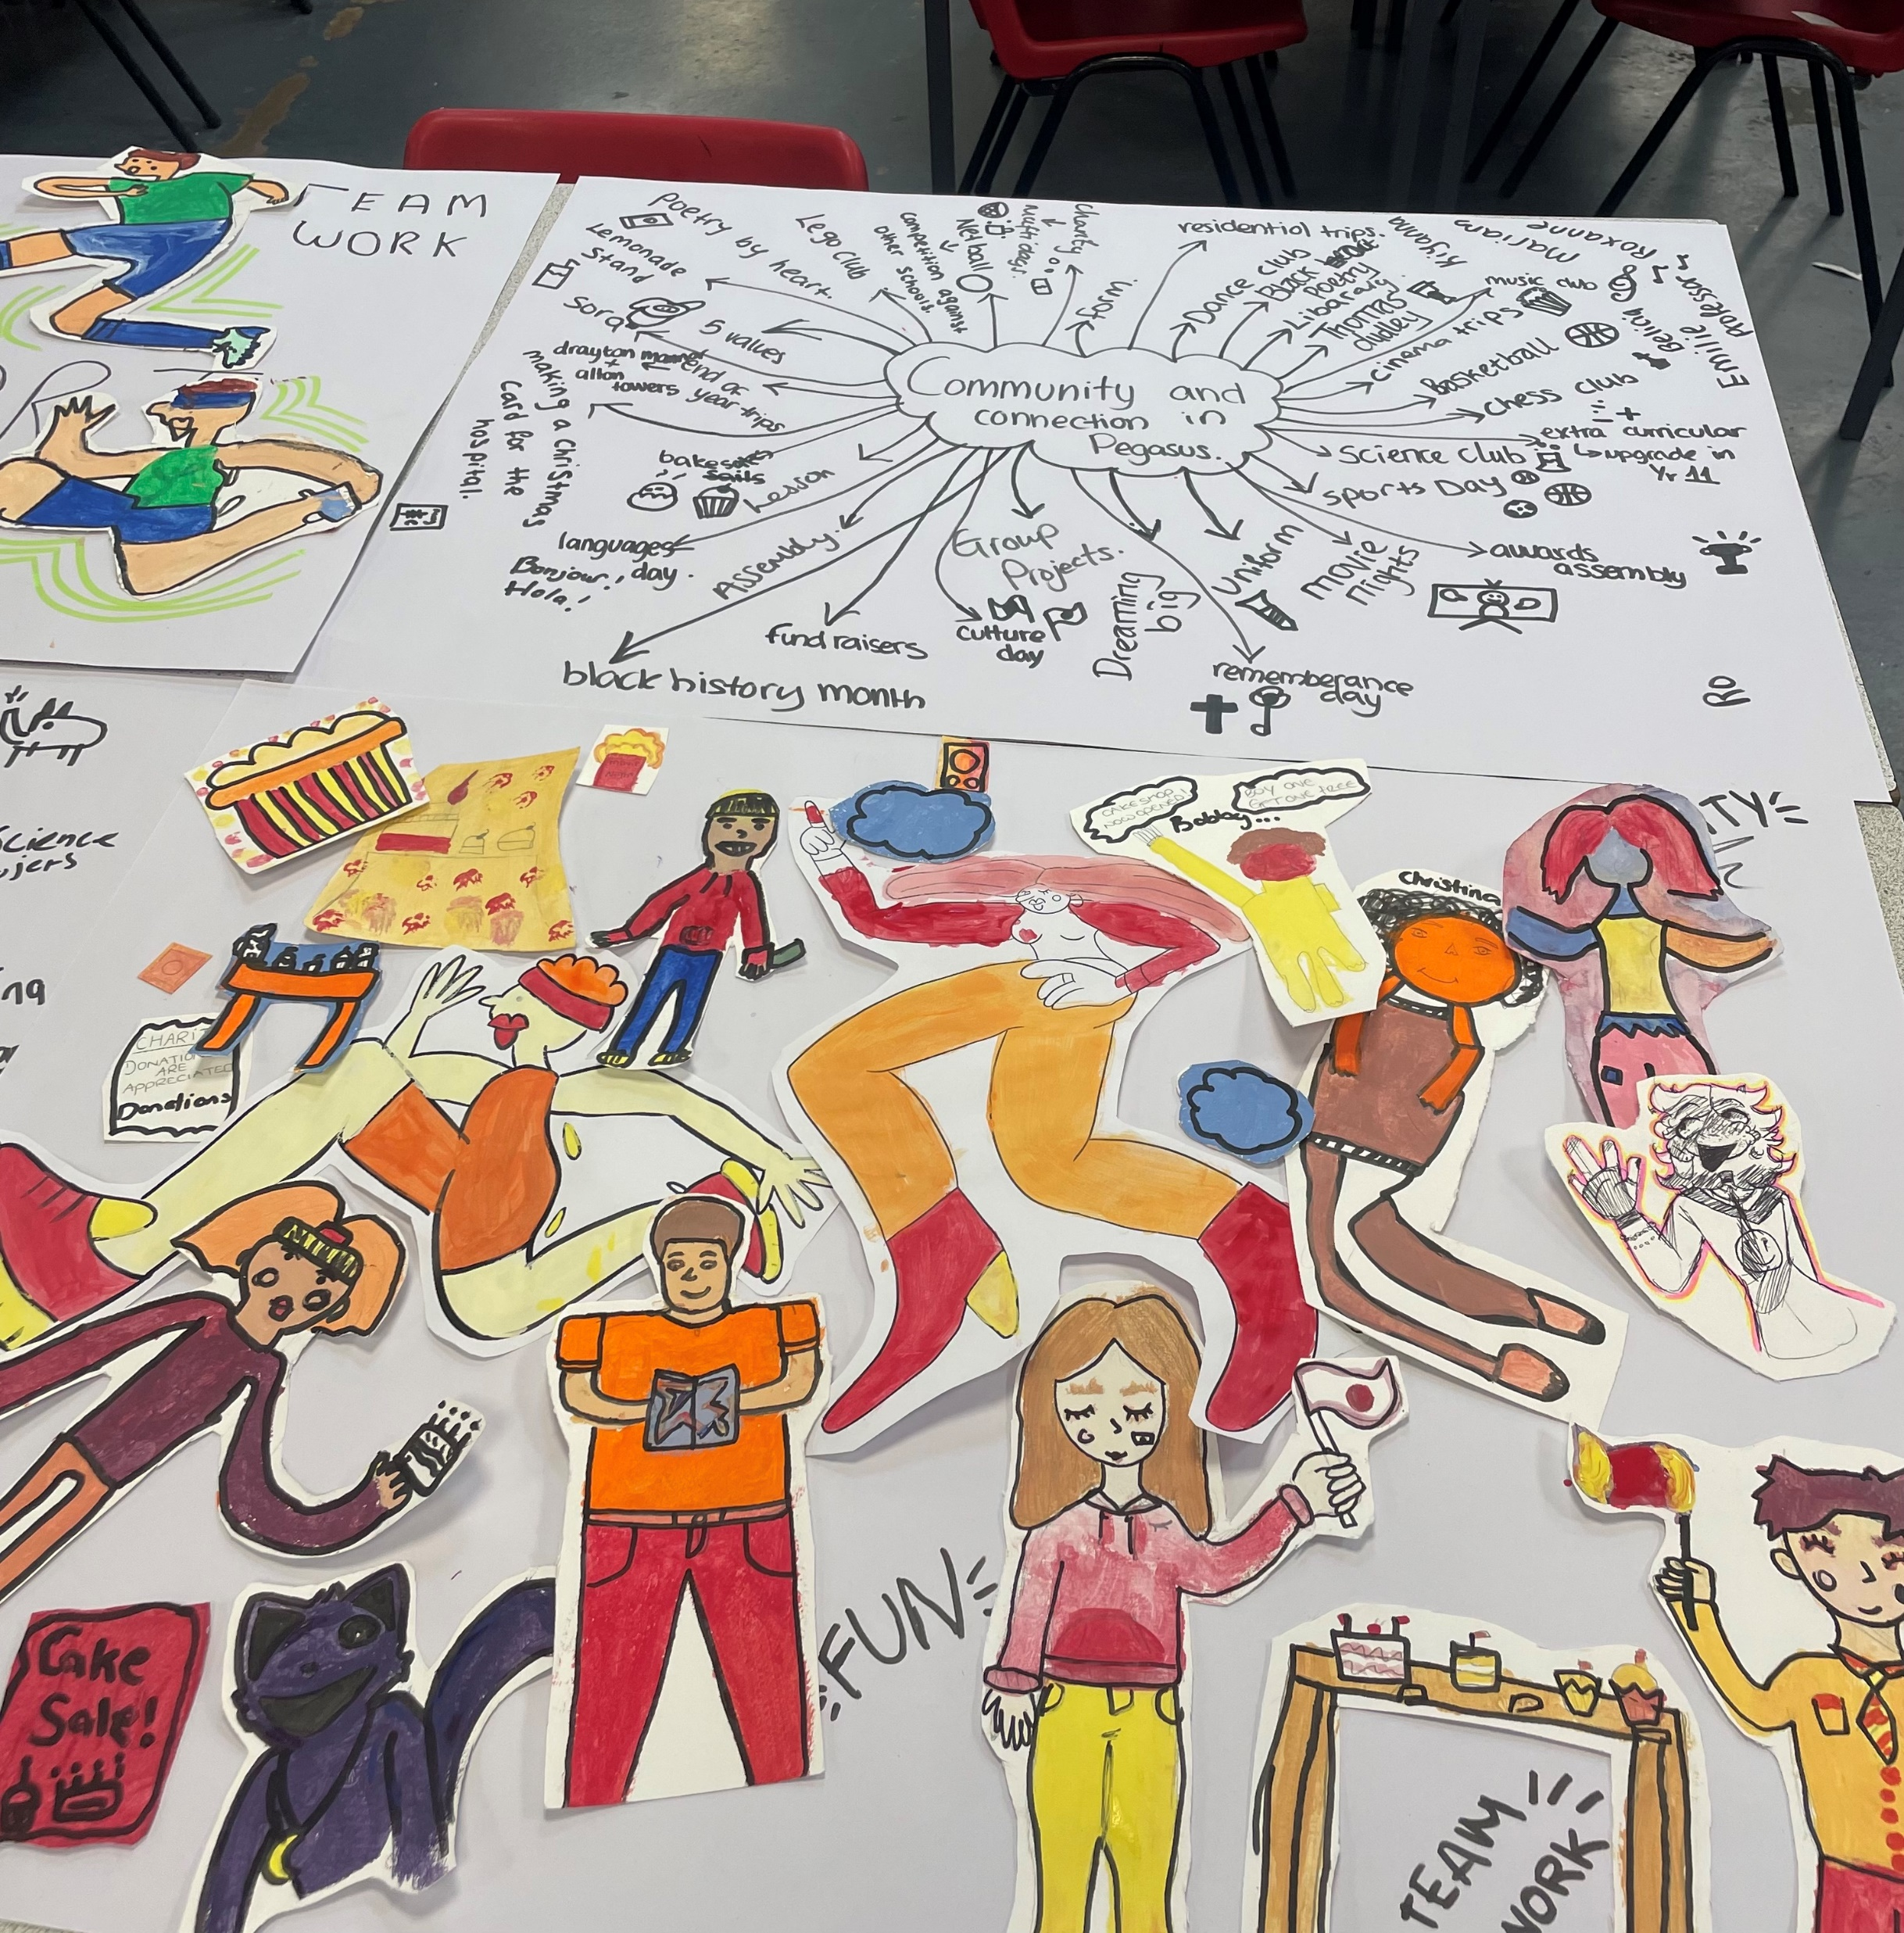
Previous murals
Murals are always centered around the community and how people connect together. You are going to create a mural on communication.

Slide 5
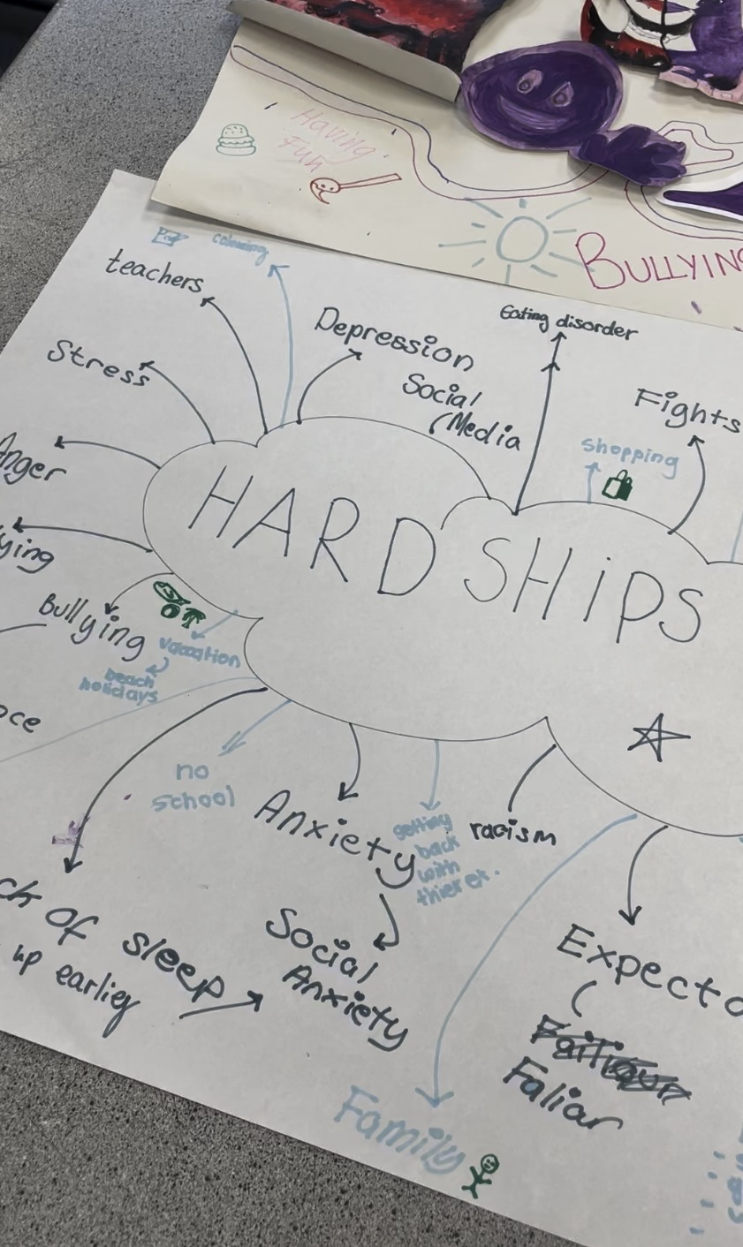
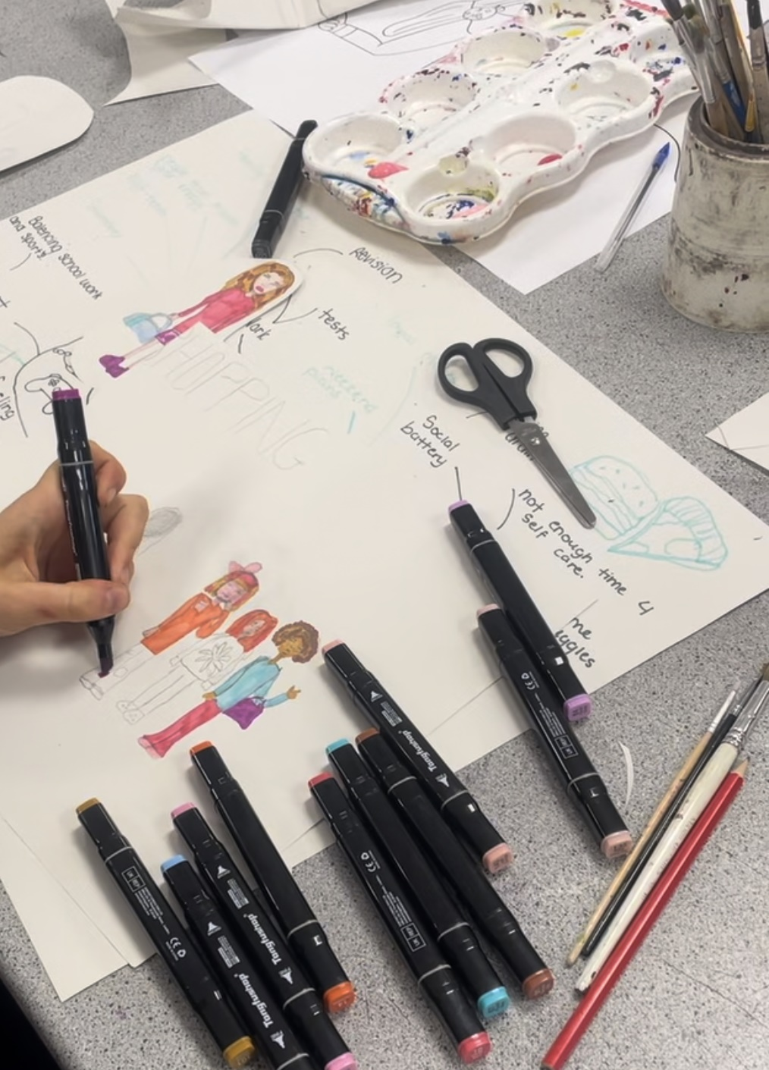
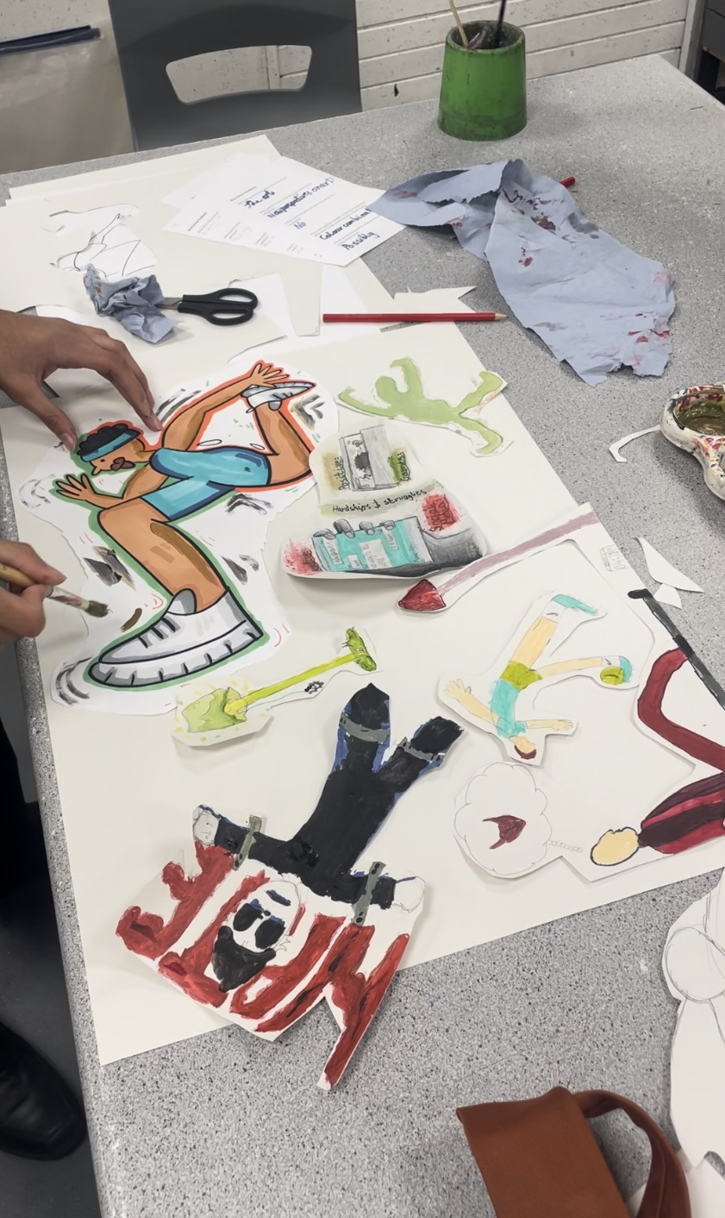
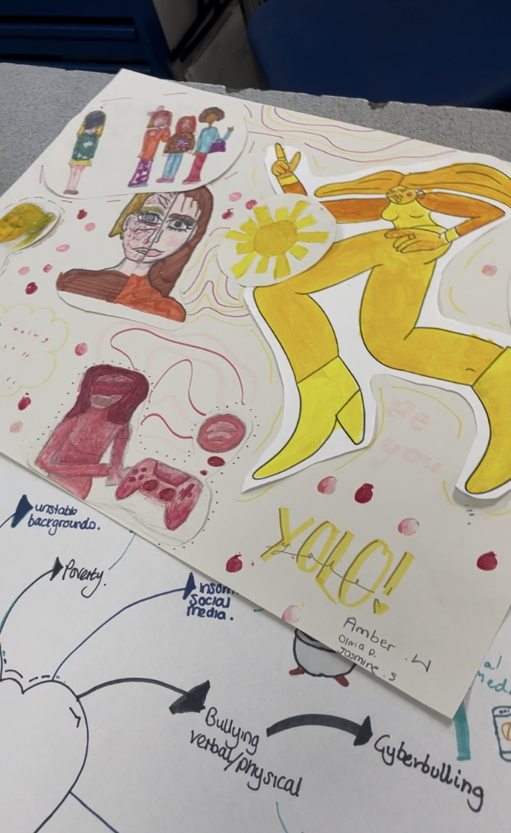

Slide 6
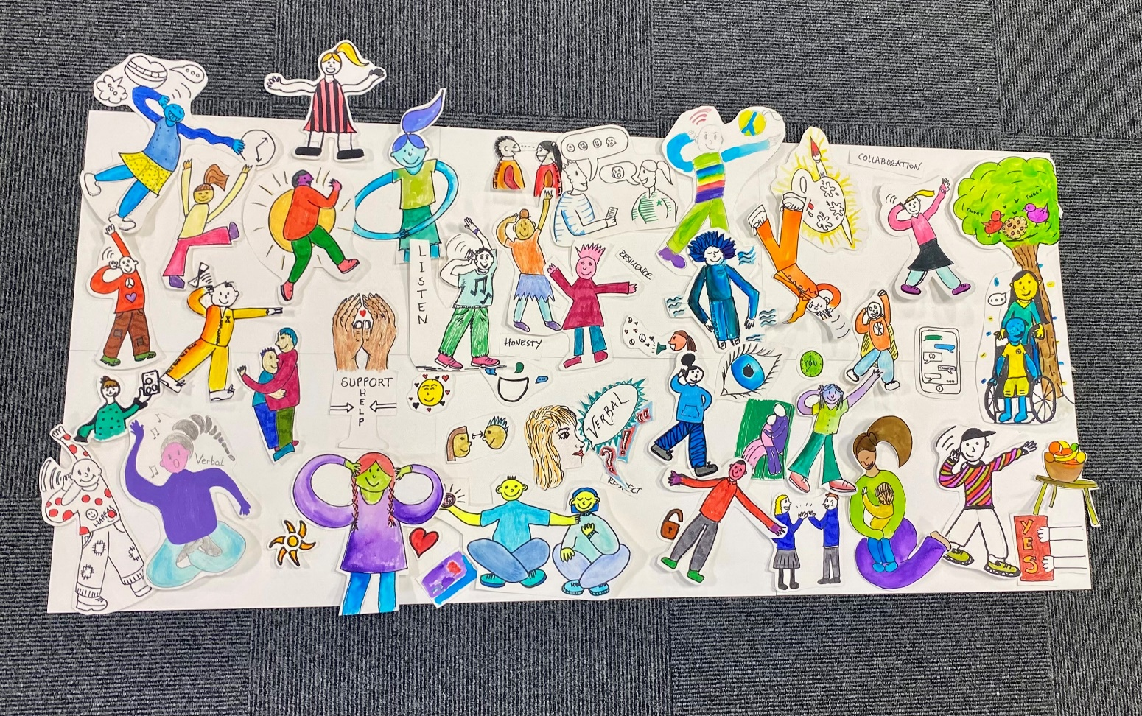
We are going to create a mural about communication in healthy relationships using Millie’s style. You will create characters, objects and images that will form our mural. Here is an example:

Slide 7
We will start by thinking about what communication looks and feels like in healthy relationships.
In the centre of your page, write ‘Communication in Healthy Relationships’
As a group, create a mind map sharing all your ideas about communication in healthy relationships. You can share your ideas using words, or by drawing people, symbols, objects, or icons.
Notes:
Prompt questions for brainstorm if needed:
What colours represent healthy communication in relationships?
How can we make others feel valued and respected when we communicate with them?
What three words would describe the best communication?
How can we show we care through our communication?
What does communication in a healthy relationship look like?

Slide 8
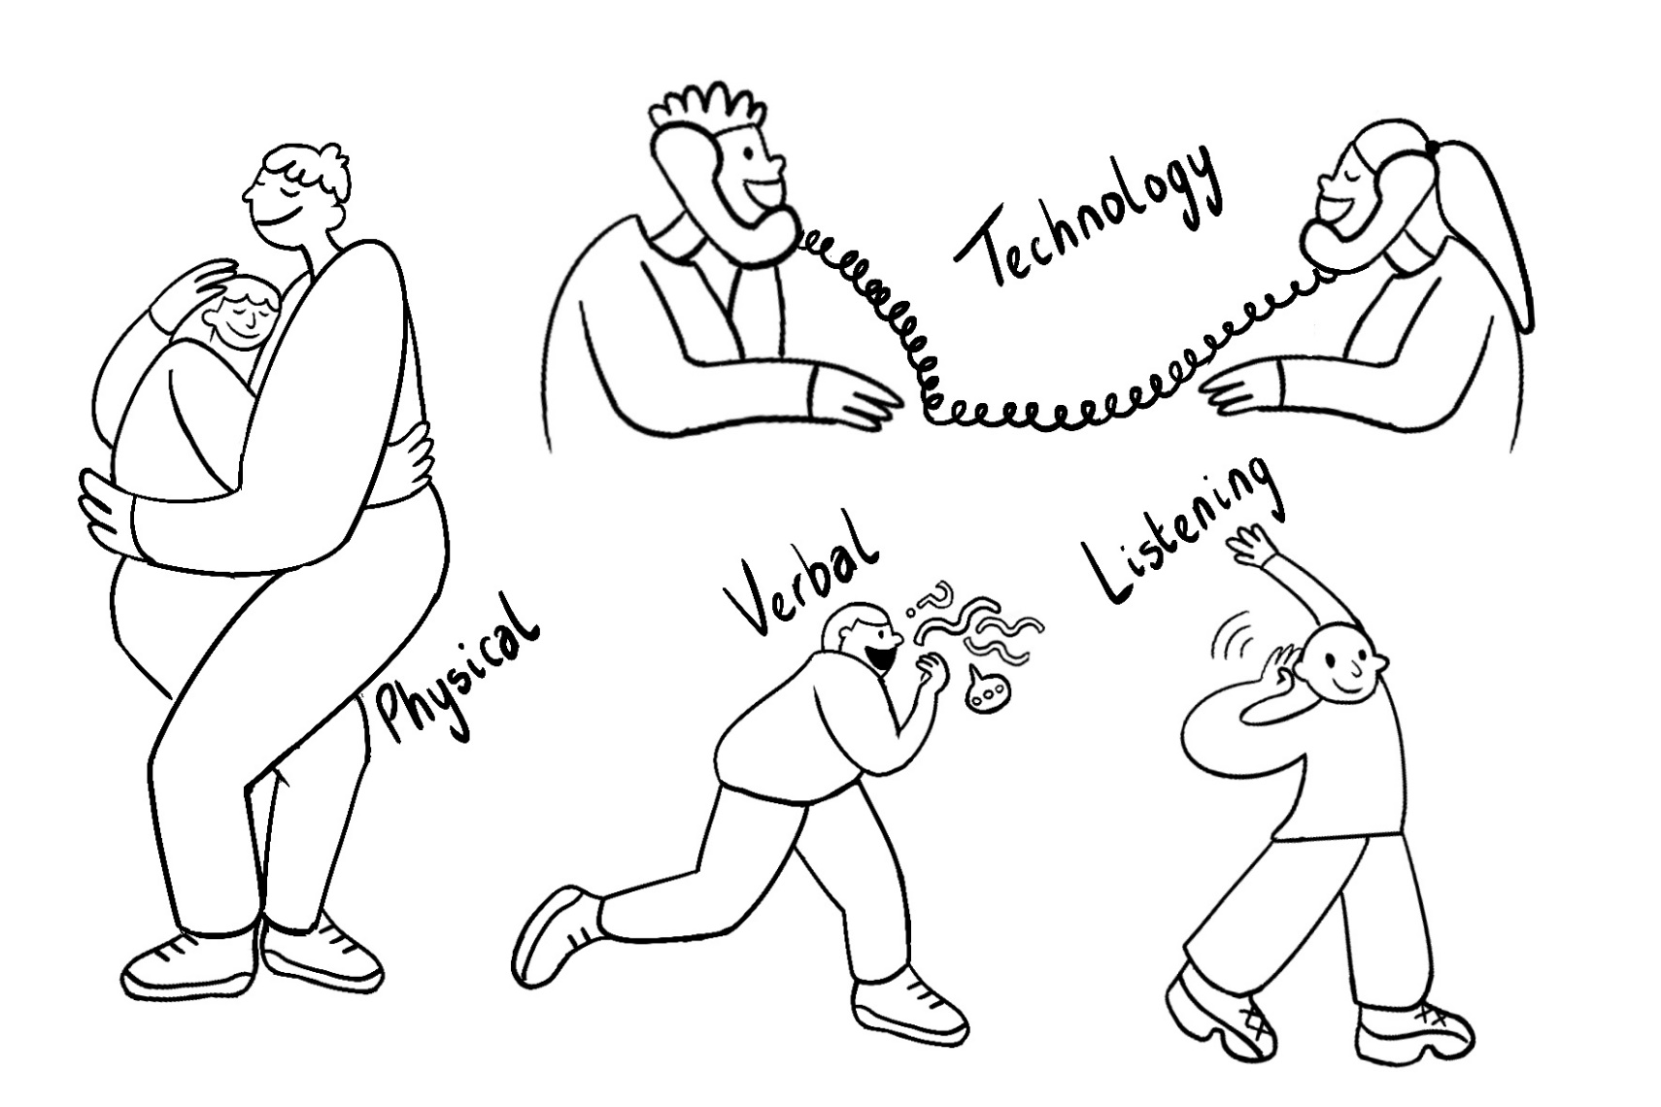
Millie has a particular style when she draws people. What do you notice about Millie’s characters?

Slide 9
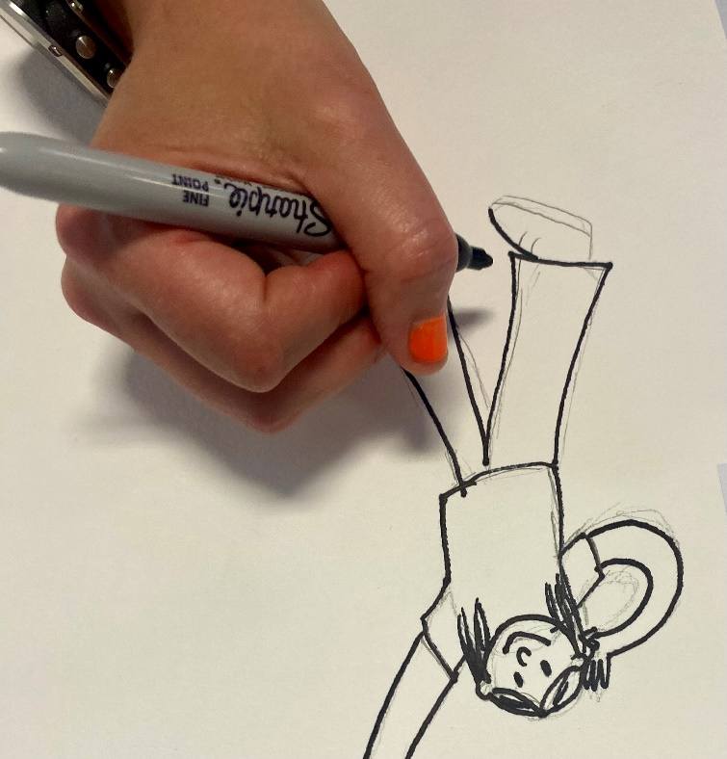
Using some of the ideas from your spider diagram. Draw some characters and objects in pencil following Millie’s style. Once you are happy with your characters, outline them in pen and colour them in using our colour palette.

Slide 10
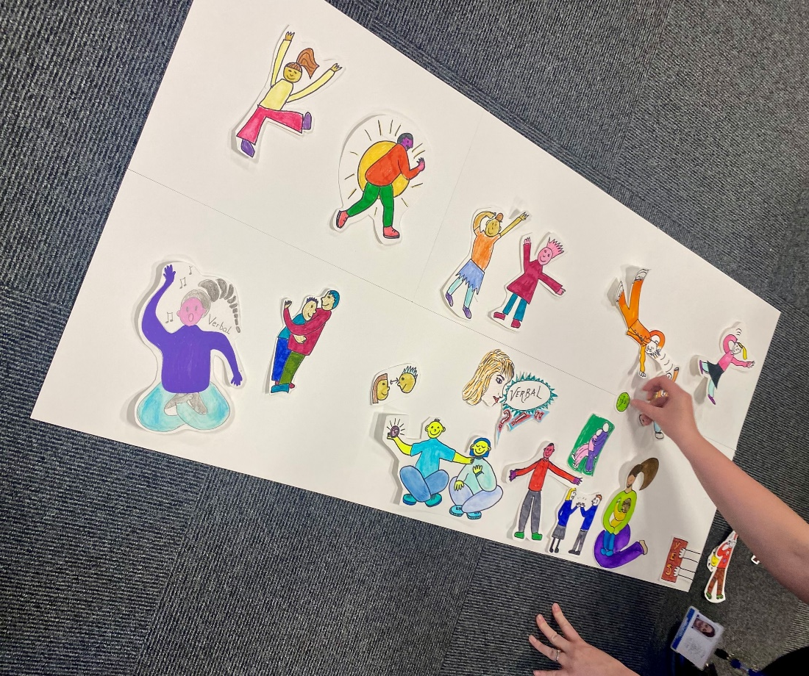
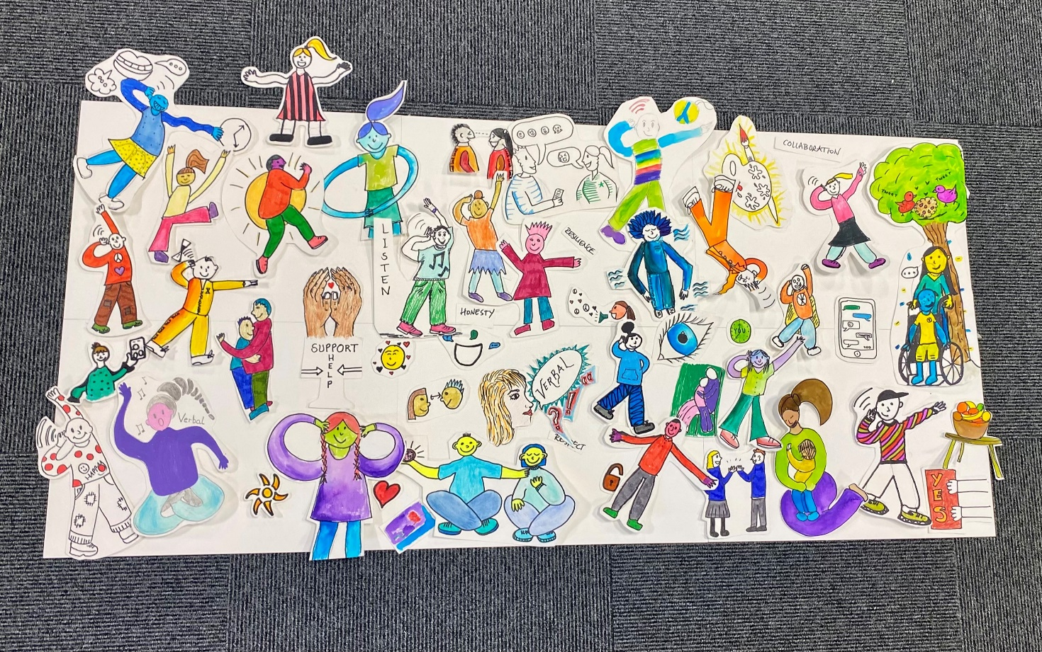
Next, we will assemble our mural. Where do your characters and images belong? Place your drawings into the mural

