Slide 1




It Begins With Me RSE Day 2026

Slide 2
RSE Day
RSE Day is a day to celebrate great Relationships and Sex Education in schools and other settings and takes place on the last Thursday in June each year. In 2026, it will be held on Thursday 25th June.
The theme for RSE Day 2025 is ‘It Begins with Me’!
RSE Day began in Nottingham in June 2018 and continues to be run by Nottingham City Council.

Slide 3
This song was created using words and music suggested by children and young people in Nottingham during the Autumn of 2025. The project is a collaboration between Nottingham Music Service, Challenge Nottingham and Nottingham City Council’s Achieve Well Team.
We want children and young people around the country to join us in singing the song on RSE day, 25 June 2026. Let’s raise our voices to celebrate the power of us!
Please share videos of your class or school singing the song via our Padlet and you may feature in our ‘It Begins with Me’ in the UK music video.

Slide 4
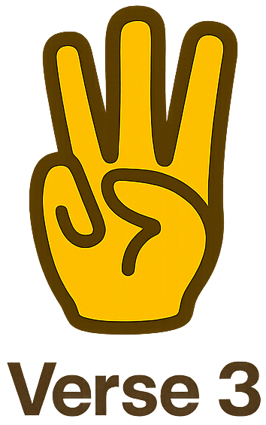
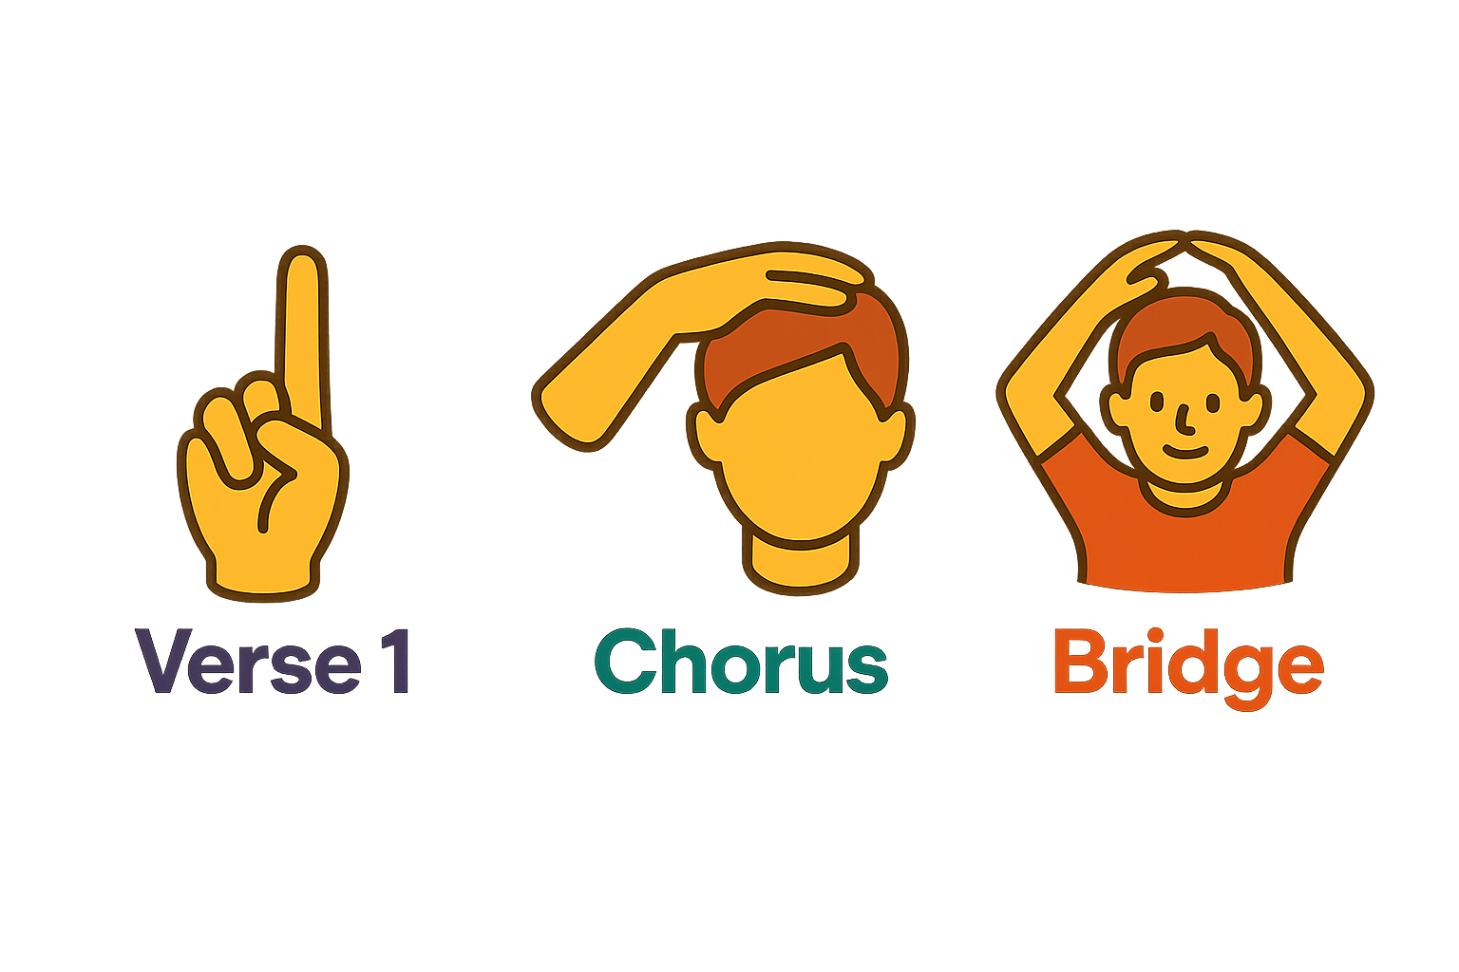
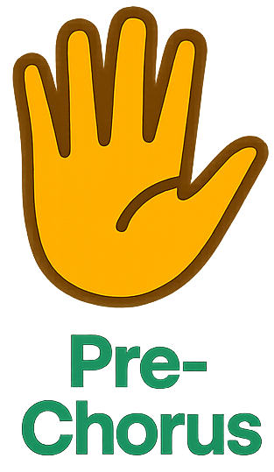
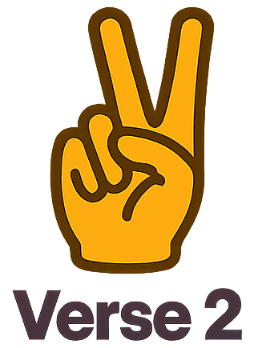


I’ve been looking for my place, for my place inside this world
It may spin, it may twirl, but I’ll never let you down
I want to figure out my place, my place within this town
And if I know myself, I can better support you too
Mistakes are just a chapter, not the whole book
Spreading kindness is needed, it starts from within
The best thing can be if we were all to win
I am good and I care, I help and I share, I’m always there
Be kind to myself to be kind to you
Be proud of myself it’s what I must do
You can achieve it if only you believe it
(It begins with me) I smile when I feel hope
You smile bright, it’s such a beautiful sight
Who you are tomorrow begins with what you do today
I smile because I am me
My smile never fades away
Who you are tomorrow begins with what you do today
I climb my mountains, take pride when I see the view
We are unique, we are special, I am good at being me
Be a safe space for you….it starts with being me
Don’t choose hate over kindness, choose to spread love instead
Be kind to myself to be kind to you …
I smile when I feel hope …
I like me and that's okay
I help others every day
I jump so high and laugh so loud
I stand up tall, I feel so proud
I am me and I am one of a kind
A brighter star you will never find
I smile when I feel hope …
A brighter star you will never find - it begins with me (x 5)
It begins with me
Rehearsal Track
Backing Track

Slide 5
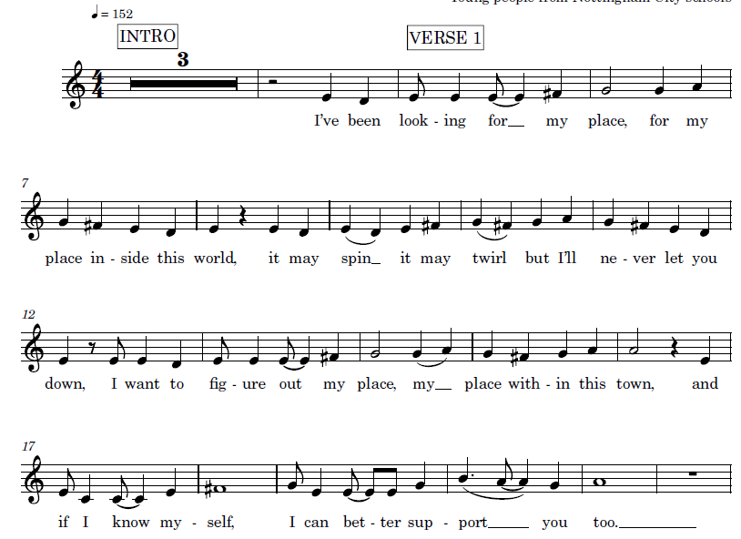
Rehearsal
Backing
I’ve been looking for my place, for my place inside this world
It may spin, it may twirl, but I’ll never let you down
I want to figure out my place, my place within this town
And if I know myself, I can better support you too

Slide 6
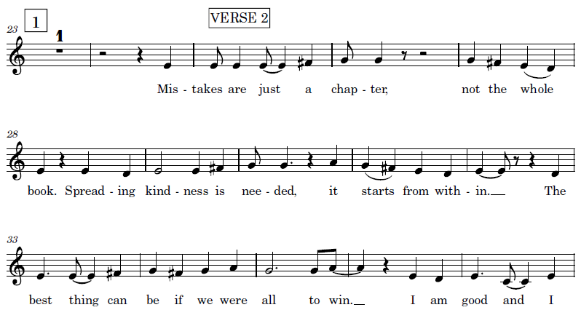
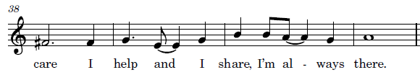
Rehearsal
Backing
Mistakes are just a chapter, not the whole book
Spreading kindness is needed, it starts from within
The best thing can be if we were all to win
I am good and I care, I help and I share, I’m always there.

Slide 7
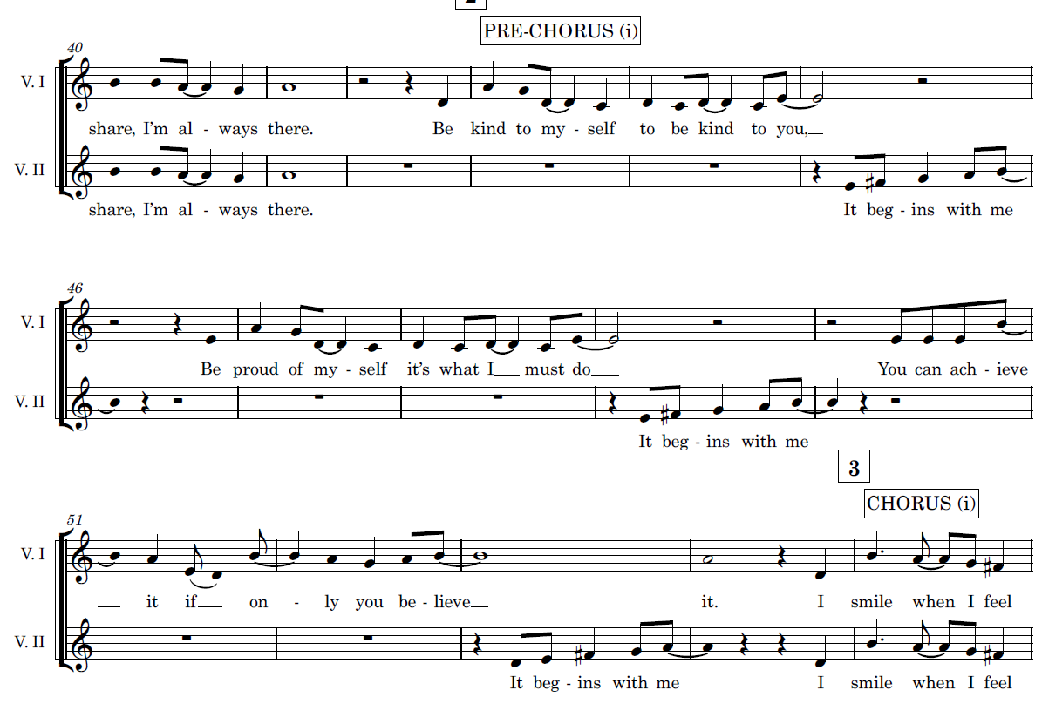
Rehearsal - Both
Backing
Group 1
Be kind to myself to be kind to you
Be proud of myself it’s what I must do
You can achieve it if only you believe it
Group 2
It begins with me
It begins with me
It begins with me

Slide 8
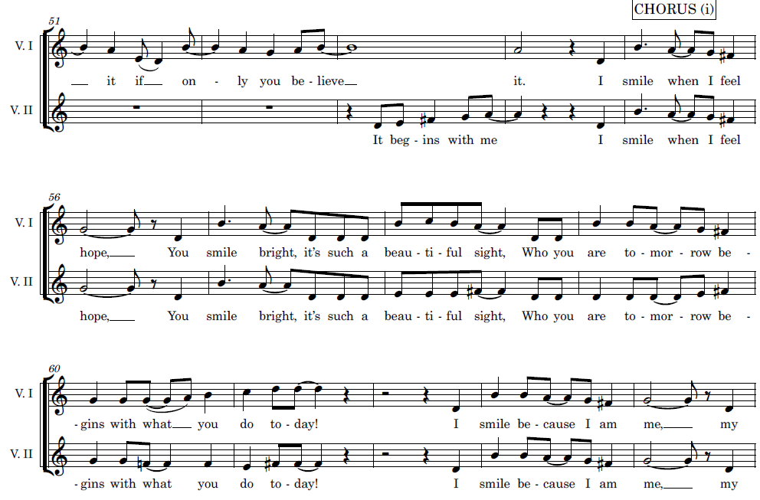
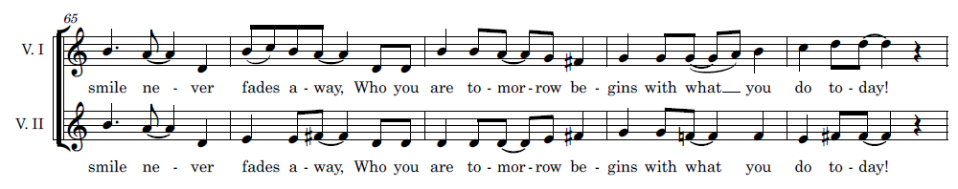
Melody
(It begins with me)
I smile when I feel hope
You smile bright, it’s such a beautiful sight
Who you are tomorrow begins with what you do today
I smile because I am me
My smile never fades away
Who you are tomorrow begins with what you do today
Rehearsal - Both
Harmony
Backing

Slide 9
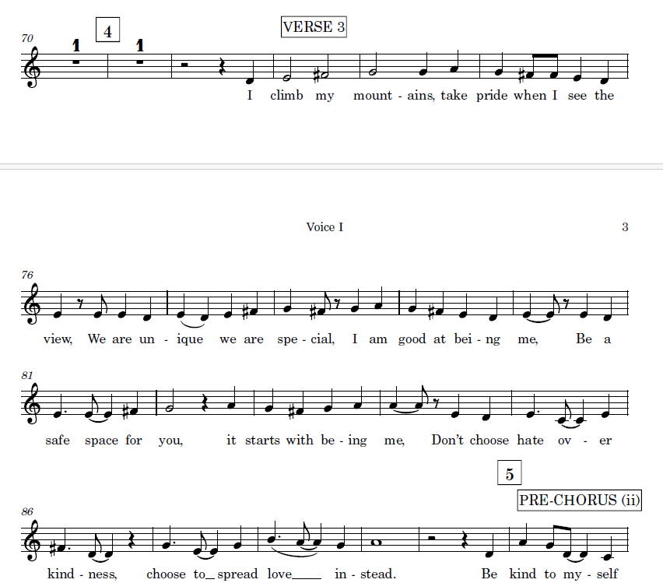
Rehearsal
Backing
I climb my mountains, take pride when I see the view
We are unique, we are special, I am good at being me
Be a safe space for you….it starts with being me
Don’t choose hate over kindness, choose to spread love instead

Slide 10
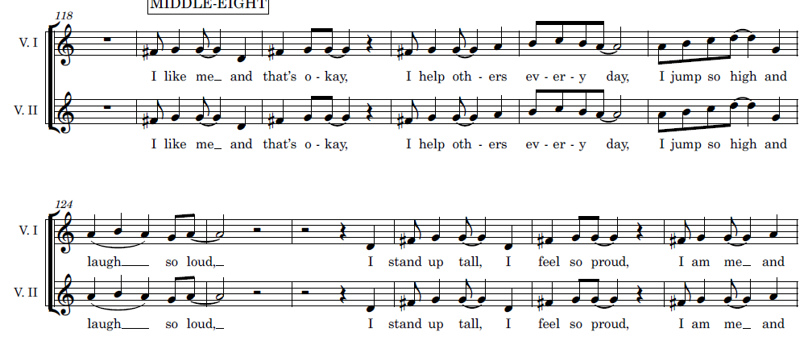
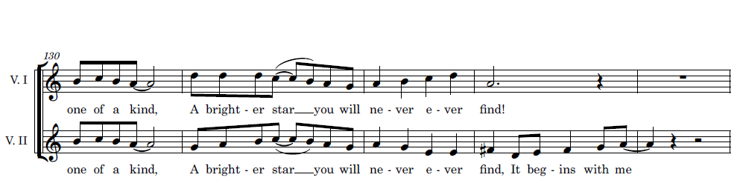
Melody
Harmony
Rehearsal - Both
I like me and that's okay
I help others every day
I jump so high and laugh so loud
I stand up tall, I feel so proud
I am me and I am one of a kind
A brighter star you will never find
(It begins with me)
Backing

Slide 11
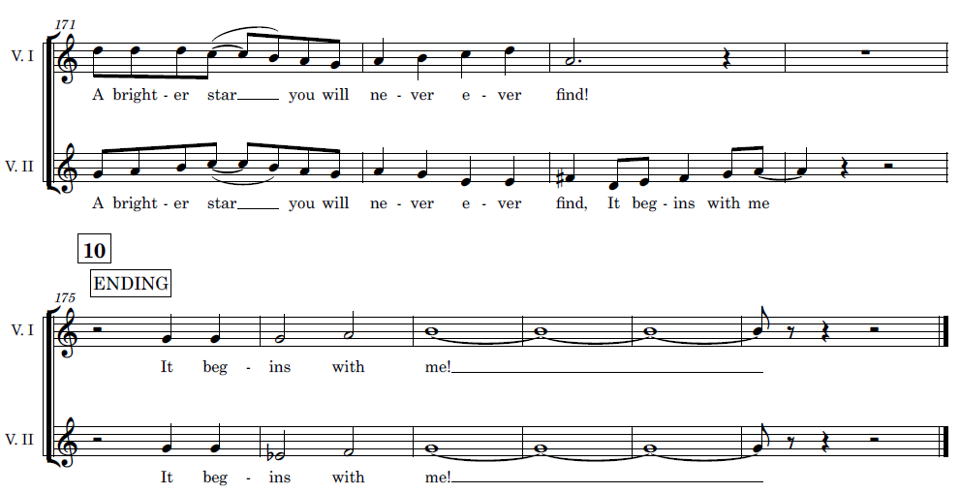
x 5
Melody
Harmony
A brighter star you will never ever find - it begins with me (x 5)
It begins with me________________
Rehearsal - Both
Backing

