Slide 1
RSE Day Assembly
27 June 2024
Embracing Change

Slide 2
What is change?
Talk with the person next to you

Slide 3
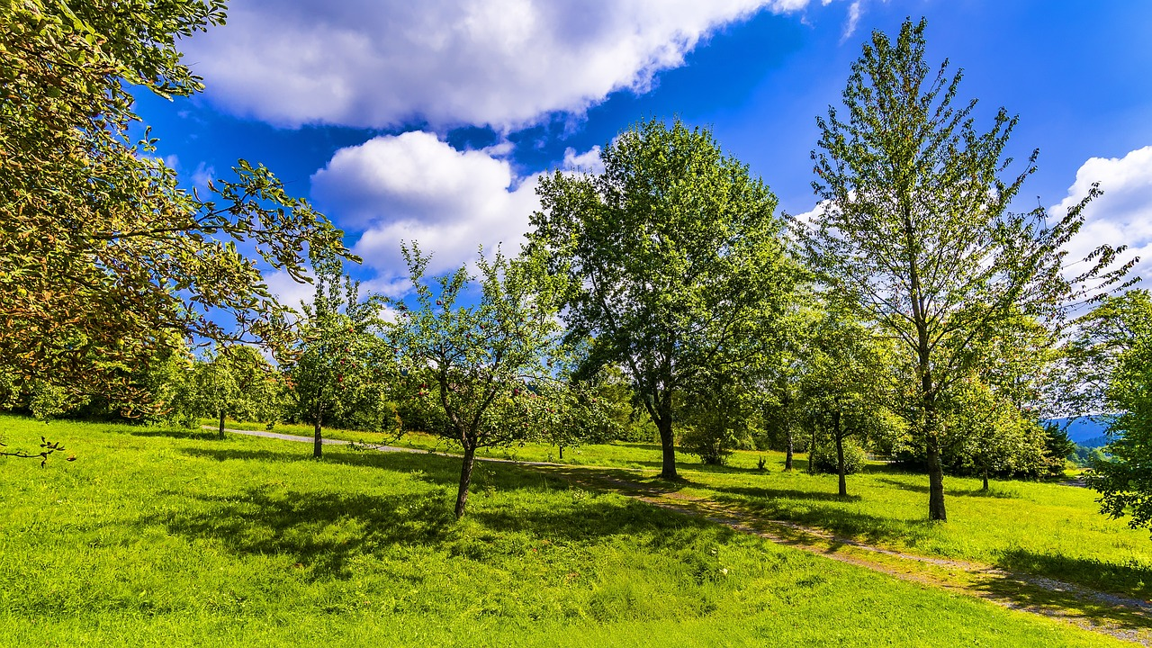
Change is when things become different
Like the seasons changing from Summer to Autumn

Slide 4
Why is change important?
Change helps us to learn, grown and develop as people.

Slide 5
What changes might happen for you as you grow up?
Talk with the person next to you.

Slide 6
Some things that can change as you go through life
Friendships
Families
Bodies
Minds
School
Home

Slide 7
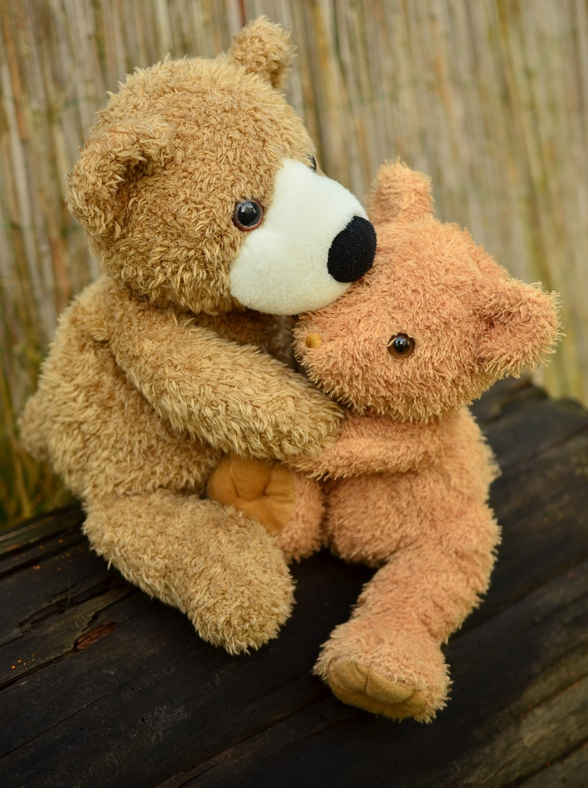
The theme of RSE Day is ‘Embracing Change’.
What does that mean?

Slide 8
Embracing Change
Be positive – Look for the good in every change.
Be brave – It’s okay to feel nervous or scared, but facing change can make us stronger.
Get help – Sometimes we need help to embrace change.

Slide 9
Why is it good for us to embrace change?
Change can lead to new and exciting experiences.
Overcoming challenges helps us to become the best version of ourselves.

Slide 10
Story-time
Sunil the Seed Embraces Change

Slide 11
Remember…
Change is part of life.
Be brave and try to stay positive when faced with change.
It’s okay to need help. Ask for help when you need it.

Slide 12
We want you to embrace change today - what could you do?
How about…
… talking to someone you haven’t talked to before?
… doing a different activity at break?
… trying some different foods at lunchtime?

