Slide 1
Hannah used the children’s images as inspiration to create a series of illustrations for RSE Day

Slide 2
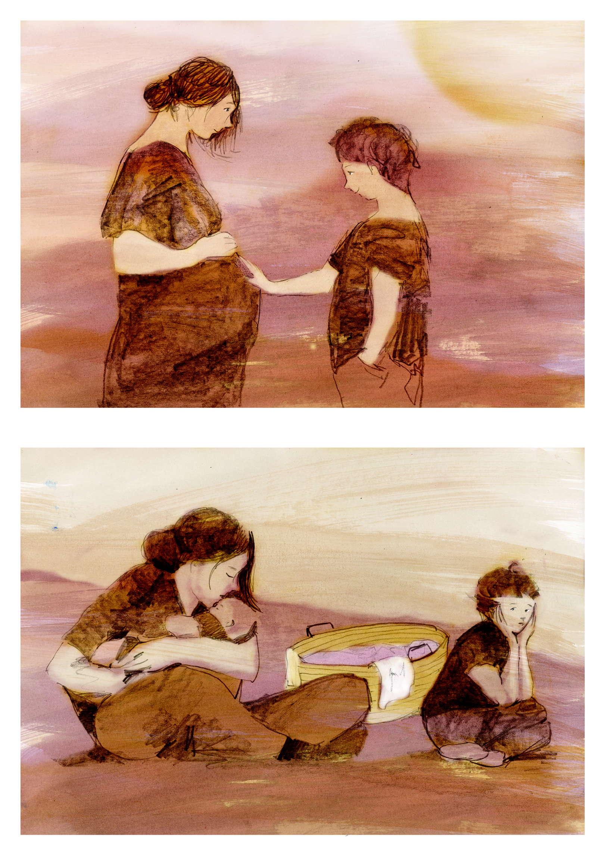
Changing Families:

Slide 3
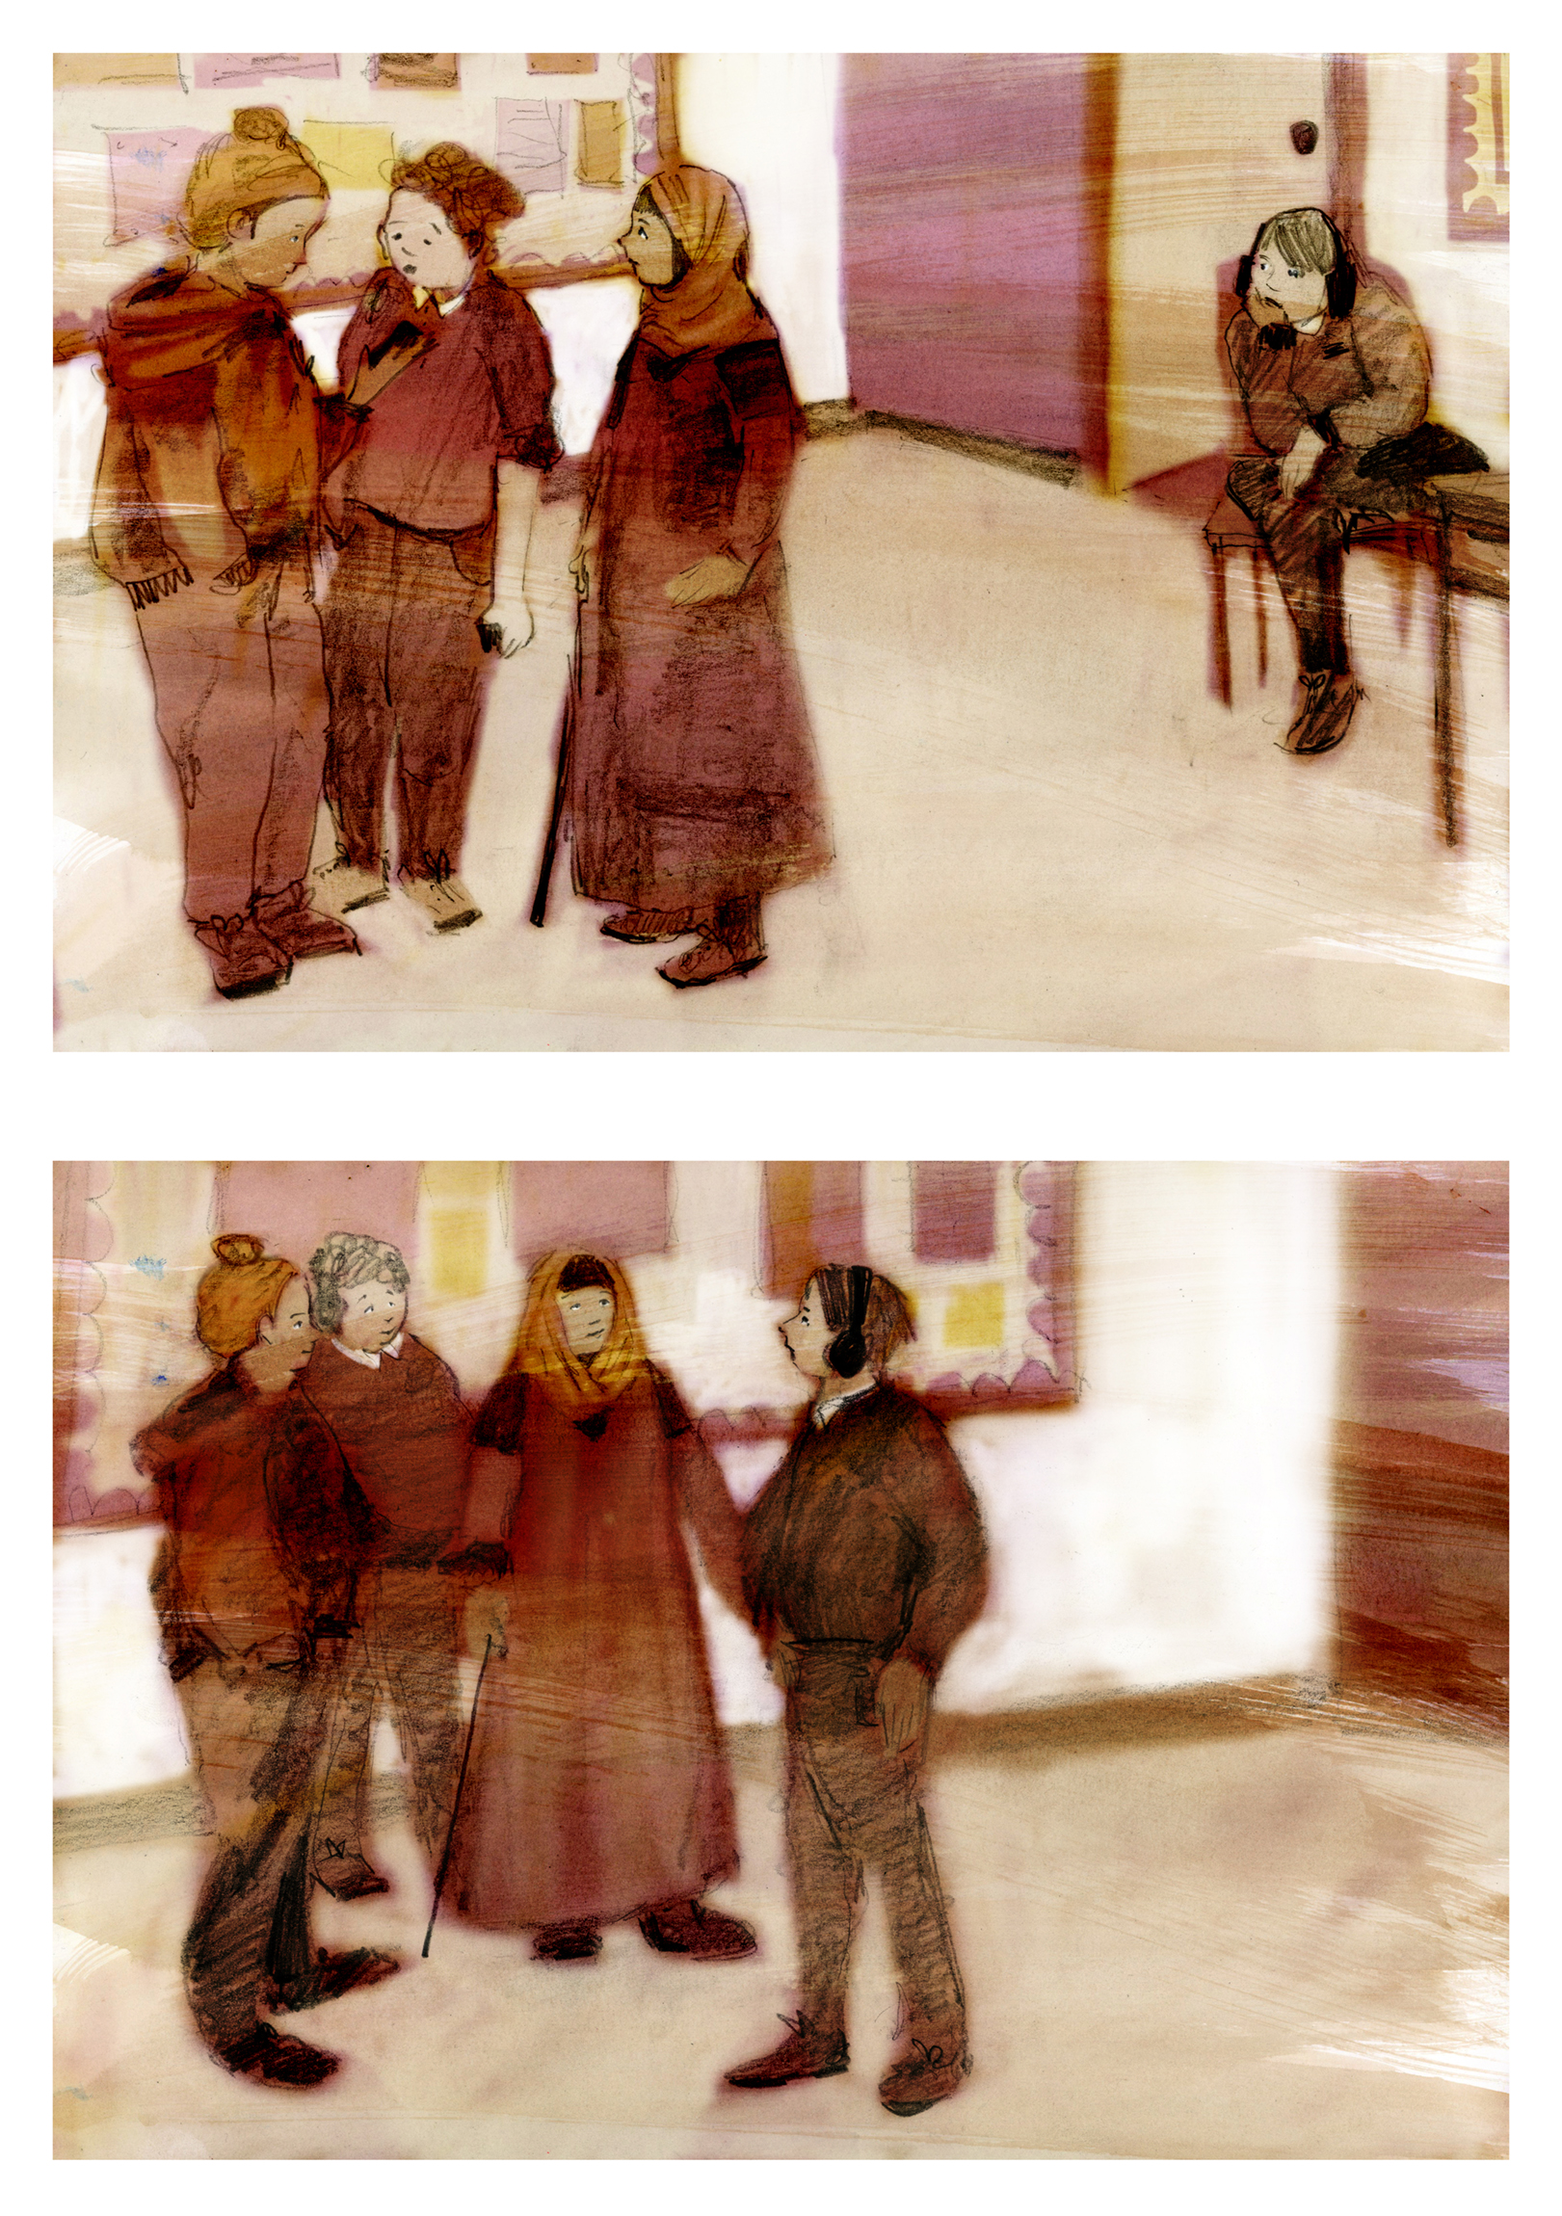
Changing Friendships:

Slide 4
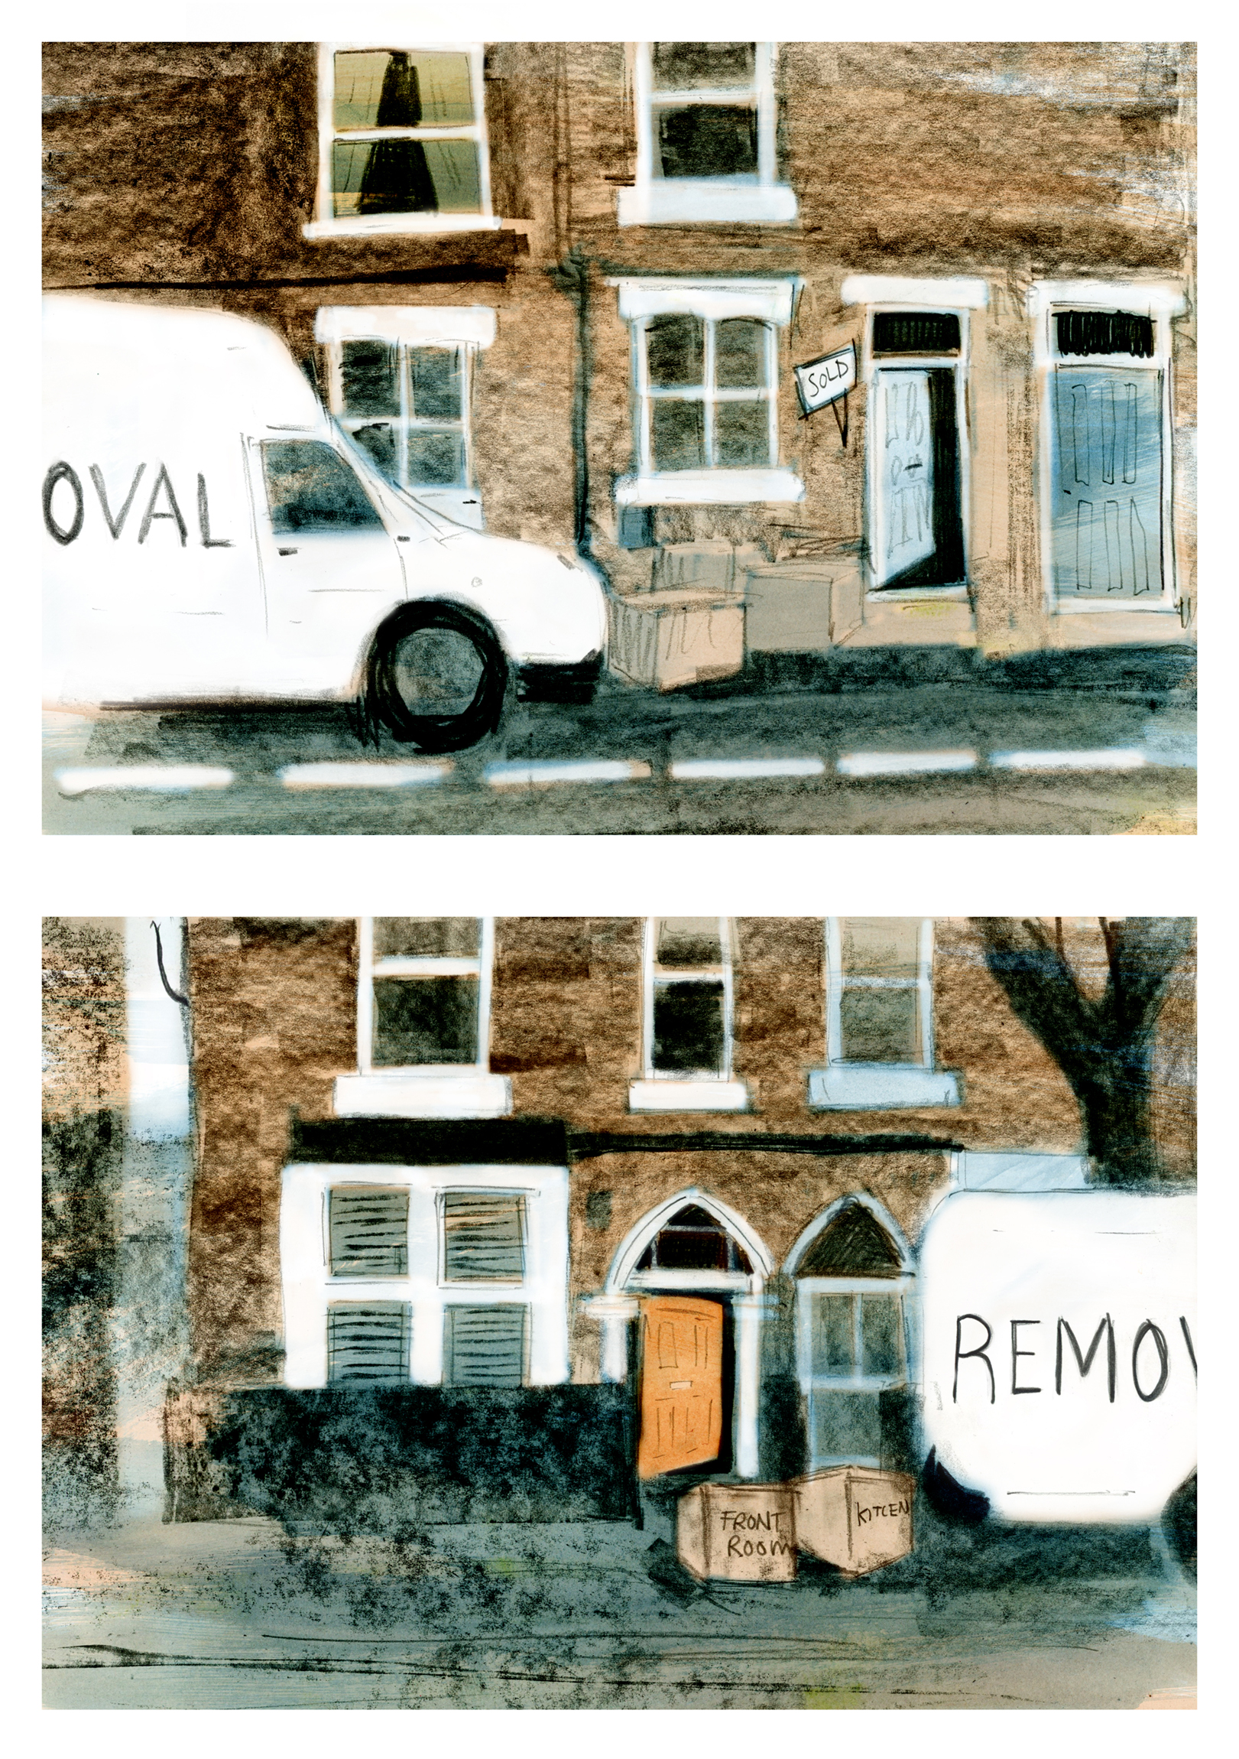
Changing Homes:

Slide 5
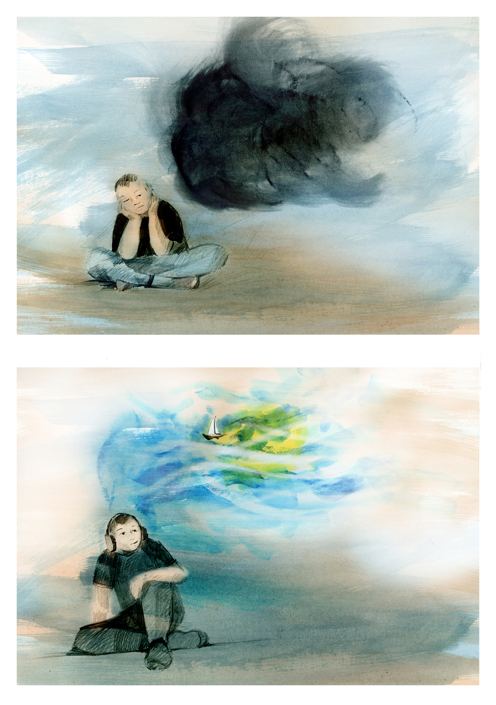
Changing Minds:

Slide 6
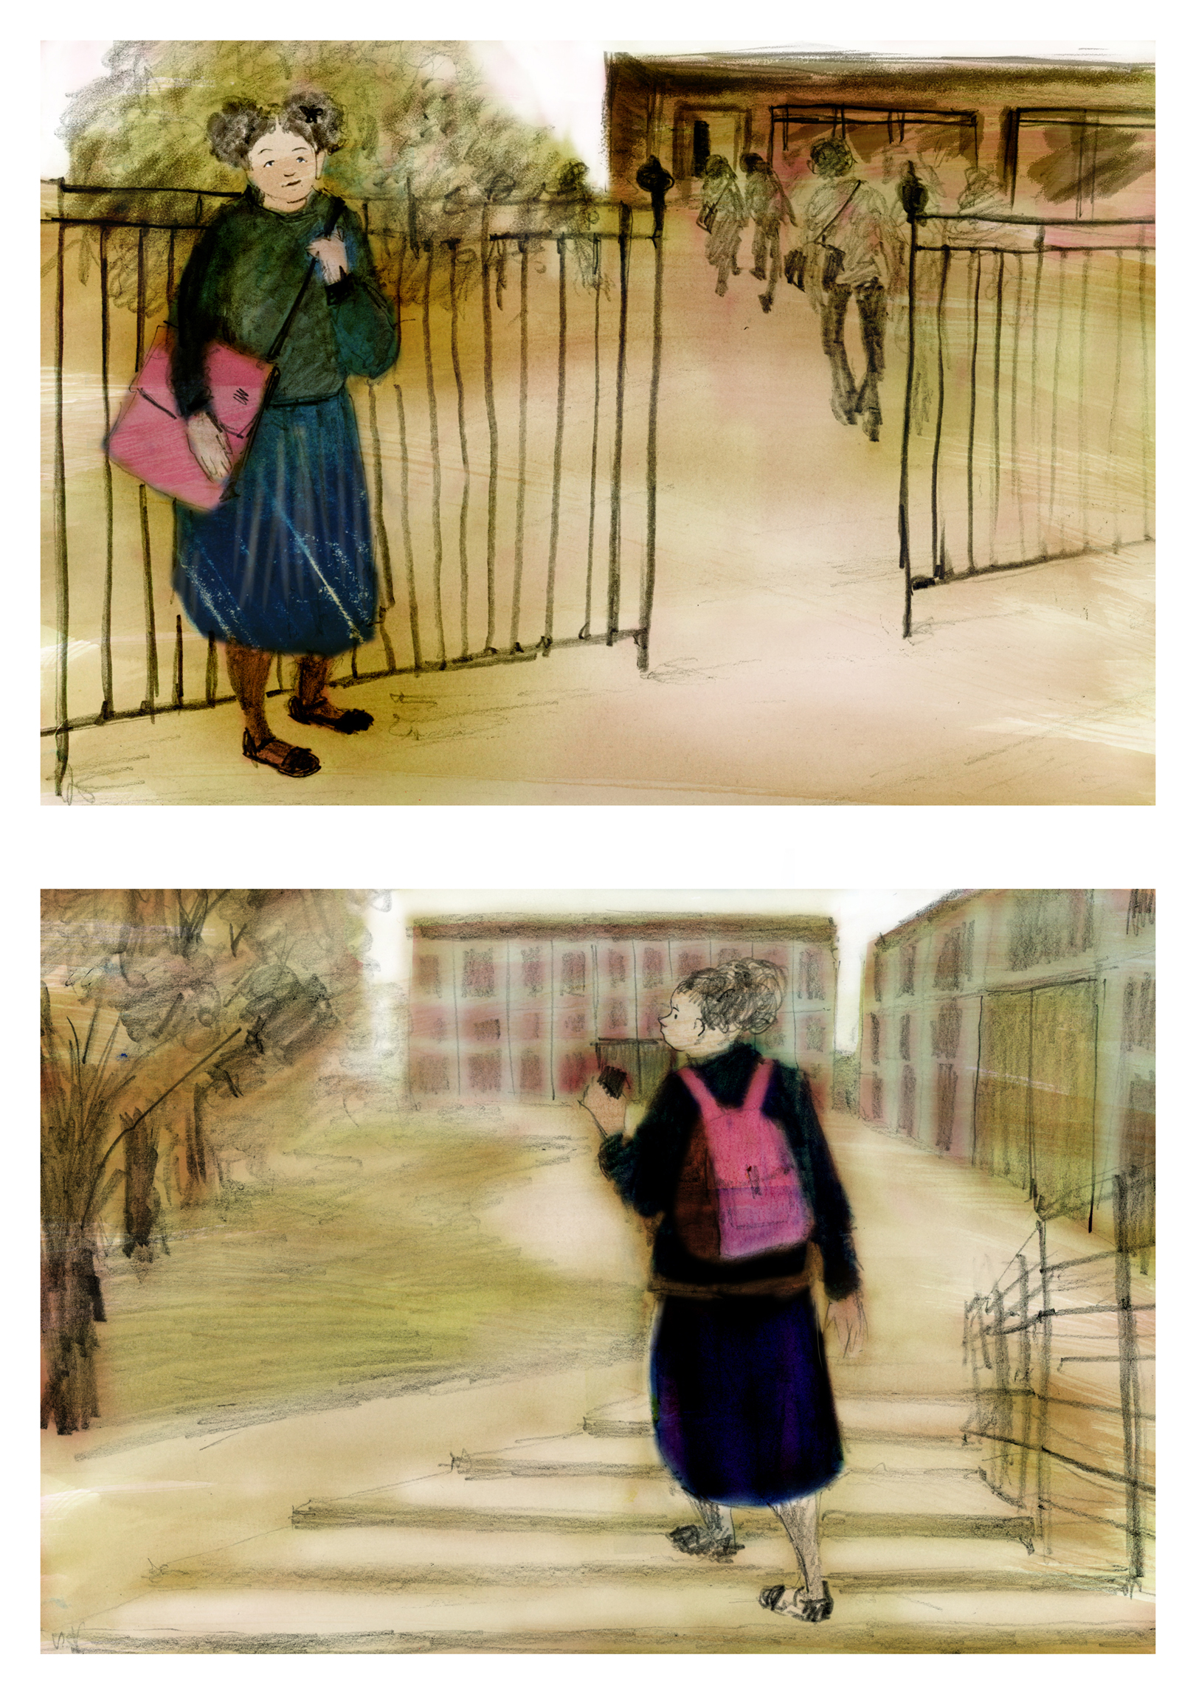
Changing Schools:

Slide 7
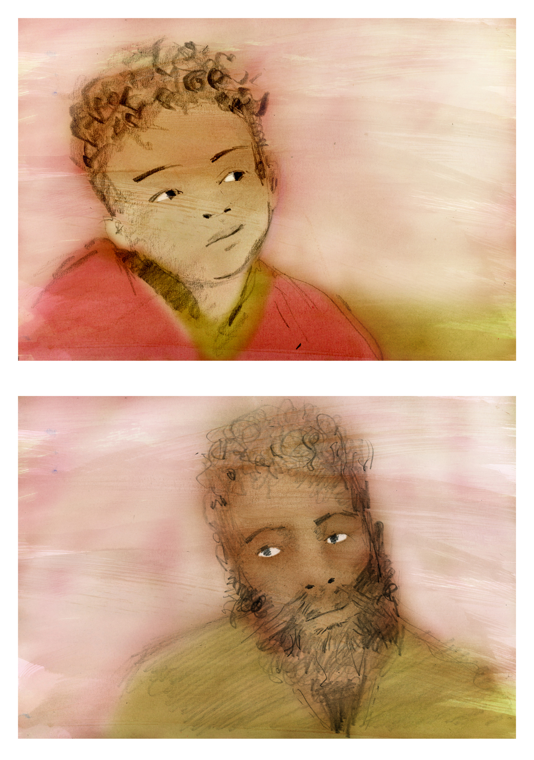
Changing Bodies:

