Slide 1




RSE DAY
25 June
2026
Read the scenarios and decide how you would respond assertively to each situation if you were the character having the friendship problem. Being assertive means using calm, confident words to say how you feel and what you need, while still being kind to others.
Act out the scenario and think about what tone of voice you should use to convey your message respectfully but assertively to the other person. You may wish to use the sentence starters as prompts.
Take it in turns with your partner to be the one in role asserting themselves, or to be the person who is being told ‘no.’
How does it feel to be in each of these types of role? Think of situations in real life when you might need to speak up for yourself and remember that it is ok to assert ourselves when we need to.

Slide 2
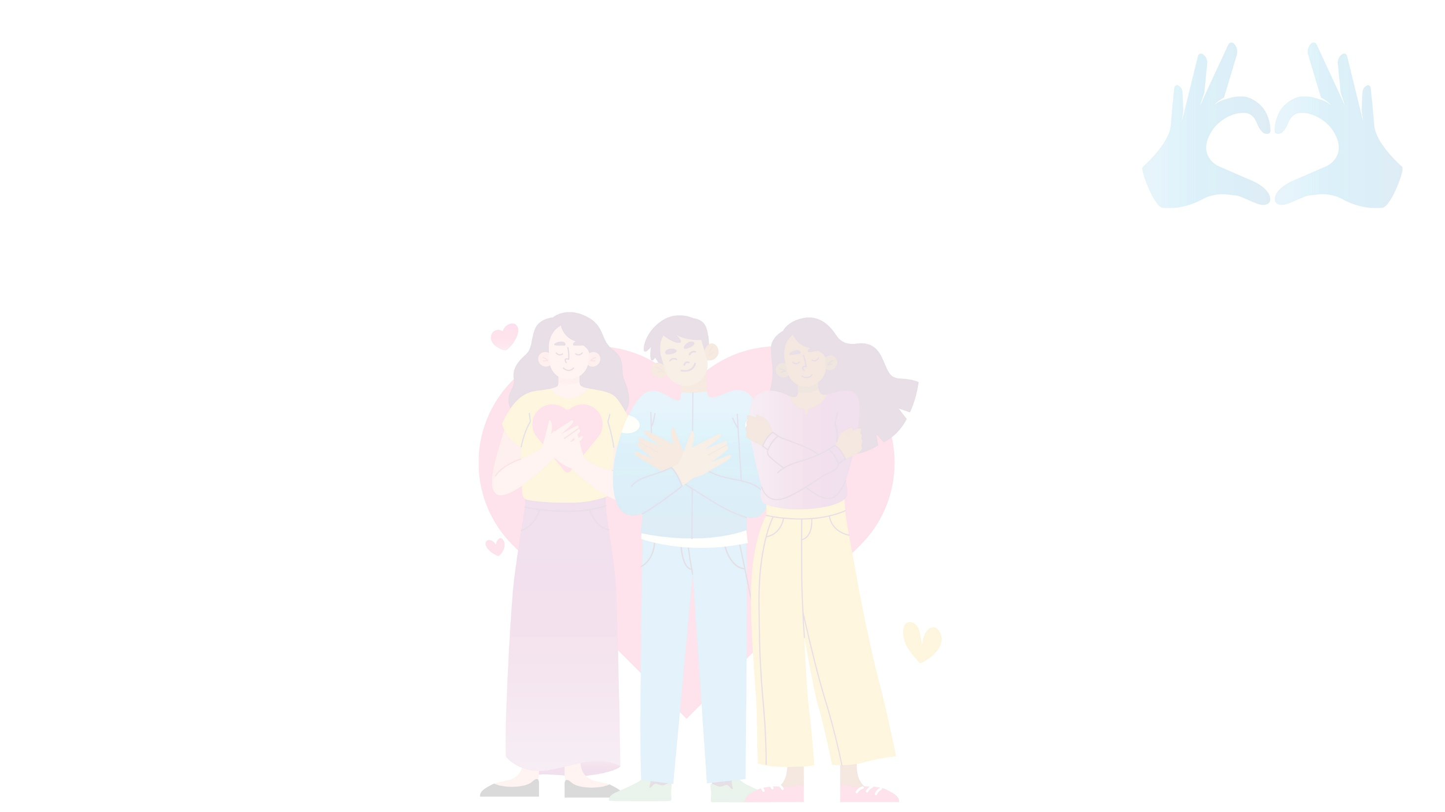
Scenario 1
Casey and Arlo are working on a research project together. Casey keeps telling Arlo what to do and says, “I’ve already decided what information we will write about.”
Assertiveness goal: Arlo should explain that they want to include their own ideas for the project too.
What would be a good way for Arlo to respond in this situation?
Scenario 2
Jules asks to swap their crisps for Ashley’s crisps as they prefer the flavour Ashley has. Ashley doesn’t want to give them their packet, but they feel bad saying no.
Assertiveness goal: Ashley needs to find a way to say “No” kindly and confidently
How might they respond in an assertive but polite way?

Slide 3
Scenario 3
Cameron is waiting in line for lunch when someone pushes in front of them. Cameron feels quite annoyed as they’ve already been in the line for ten minutes.
Assertiveness goal: Cameron needs to calmly tell the other person that they were there first
How could they respond calmly but assertively?
Scenario 4
Reese is playing with a toy at break time.
Another child comes over, grabs it from Reese’s hands, and says, “I want to play with this now.”
Assertiveness goal: For Reese to explain that they had the toy first and would like it back
What would be a good way to speak up confidently?

Slide 4
Scenario 5
Kit is trying to finish their work, but the group on the table next to Kit is being very noisy. Kit is finding it hard to concentrate.
Assertiveness goal: Kit needs to ask them politely to lower their voices.
How could Kit respond? What could they do if the other children do not listen?
Scenario 6
Someone makes a rude comment about Joe’s hairstyle, and it hurts their feelings.
Assertiveness goal: For Joe to tell them clearly that their words were unkind and ask them to stop.
How could Joe respond in an assertive way?

Slide 5
Scenario 7
Some friends want to play a game Francis doesn’t like. They say, “Come on, just play it!” But Francis feels like they always decide what game to play at break without asking their opinion.
Assertiveness goal: For Francis to state what they’d prefer to play or suggest taking turns choosing games.
How could Francis speak up about this?
Scenario 8
Someone in Robin’s table group borrowed their pencil yesterday and hasn’t given it back. Today they ask to borrow another one.
Assertiveness goal: Robin should remind them they need to return the first pencil before borrowing another.
How could Robin confidently respond in this situation?

Slide 6

Sentence Starters
Expressing your feelings | Saying what you need | Setting boundaries for yourself & standing up for others | Suggesting a compromise
I feel… when… It upsets me when… I don’t like it when… I feel worried because… I don’t appreciate it when… | Please can you…? I would like it if… Can we try… instead I’d prefer it if… My thinking is… | I don’t want to do that because… Please stop doing that. I’m not comfortable with that. No, thank you That’s not kind. You need to stop. I don’t think that’s fair. I would like to have a turn too. Please speak to me kindly/respectfully | How about we… Maybe we could both… Why don’t we consider…? I have another suggestion… Maybe we could flip a coin to decide…

