Slide 1
https://makeameme.org/meme/embracing-change-appreciate

Slide 2
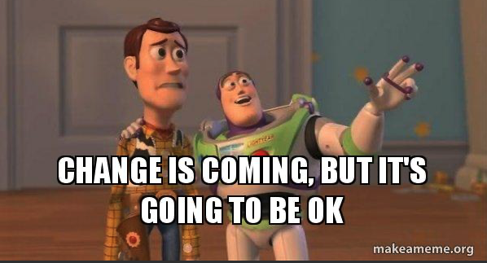
https://makeameme.org/meme/change-is-coming-xxxy2f

Slide 3
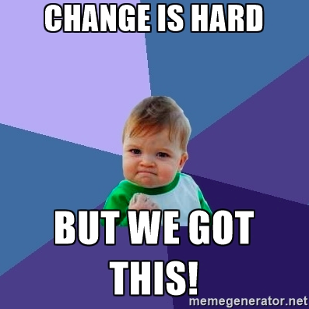
https://blog.netline.com/2017-b2b-marketing-exchange-post-event-insights/change/

Slide 4
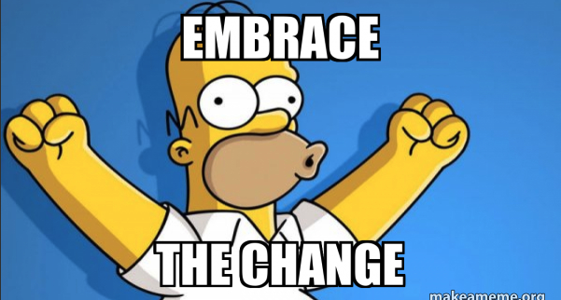
https://makeameme.org/meme/embrace-the-change-a6f72323a3

