Slide 1


Slide 2

RSE Day 2025
Communicate Quiz

Slide 3


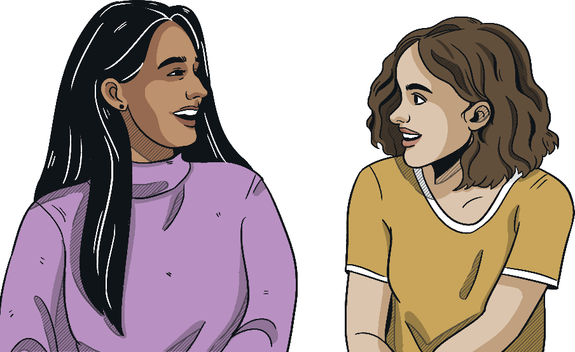
RSE Day
RSE Day is celebrated on the last Thursday of June each year. This year, it is held on 26th June 2025 and the theme is:
Communicate

Slide 4
Question 1
Match the following types of communication to the correct example.
digital
non-verbal
verbal
visual
written
using a pen and notebook to keep a diary
talking to a friend
sending a text message
being aware of body language
creating a piece of artwork for a display

Slide 5
Question 2
What is digital communication?
speaking as if you were an AI
using hand gestures to highlight your point
writing in a physical diary
communicating using technology such as emails, social media and text

Slide 6
Question 3
Communication isn’t just about sharing information or messages; it is also about receiving these.
Which of these options best describes active listening?
thinking about what you want to say whilst a person is talking
ignoring distractions and focusing fully on the person communicating
talking over the person who is communicating
being quiet while someone else is communicating

Slide 7
Question 4
What is the best way to respond to someone who is upset?
talk about it to someone else
ignore them
listen to the person, show empathy and ask if there is anything that you can do to support them
tell them they are overreacting

Slide 8
Question 5
How can you tell if someone is interested in what you are verbally communicating?
they respond appropriately by turning their body to face towards you
they turn away from you
they check their phone a lot
they start talking over you

Slide 9
Question 6
Sometimes people will communicate what they want directly, making it clear what they really want. Other times, people may suggest or imply a message; this is known as indirect communication.
Which of the following is an example of indirect communication?
‘can you turn the TV down?’
‘that music is really loud’
‘stop shouting, please’
‘I would like an apple’

Slide 10
Question 7
In which situation would it be useful to use visual communication?
giving a speech to your class, without any aids
listening to music
writing a novel
demonstrating how to evacuate a building in an emergency

Slide 11

Question 8
What changes could be made to improve your communication skills?

Slide 12


Answers

Slide 13
Question 1
Match the following types of communication to the correct example.
digital
sending a text message
non-verbal
being aware of body language
verbal
talking to a friend
visual
creating a piece of artwork for a display
written
using a pen and notebook to keep a diary

Slide 14
Question 2
What is digital communication?
speaking as if you were an AI
using hand gestures to highlight your point
writing in a physical diary
communicating using technology such as emails, social media and text
communicating using technology such as emails, social media and text

Slide 15
Question 3
Communication isn’t just about sharing information or messages; it is also about receiving these.
Which of these options best describes active listening?
thinking about what you want to say whilst a person is talking
ignoring distractions and focusing fully on the person communicating
ignoring distractions and focusing fully on the person communicating
talking over the person who is communicating
being quiet while someone else is communicating

Slide 16
Question 4
What is the best way to respond to someone who is upset?
talk about it to someone else
ignore them
listen to the person, show empathy and ask if there is anything that you can do to support them
listen to the person, show empathy and ask if there is anything that you can do to support them
tell them they are overreacting

Slide 17
Question 5
How can you tell if someone is interested in what you are verbally communicating?
they respond appropriately by turning their body to face towards you
they respond appropriately by turning their body to face towards you
they turn away from you
they check their phone a lot
they start talking over you

Slide 18
Question 6
Sometimes people will communicate what they want directly, making it clear what they really want. Other times, people may suggest or imply a message; this is known as indirect communication.
Which of the following is an example of indirect communication?
‘can you turn the TV down?’
‘that music is really loud’
‘that music is really loud’
This could indicate that the person is irritated, overwhelmed or dislikes the music.
‘stop shouting, please’
‘I would like an apple’

Slide 19
Question 7
In which situation would it be useful to use visual communication?
giving a speech to your class, without any aids
listening to music
writing a novel
demonstrating how to evacuate a building in an emergency
demonstrating how to evacuate a building in an emergency

Slide 20
Question 8
What changes could be made to improve your communication skills?
Answers may include:
practise active listening,
show people that you are listening through body language or appropriate listening sounds and signals,
before sending a text, email or any other form of digital communication, read through carefully and consider how another person might interpret what you are saying,
practise starting conversations verbally or with a safe person online,
using eye movement and facial expressions that feel comfortable for you.

Slide 21


