Slide 1


Relationships and Sex Education (RSE) Day
RSE Day Assembly (Primary)
RSE DAY
26 June 2025

Slide 2

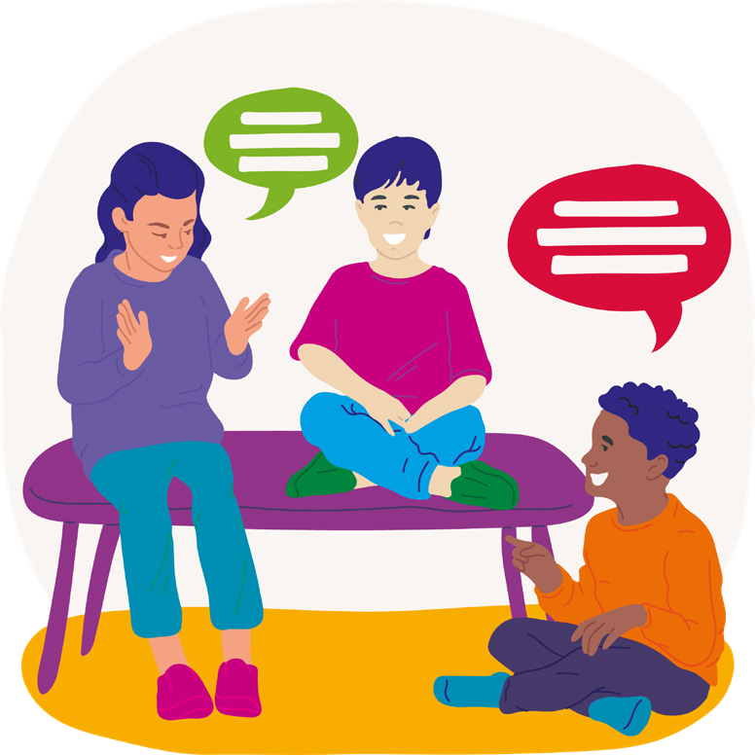

Communication
It’s something we do everyday and rely on as humans.
But what is it?
Can you talk to the person next to you about what it is and give 3 examples of it?

Slide 3

Communication is the sending and receiving of a message, information, or ideas between individuals or groups of people.
Communication allows us to tell others about our thoughts, feelings, what’s going on, solve a problem, ask for help and more.

Slide 4

Why is communication important to us?
How does it help us in our lives?
Communication is important as without it, we wouldn’t get very far in life.
It helps us build strong relationships, supports teamwork, solves problems, and allows us to accomplish goals. It also helps us feel better, feel more connected and help us grow.

Slide 5

Think about a time that communication has helped you in your life or has been really important. Talk to the person next to you and share it with them
Communication could have…
Helped you overcome a problem with a friend
Made you feel better when you were feeling low
Allowed you to achieve something in a lesson
Helped you win at an event
Put a smile on someone else’s face

Slide 6
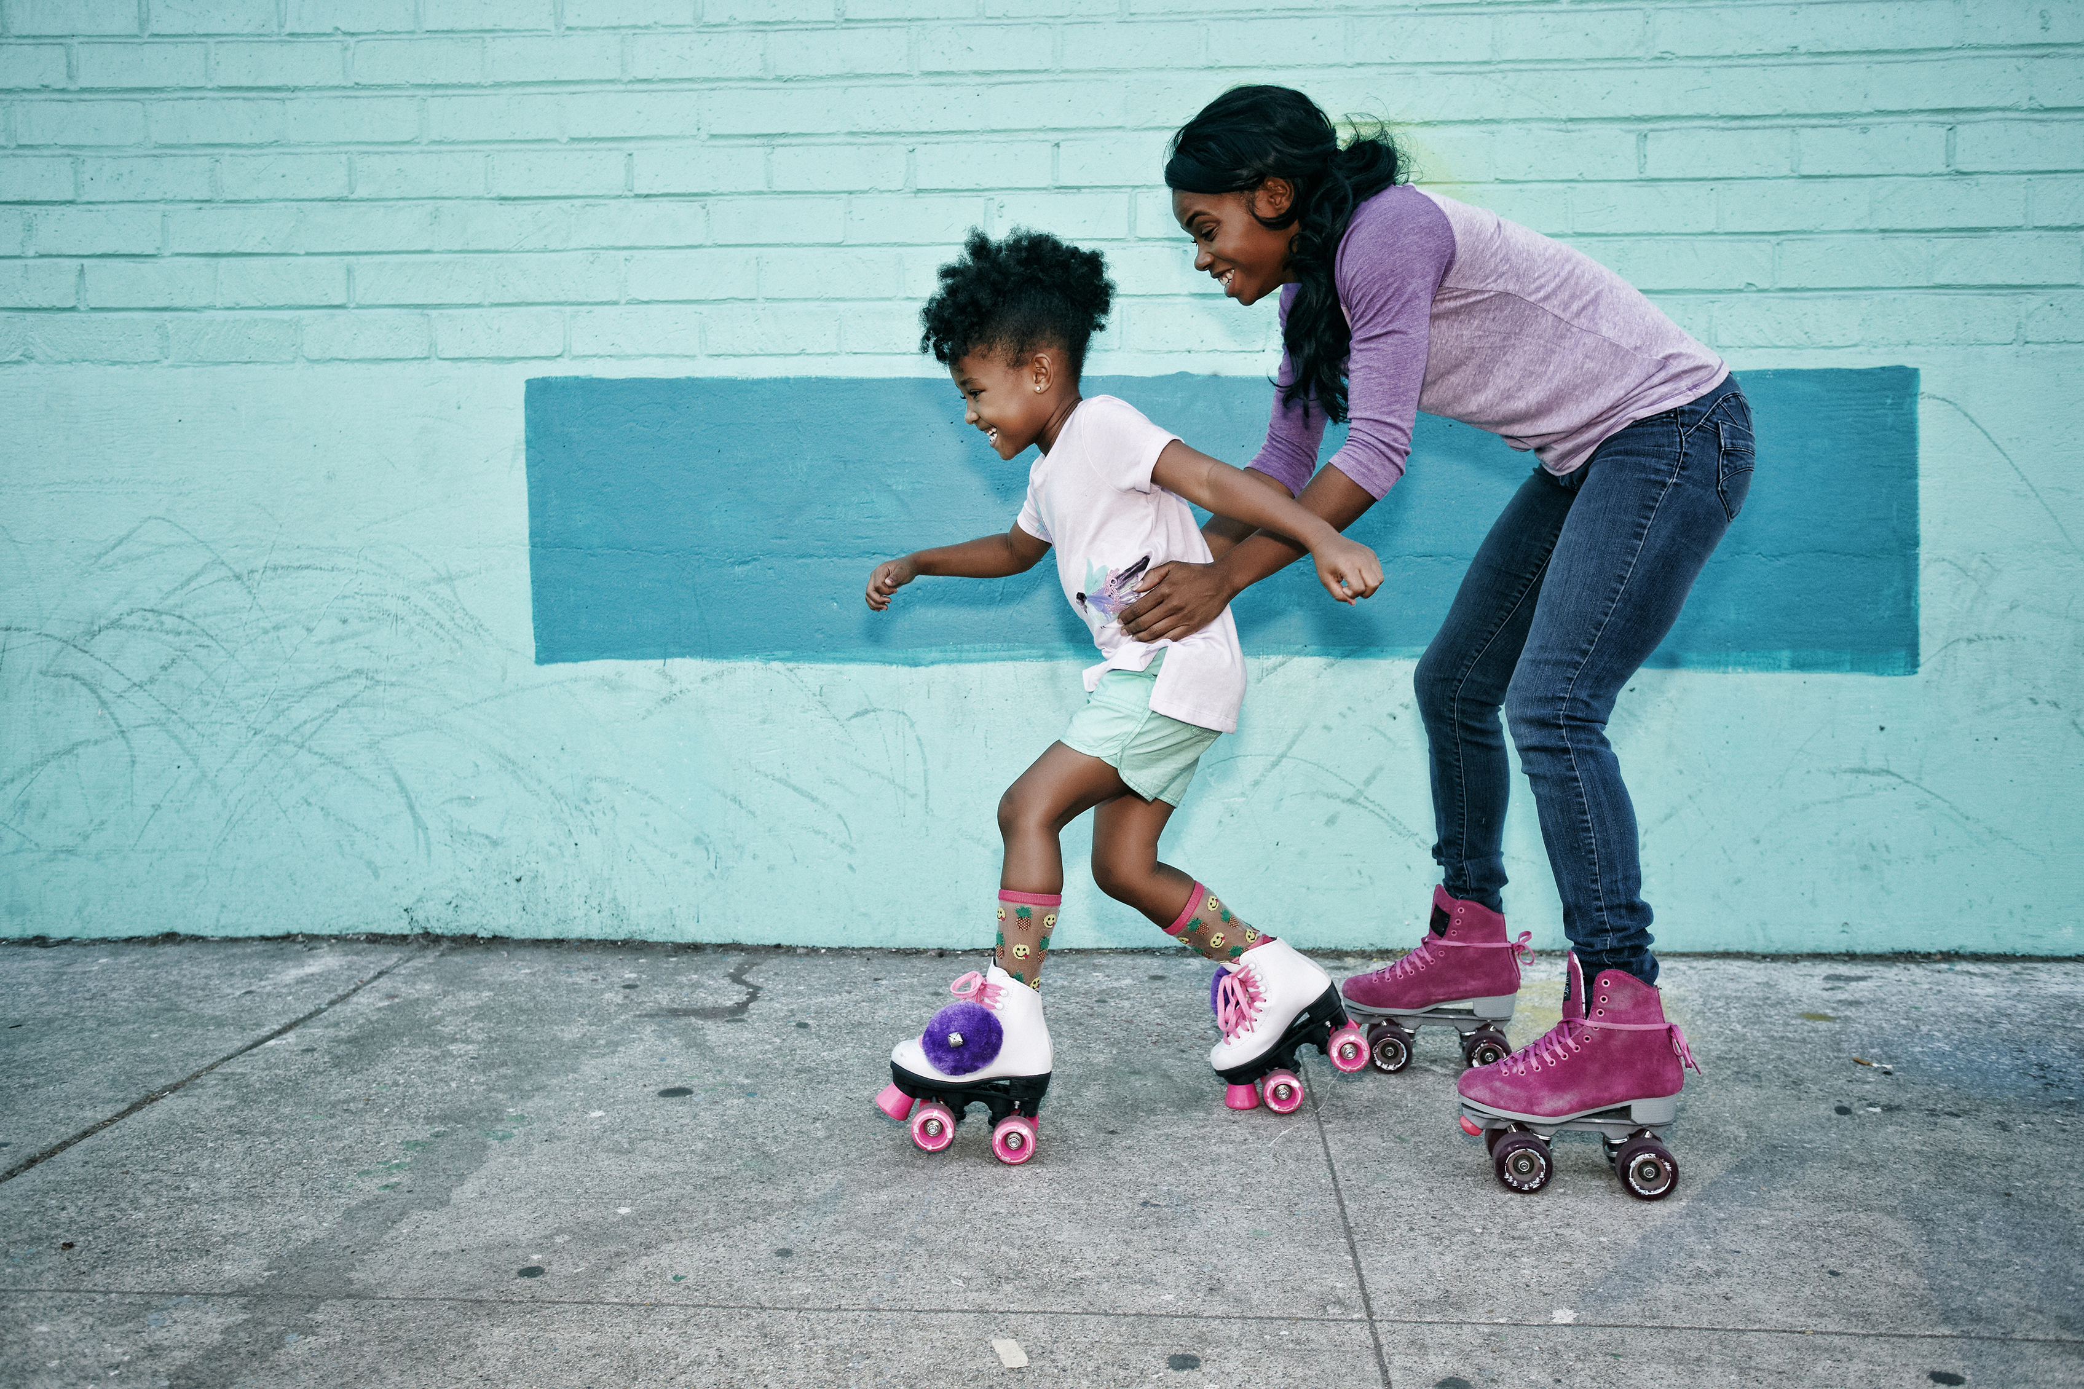
This year's theme for RSE Day is…
Communicate
“Communicate” is the verb form of the word “Communication”.
“We should communicate our problems to each other”

Slide 7
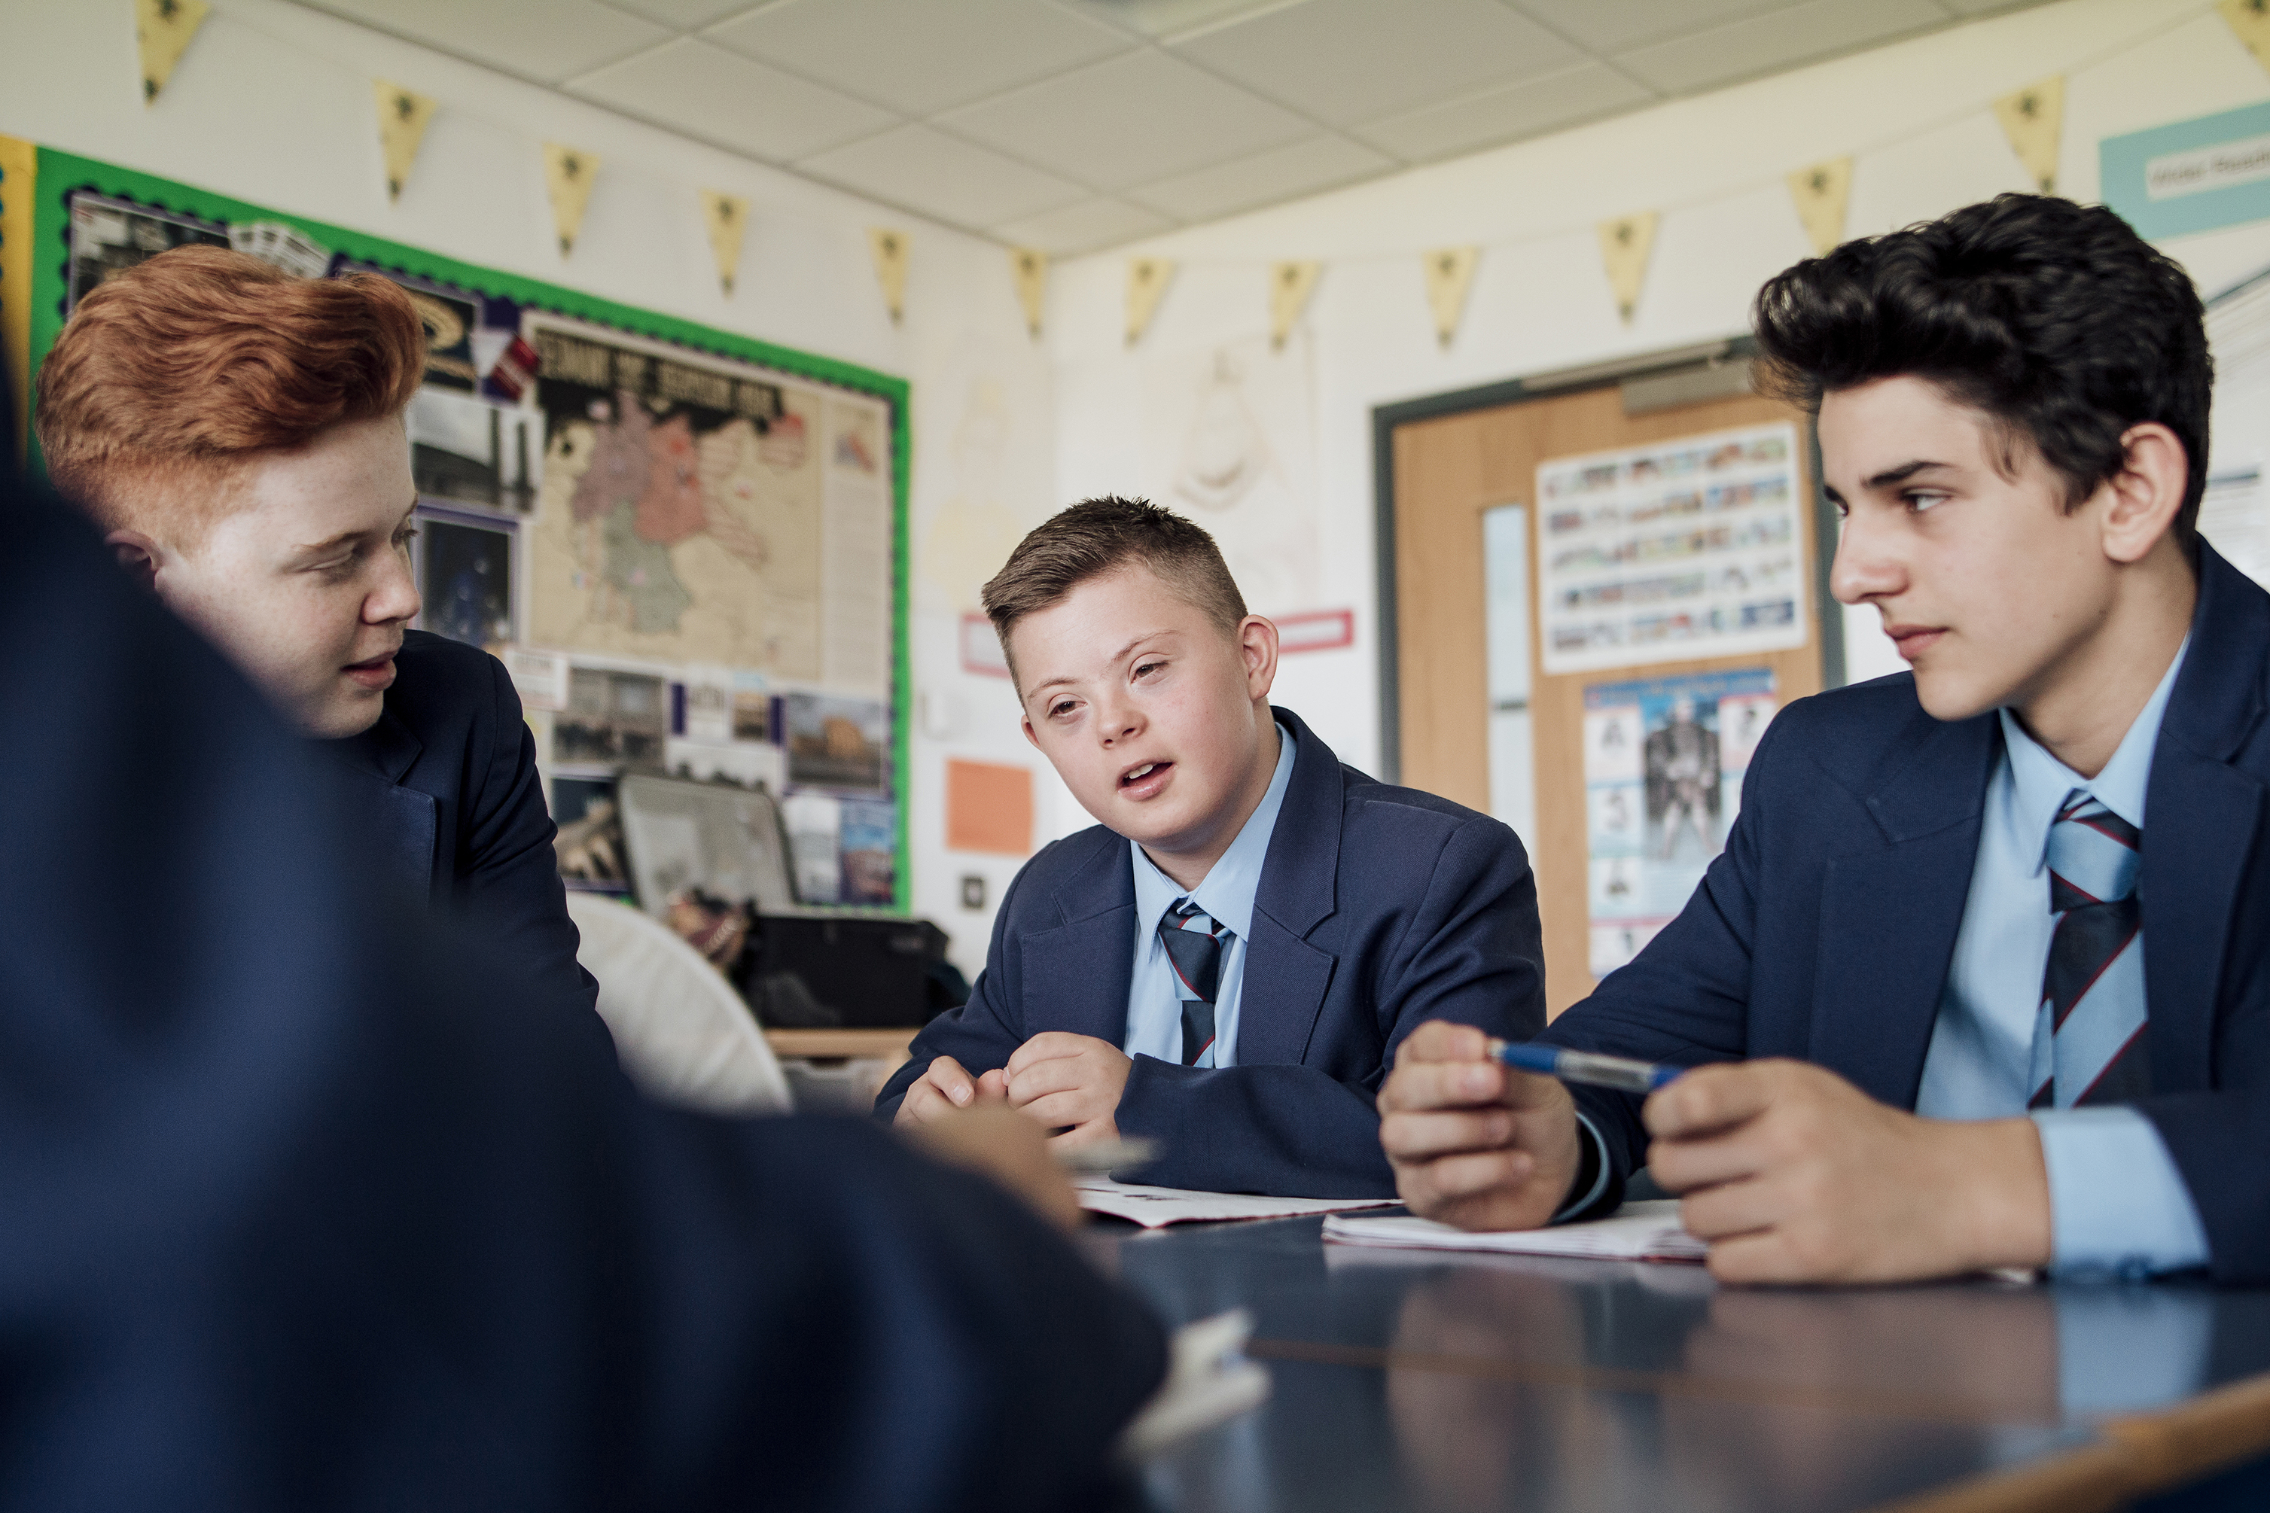


So now we understand what communication is and what communicate means…
Have a think about ALL the different ways you could communicate. Talking to someone is just one way to communicate, and there are lots of other ways people communicate with one another daily.
Be ready to share some answers with everybody!

Slide 8
For RSE day we’re going to be taking part in activities all around communication.
Throughout this day have a think about the following:
Ways to communicate – There are more ways to communicate than we realise. Are we using them all? Which ones do you use more?
Importance of communication – How does communication help us in our daily lives? How difficult is it when we can’t communicate what we want to say?
One half of communication is listening – If one person is trying to communicate, the other person at that time should be listening or receiving the information. Listening/receiving is equally as important as communicating, as without it communication isn’t possible. How can we be better listeners?

Slide 9

Let’s end this assembly with a short story
The Silent Strikers
Whilst listening, think about how communication played an important role in the story and without it the team would not have succeeded

Slide 10
What do you think the Silent Strikers learnt about communication?
Remember…
Communication allows us to do better! We can get the help we need, achieve better things or help others.
There are lots of ways to communicate, but without communicating we can often feel lonely.
And listening is a huge part of communication.

Slide 11

Have a great RSE day!
Communicate with those around you and find different ways to keep on communicating
RSE DAY
26 June 2025

