Slide 1


Slide 2

RSE Day Assembly
26th June 2025
Communicate

Slide 3
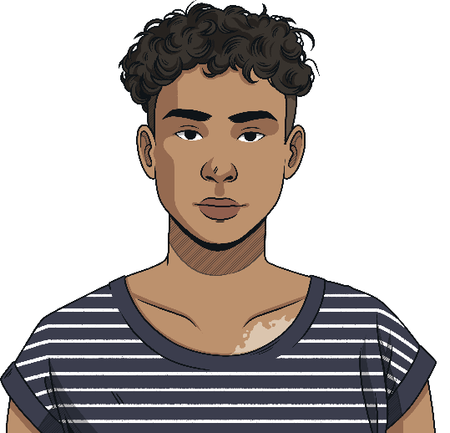
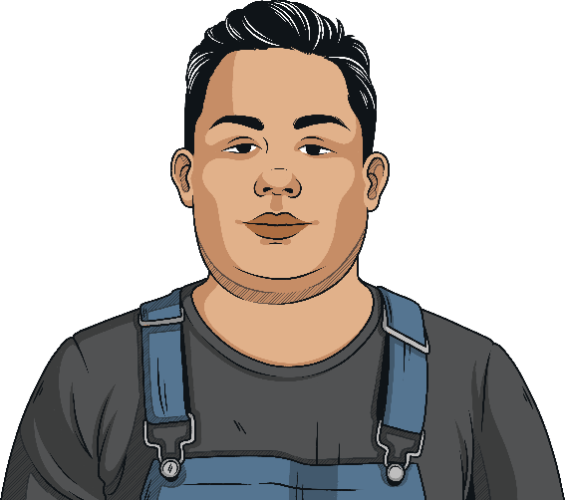
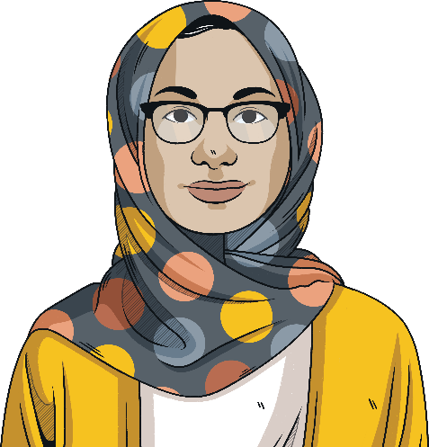
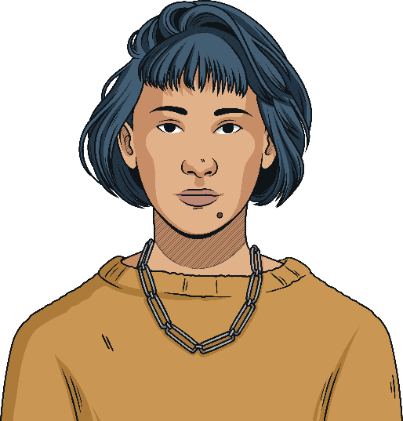
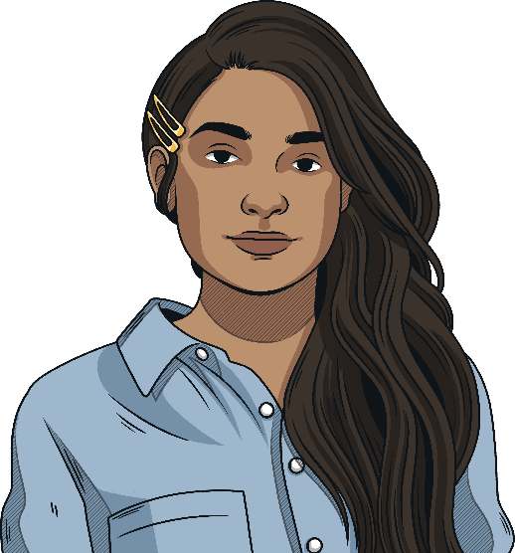

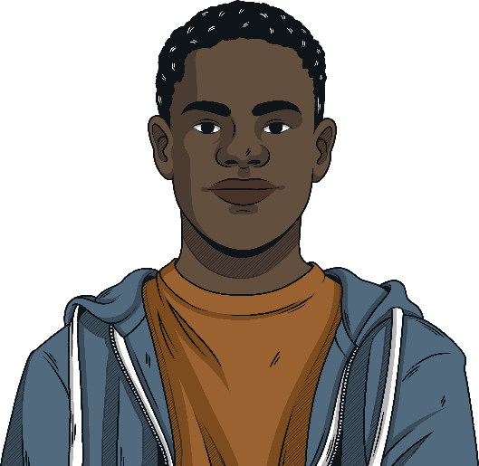
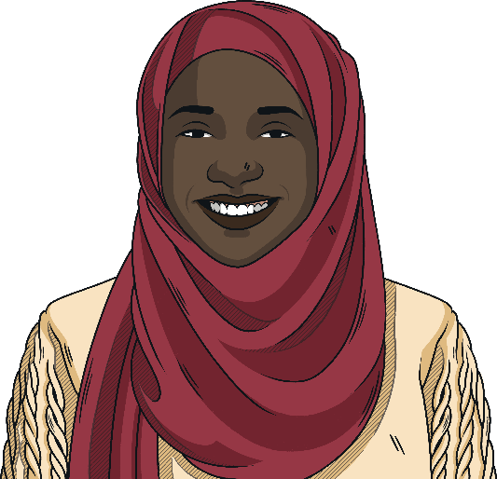
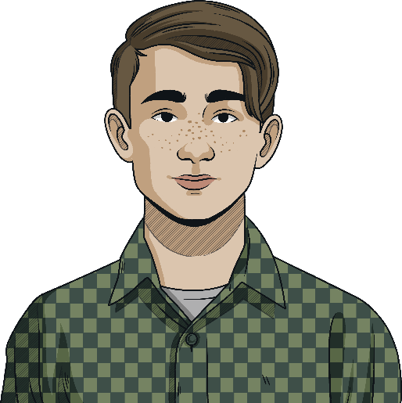
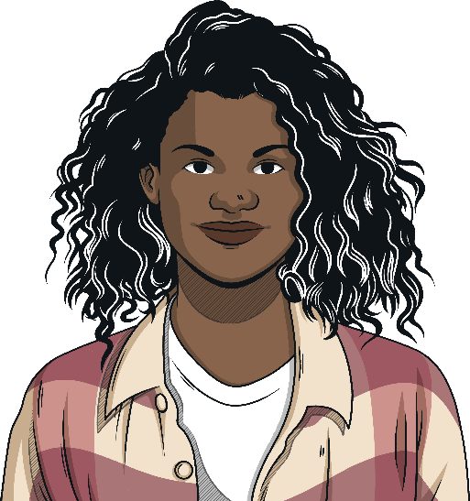
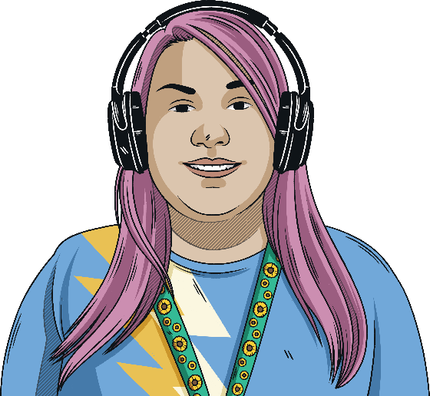
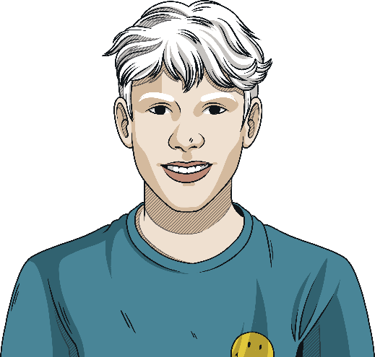
What is RSE Day?
RSE Day is celebrated on the last Thursday of June each year. This year, it is held on 26th June 2025
The day celebrates excellent relationships and sex education (RSE) that promotes the wellbeing and safety of children and young people in schools and other settings.

Slide 4
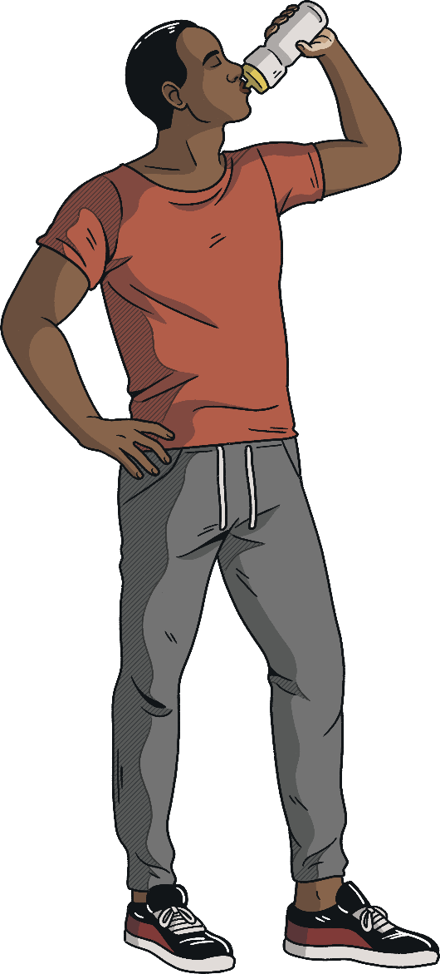
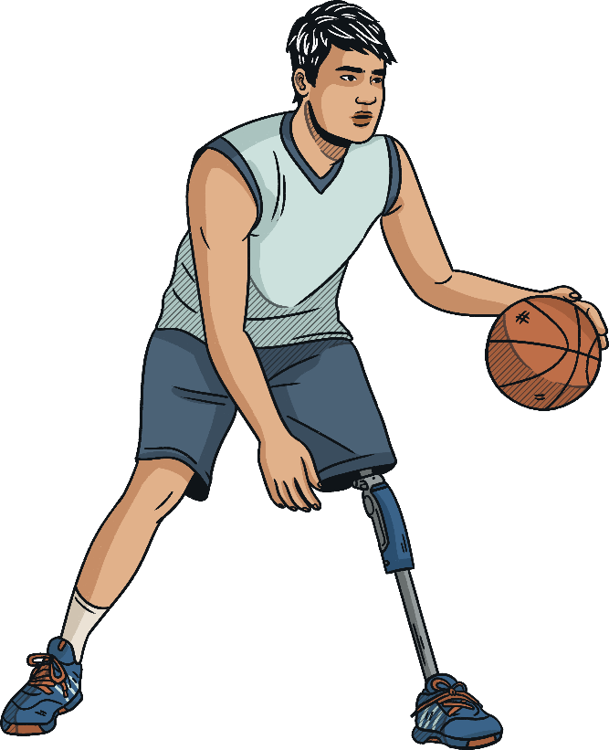
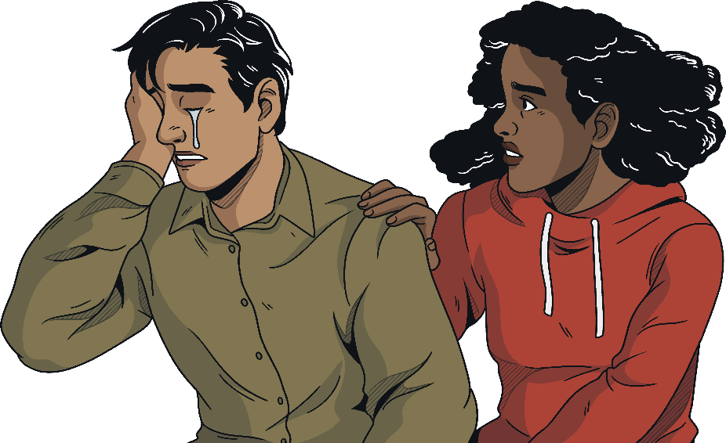
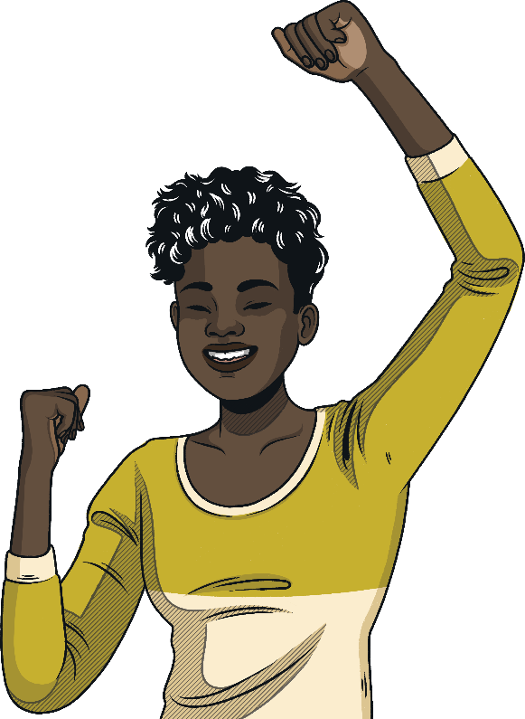
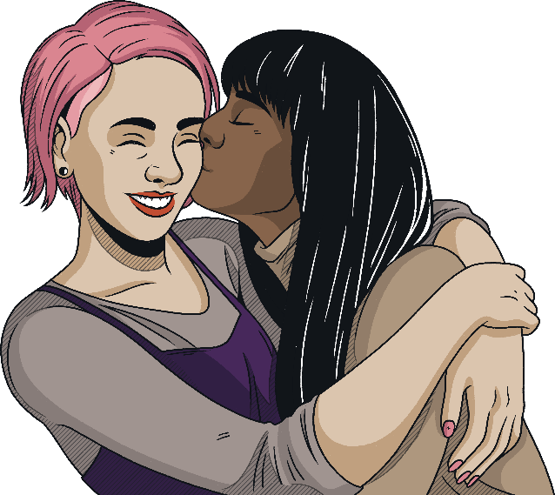
What is RSE Day?
RSE Day gives us an opportunity to talk openly about many topics related to relationships and sex education.
Being comfortable talking about RSE has a positive impact on our lives.
Conversations around RSE help to:
keep us safe and healthy;
improve our communication;
increase our understanding of relationships and other related topics;
improve our confidence and wellbeing.

Slide 5

RSE Day 2025
The theme for RSE Day 2025 is:
Communicate
This theme encourages us to consider all of the different ways we can empower and support each other and ourselves in our daily lives, through reflecting on the impact and value of different forms of communication:
What makes communication effective?
How many different forms of communication have you used today?

Slide 6
Communication
Communication takes many forms. Some we may not even realise.
  self-expression, such as how we choose to present our appearance,
  verbal, including how we express ourselves and the words we choose,
  non-verbal, such as signing,
  written communication, such as writing an essay in school,
  body language, including facial expressions,
  visual language, such as drawings and illustrations,
  digital communication, including writing an email.
Through communication, we can advocate for ourselves, share our thoughts and opinions, as well as listen to others and react to what they communicate.

Slide 7
Advocating for ourselves
Advocating for ourselves means being able to share and express our thoughts and feelings. It can be vital in situations such as job or education interviews but it is also something that we can all use on an everyday basis, such as being assertive without being aggressive or actively listening and responding appropriately.
We can support and build our self-esteem by making good verbal and written communication choices.
What are your tips for speaking up for yourself in difficult situations?
How could you advocate for someone else who was struggling to recognise their strengths?

Slide 8

Advocating for others
Advocating for others involves speaking up or noticing what others need. This includes:
Considering the needs of others
Adapting and listening others
Rethinking how we communicate

Slide 9

Technology
Technology is a constantly changing and developing tool to support and innovate communication. The internet connects billions of people across the world and new apps and devices make learning easier, more engaging and more inclusive.
Which forms of technology have made communication better or easier?
How is technology going to change and improve communication in the future?

Slide 10
Inclusive Communication
People think, learn, and communicate in lots of different ways. Some people may prefer spoken or written words, while others might use signs, gestures, or visual supports.
There isn’t one ‘right’ way to communicate — it’s about understanding and adapting to each other’s different needs.
Some people might express themselves in ways that are different from what others expect, and that’s okay. These differences bring new ideas and perspectives that make learning richer for everyone.
We can support each other by:
accepting and respecting people’s differences;
adapting how we communicate so everyone is heard and included;
making sure that people who think and communicate differently are supported in ways that work for them.

Slide 11
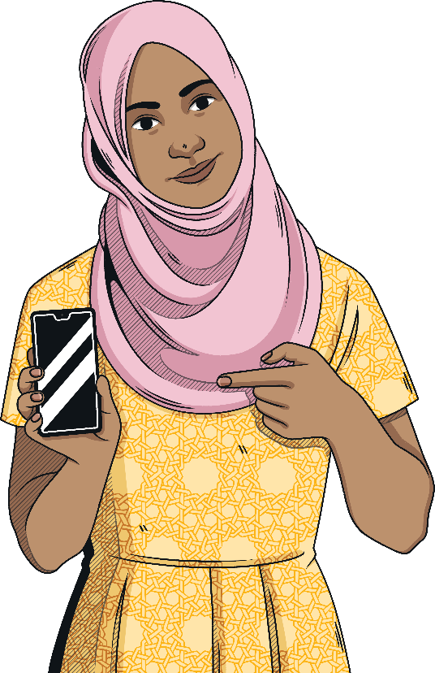
Social Media
Social media and online information are powerful tools that enable us to connect with others, share successes and communicate our thoughts and ideas. This is constantly evolving and changing; we each have our own relationship and experience of this.
It is important that we know how to protect ourselves and others while using social media by learning how to recognise where it might be limiting or deceptive.
Do social media posts always show a full or true picture of someone’s life or beliefs?
How can social media be used to help and support other people?

Slide 12

Communicate
Think of one thing you can do today to show someone that you have heard and understood something important to them.
How can you help someone else to express themselves?
How can you be a more reflective and active listener?

Slide 13


