Slide 1
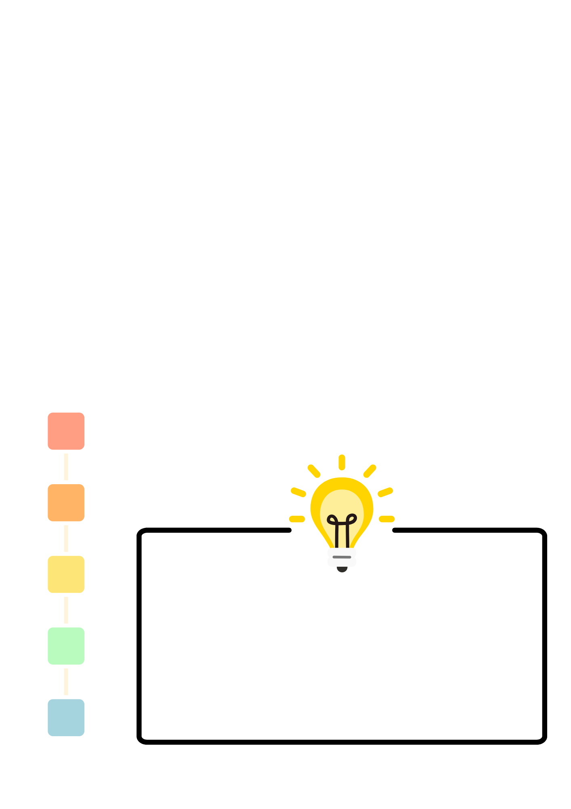
RSE Day Book Review
Use the book review template on the following page to share your thoughts and feelings about a book that fits the theme of RSE Day 2026 – It Begins With Me.
Podcast Interview
Use the space below to devise some interview questions for a guest to ask them about a favourite book they would recommend to young people on the themes of self esteem, courage, identity, friendship and resilience.

Slide 2

