Slide 1

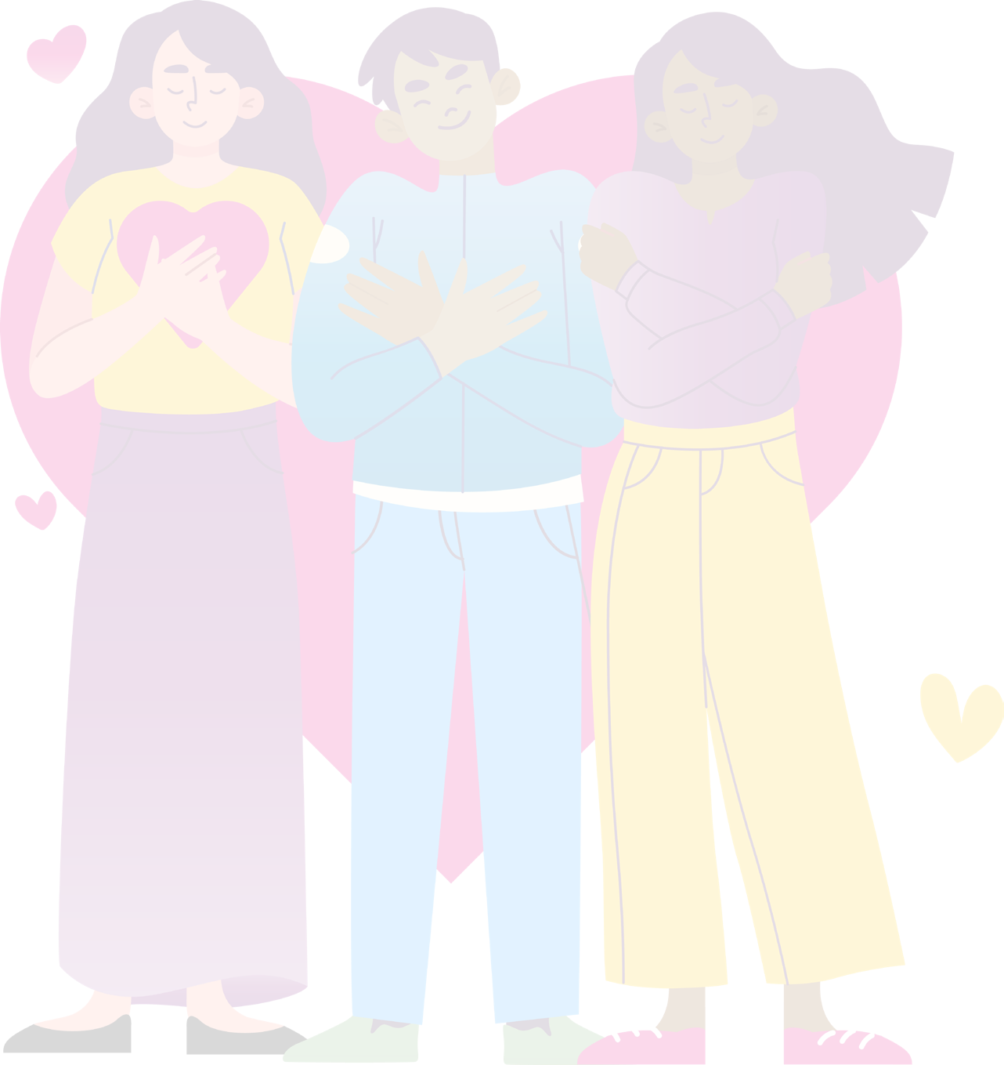

RSE DAY
25 June
2026
It Begins with Me
Primary Assembly 2026

Slide 2

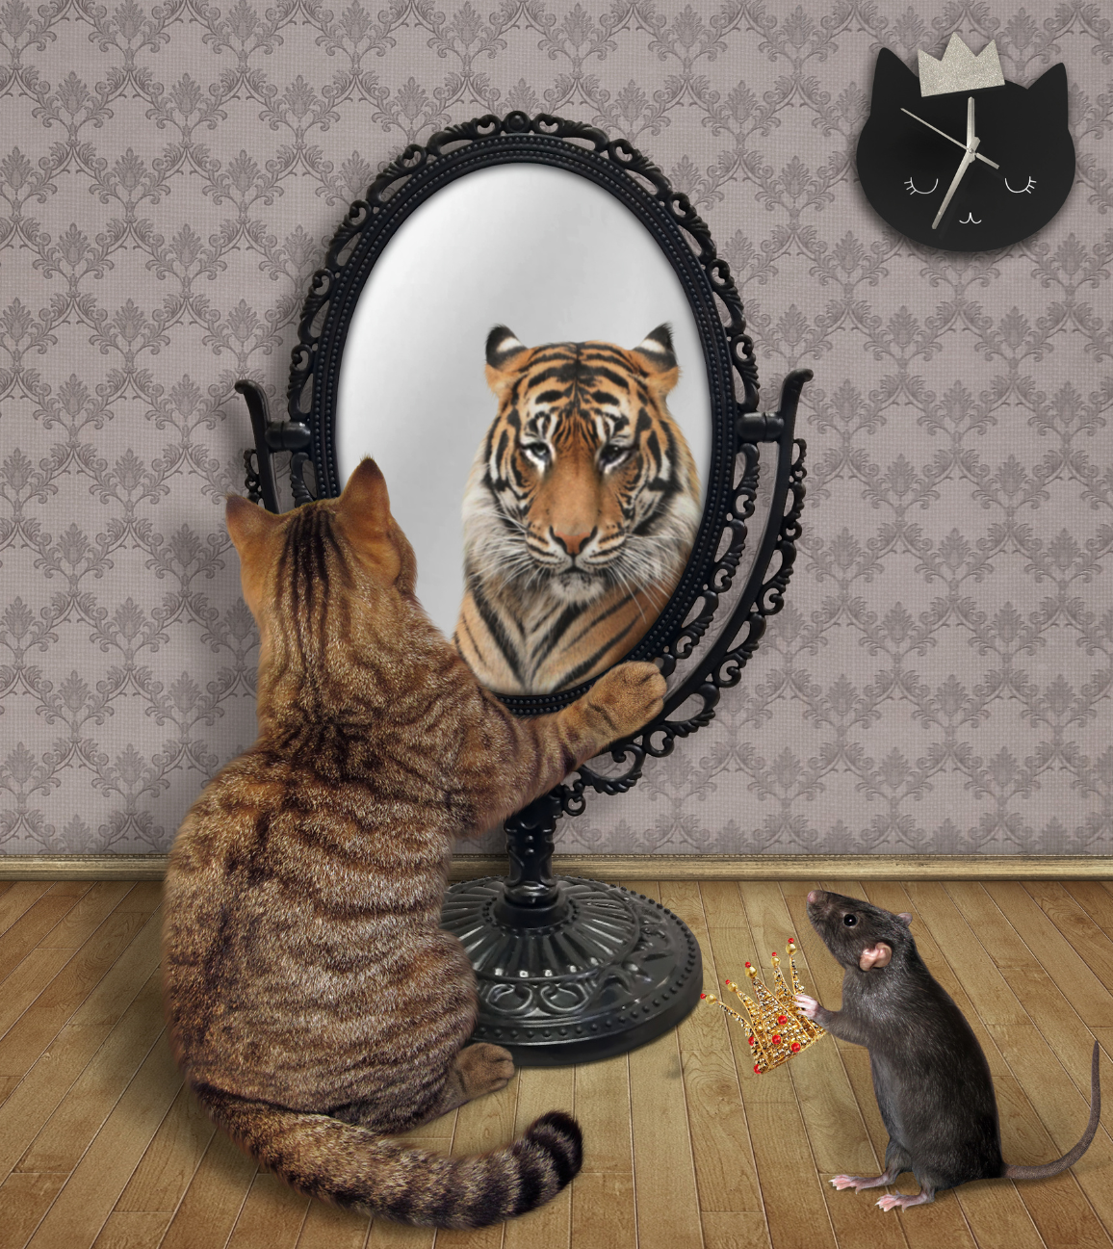
Who are you?
What do you see when you look in the mirror?
Is it a timid cat or a roaring tiger?
This cat is so confident in itself that it feels like a tiger.
This is because the cat has positive self esteem.

Slide 3
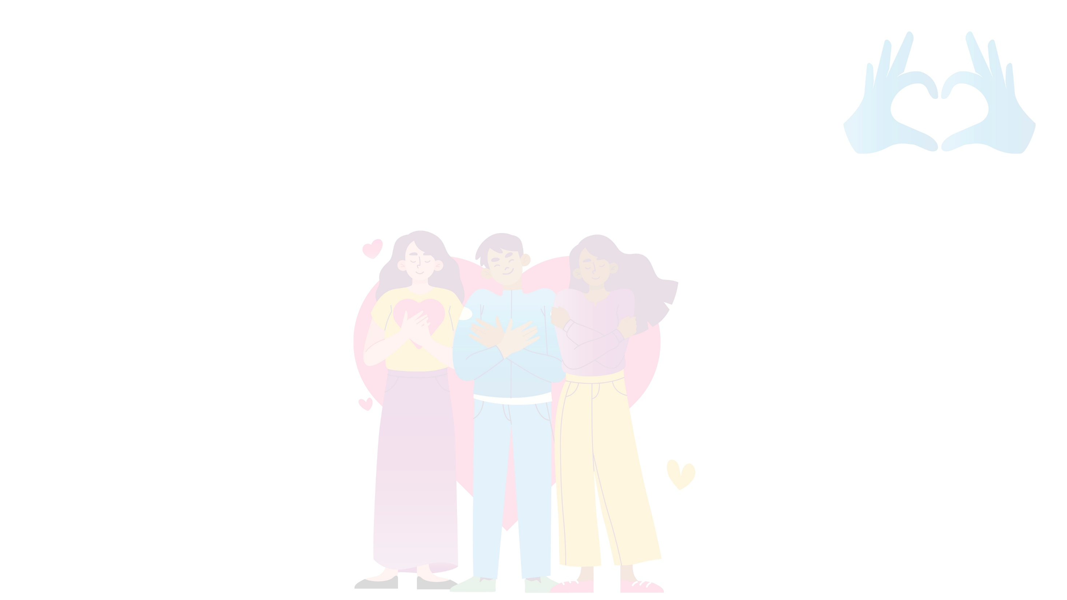
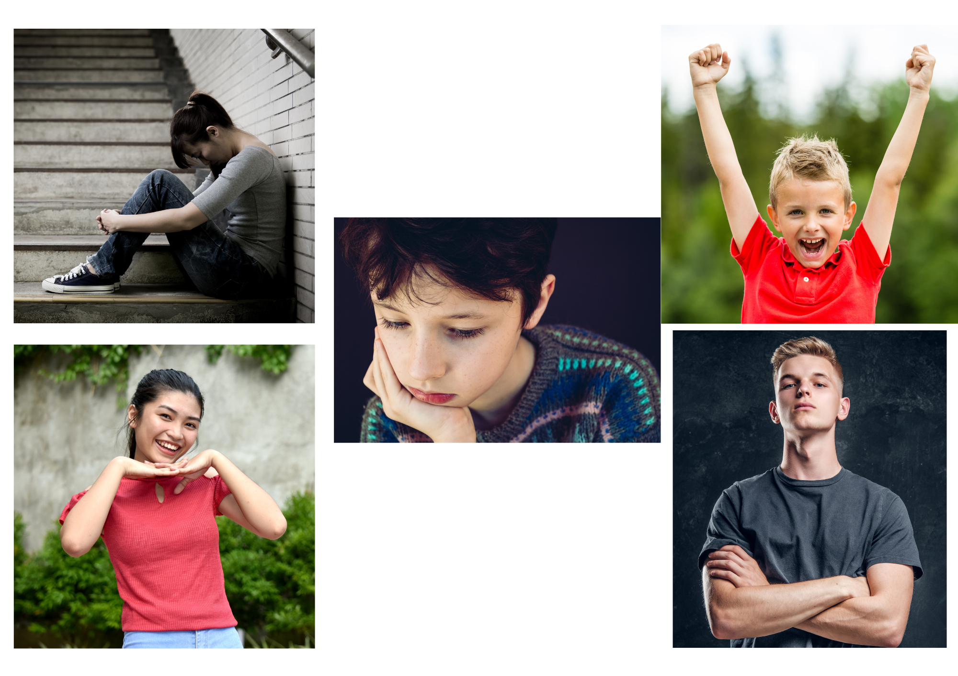
How do these people feel?
How can we tell?

Slide 4
What is confidence?
Text
Confidence is how we feel about ourselves in a particular situation
For example, Ash might be confident at playing football but not so confident at swimming.
Are we always good at everything we do?
Is it ok if we are not?

Slide 5
What is self-esteem?
Self-esteem is the way we feel about ourselves
Do you think self-esteem is the same as confidence?
What is the difference?
Can you think of something you are really confident at?

Slide 6
Where does self-esteem come from?
Self esteem can start early in life.
We learn about self-esteem from those around us, the way others treat us and the experiences we have.
The way other people treat us can impact our self-esteem and may either build it up or knock it down!

Slide 7
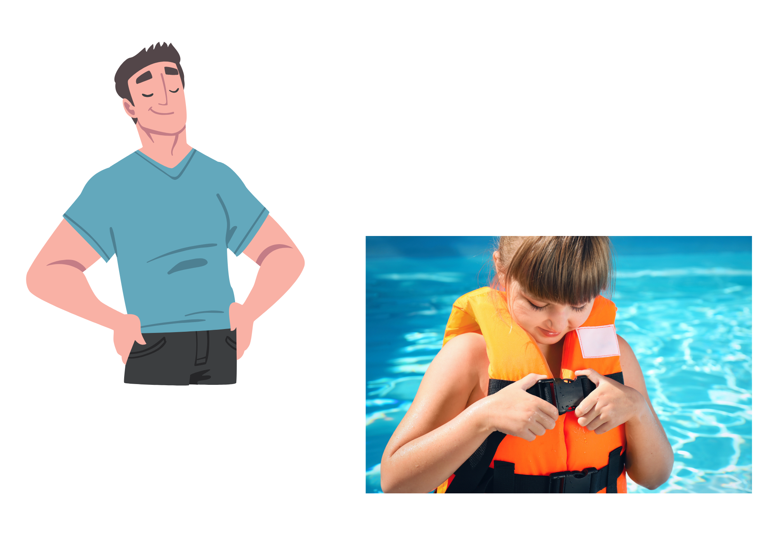
The theme of RSE Day 2026 is
‘It Begins With Me’
What do you think this means?
Why is it important that we focus on our own self-esteem as a starting point?

Slide 8
How does healthy self esteem help us in our lives?
It can help us express our needs clearly and respectfully.
People with positive self esteem know they are worthy of love and care.
When we feel worthy, we are more likely to choose relationships that are safe and respectful.
Healthy self-esteem also shows up in the way we treat people.
It makes it easier to be kind to others, to give and receive support to one another and to set clear boundaries.

Slide 9
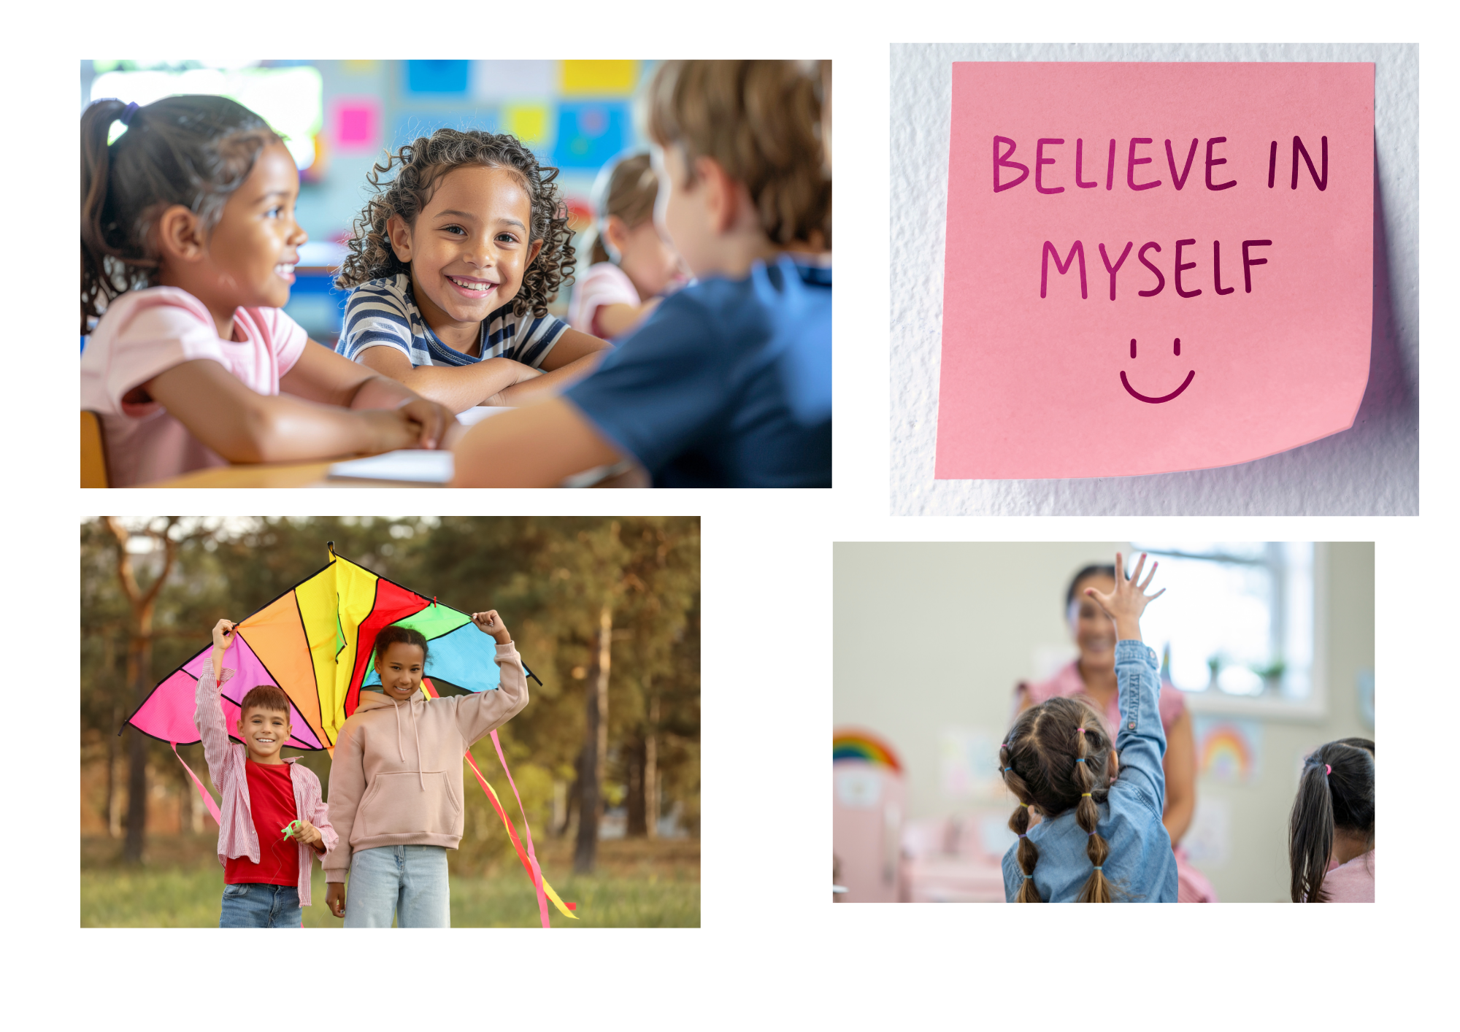
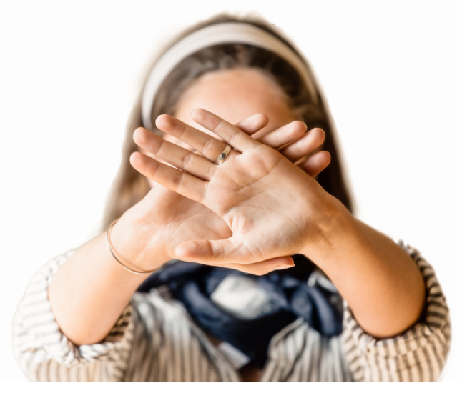
What positive self esteem looks like
Getting along with and helping others
Believing in yourself and valuing others
Making time for the things you love and spending time with others
Asking for help and helping others
Listening to advice and supporting others
Setting safe boundaries for yourself and others (including saying
no when needed)

Slide 10

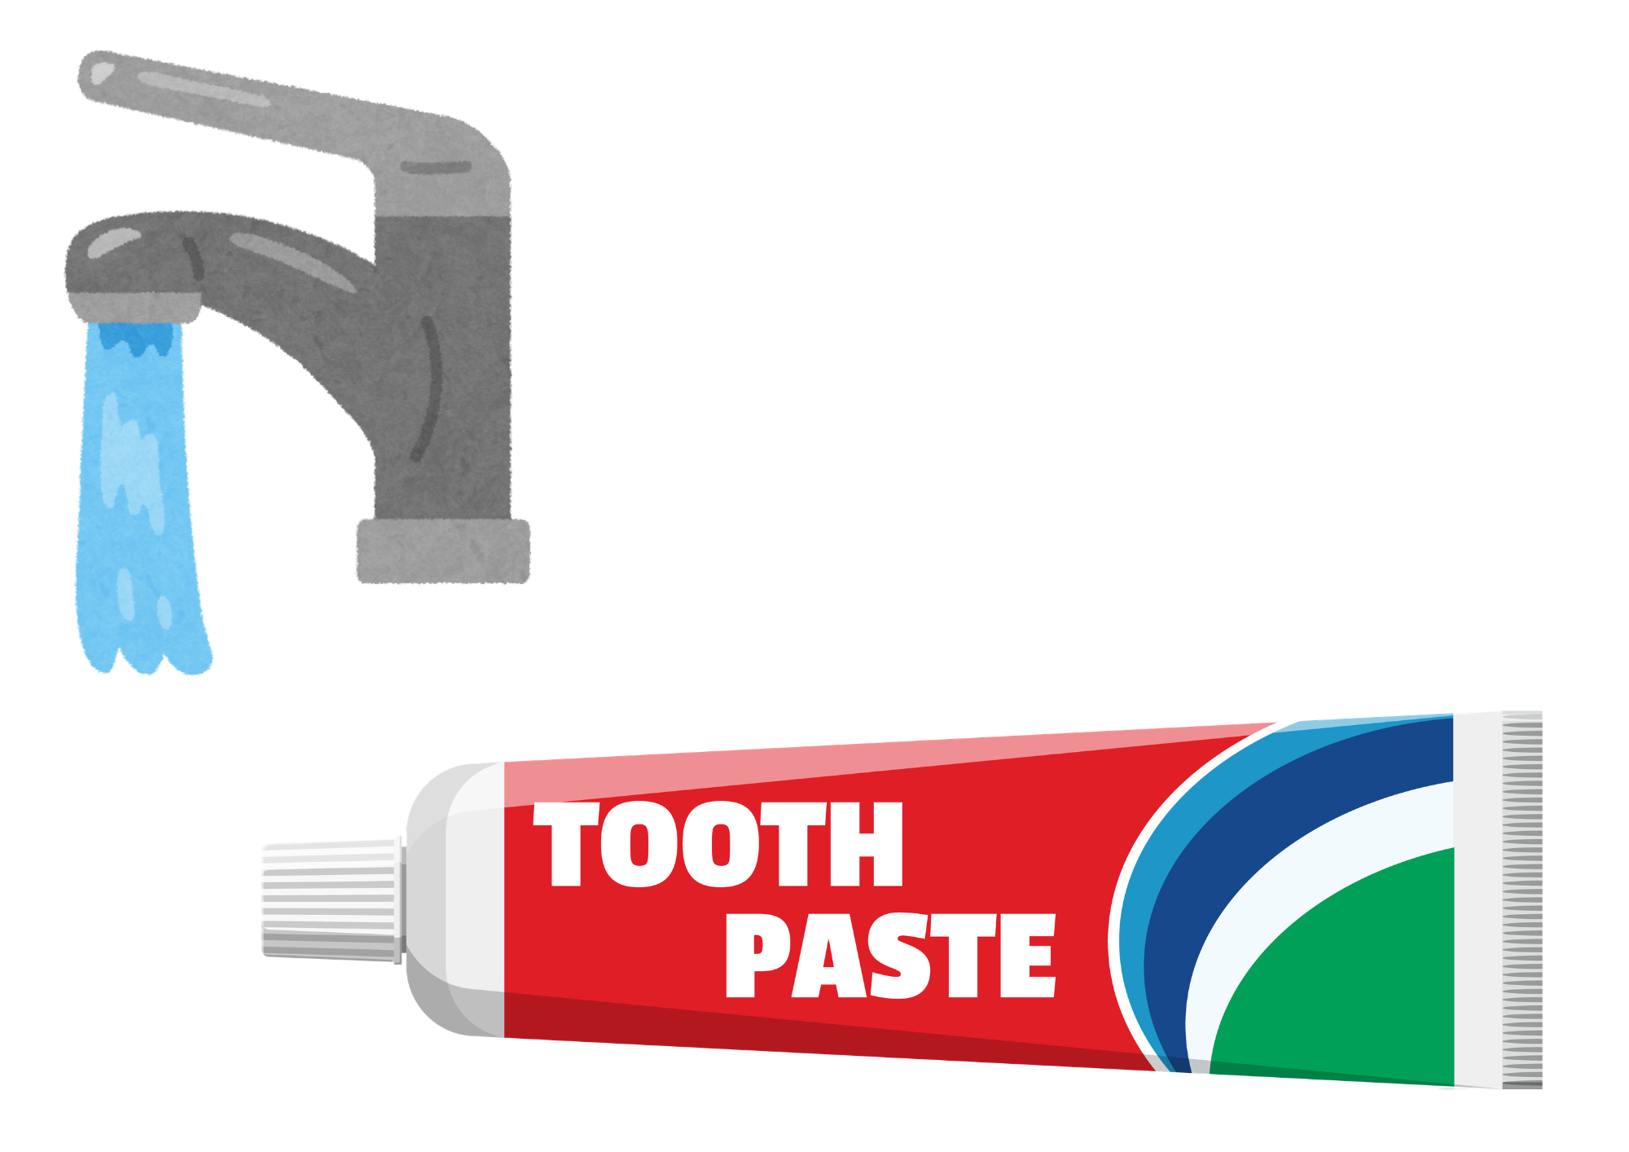
Words stick!
What does this demonstration show us?
Notes:
Use a picture of a heart stuck on a paper plate to represent someone receiving comments. Invite a child up to hold the toothpaste tube. Every time a negative comment is made, the child should squeeze a blob of toothpaste onto the paper heart. At the end, apologise and say you didn’t mean the hurtful comments. Ask if the child can help you take them back and put them back into the tube. They will find this almost impossible. Explain that this is a bit like when we traet people unkindly. It can cause damage to their self esteem and it can be very hard to take the words back once they are out. Emphasise that we have a responsibility to be careful with our words so we don’t hurt others.

Slide 11
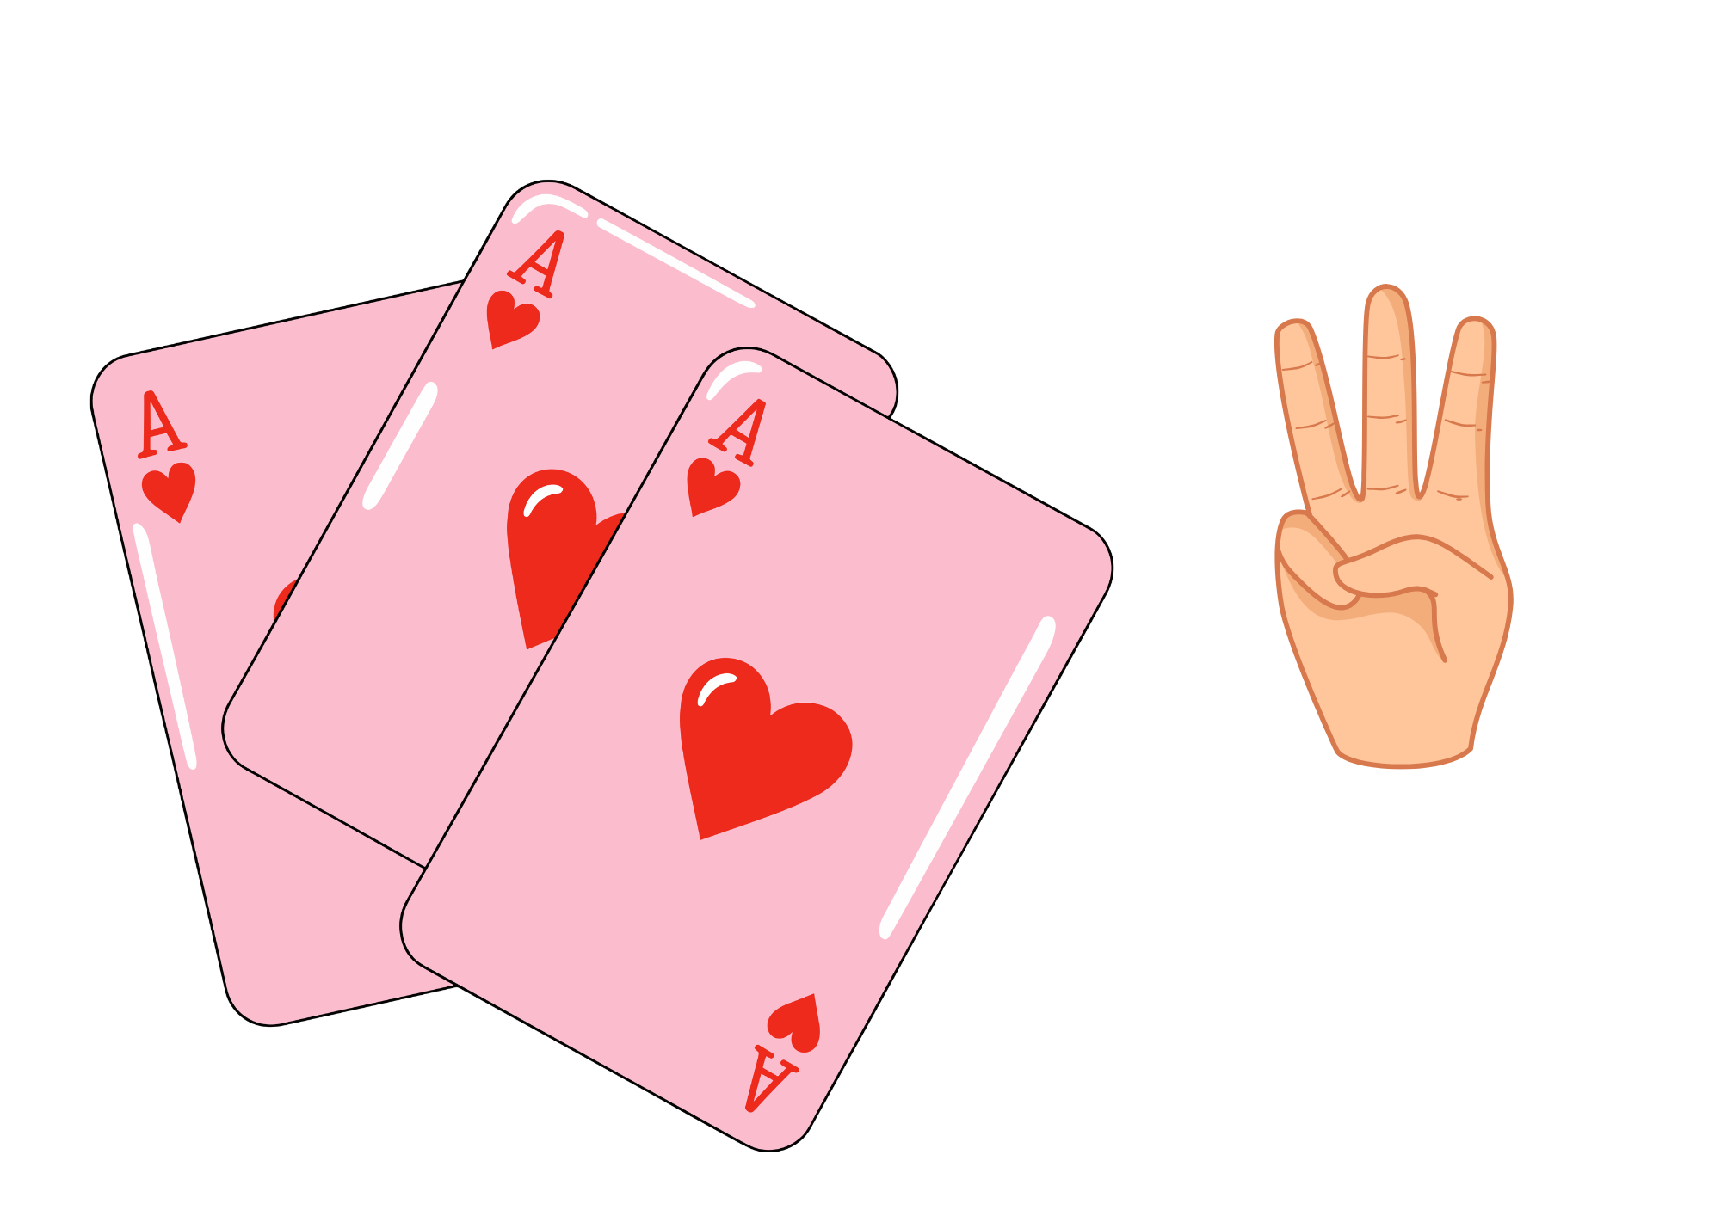
Positive self-belief
Tell the person next to you three things you most value about yourself:
Something you are good at
Something you like about your personality
Something you are proud of
1.

Slide 12
Tips for Building Self-esteem
Practice positive self talk – speak like you would to a best friend
Realise it is ok to make mistakes – we all do sometimes!
Set small goals you want to reach
Identify your strengths and abilities
Focus on things you are thankful for
Don’t compare yourself to others
Practice kindness and friendship

Slide 13
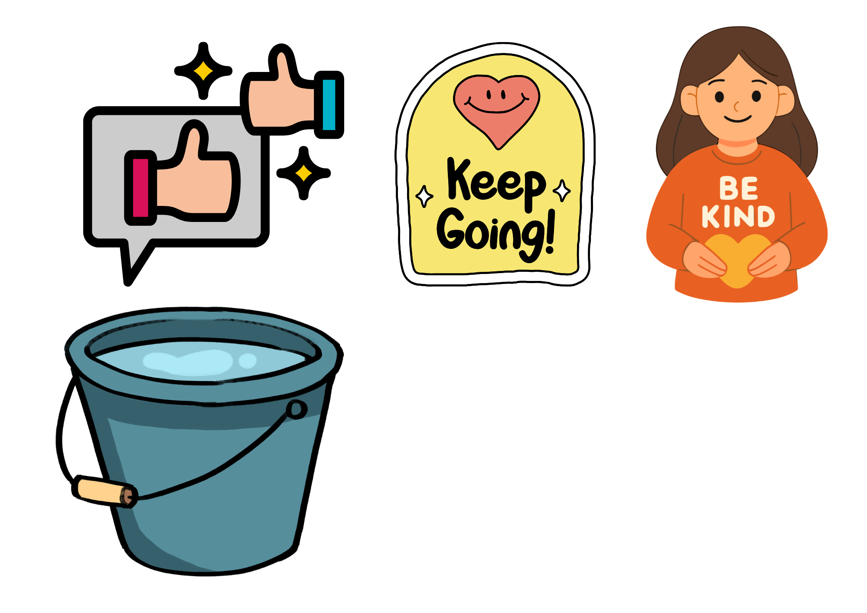
How can we fill a bucket of kindness?
What things fill your own bucket?
When we take care of ourselves, we can take better care of others
What drains it?
Notes:
Teacher may want to use a visual bucket as a prompt, showing how self care actions, hobbies, kind gestures, joyful moments can fill the bucket, while criticism, unkind words, rejections, mistakes, setbacks and negative experience act like holes that drain it. Demonstrate pouring water into the bucket (or tip in cups of glittery sequins if you want to make it messy fun), each time you say a positive thing. You may wish to ask pupils to call out actions or words that would help fill it. Once the bucket is full, show how you need to tip the excess into a second bucket to represent sharing that positivity and kindness with someone else.
In class you may want to read ‘Have You Filled a Bucket Today?’ to explore this concept further.

Slide 14
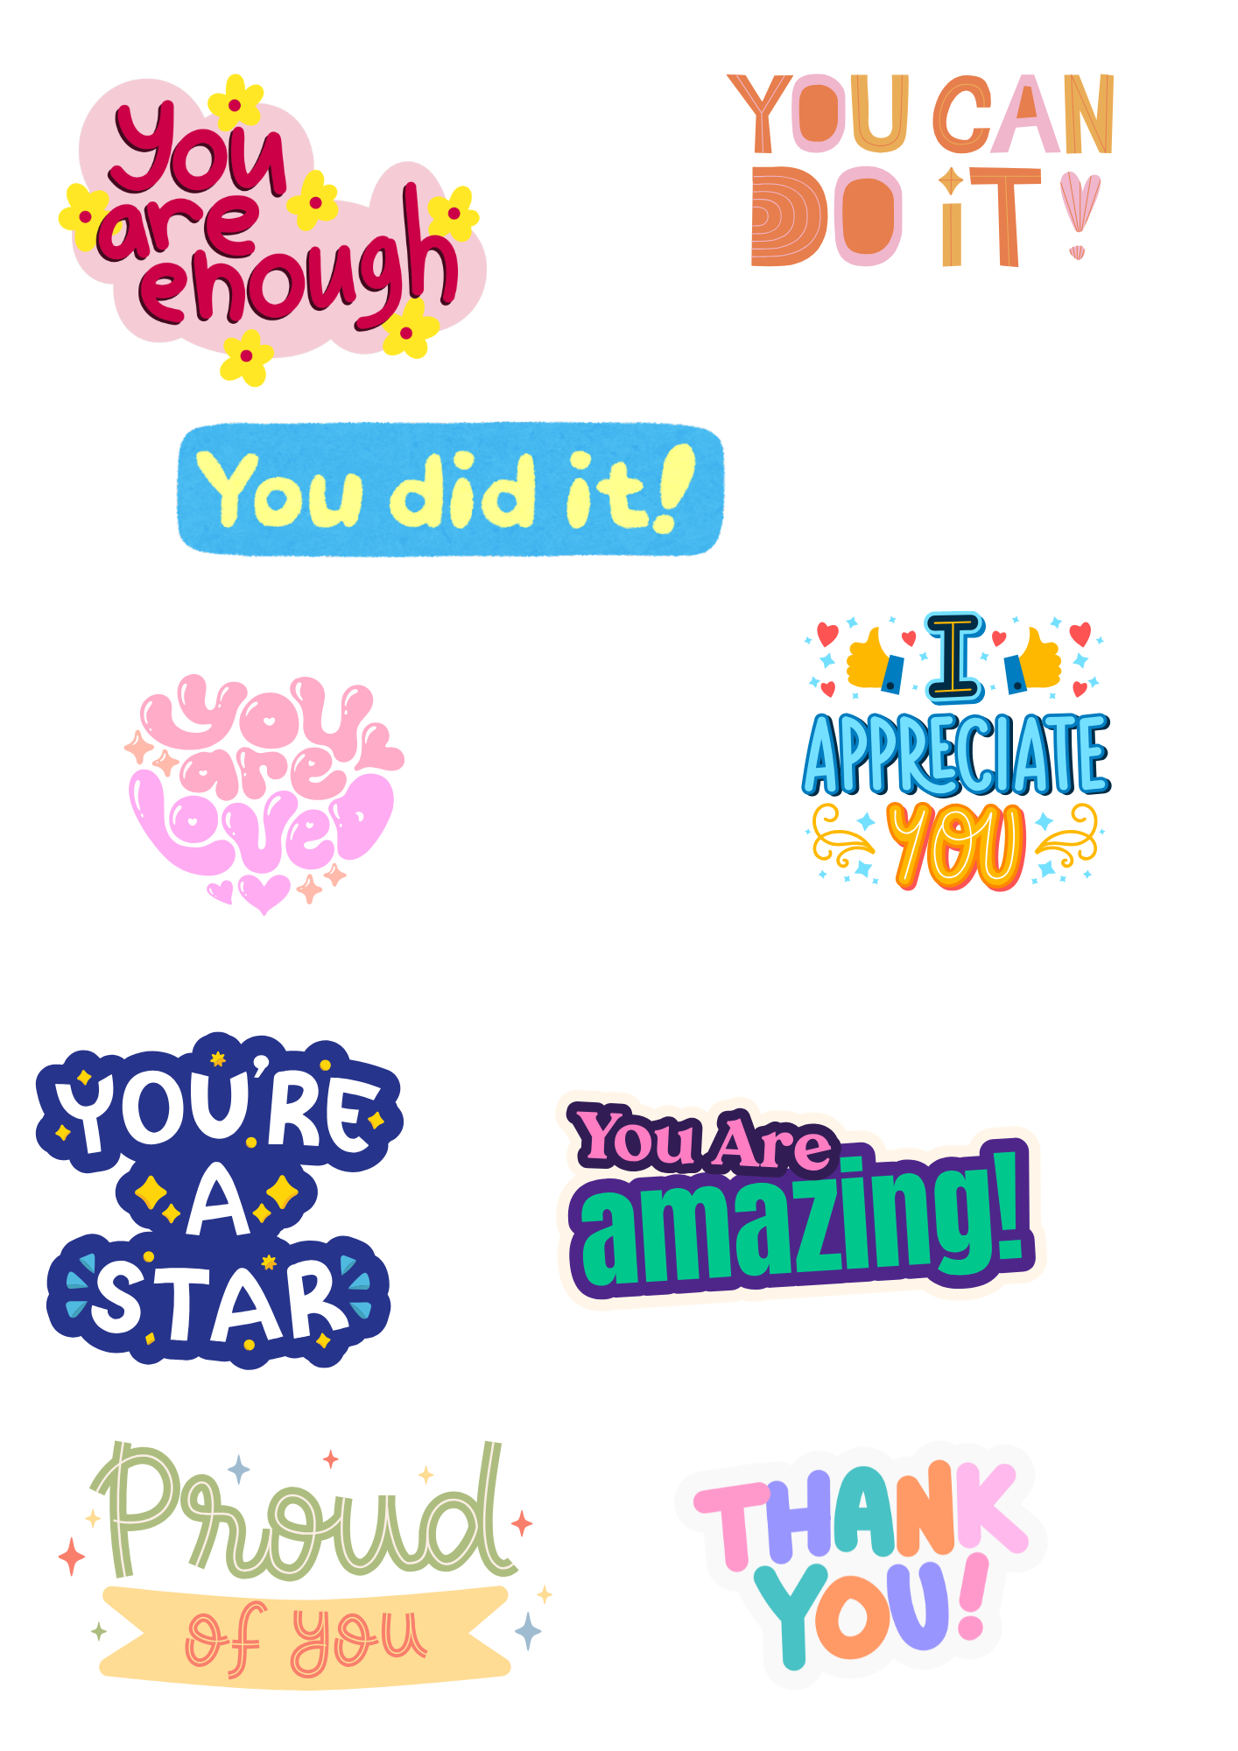
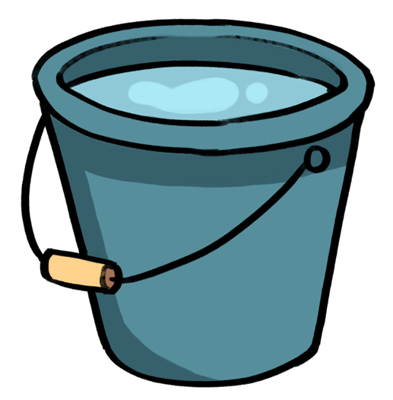
We can give from the overflow of our own bucket!
Text
Notes:
Teacher may want to use a visual bucket as a prompt, showing how self care actions, hobbies, kind gestures, joyful moments can fill the bucket, while criticism, unkind words, rejections, mistakes, setbacks and negative experience act like holes that drain it. Demonstrate pouring water into the bucket (or glittery sequins if you want to make it messy fun), each time you say a positive thing. You may wish to ask pupils to call out actions or words that would help fill it. Once the bucket is full, show how you need to tip the excess into a second bucket to represent sharing that positivity and kindness with someone else.
In class you may want to read ‘Have You Filled a Bucket Today?’ to explore this concept further.

Slide 15
Helping Others with self-esteem
Support them to try new things
Give encouragement and praise
Use kind and respectful behaviour and don’t judge

Slide 16
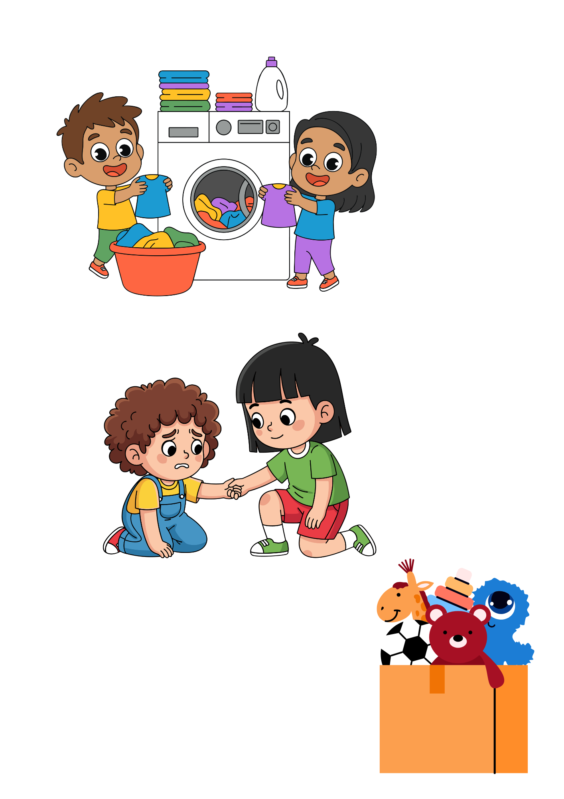
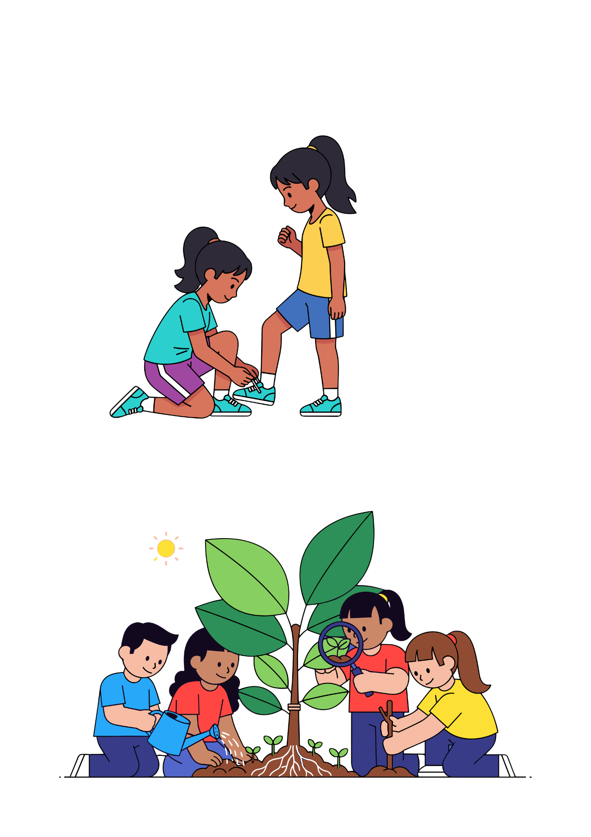
What are some ways we can build positive relationships…
In the local community?
at home?
at school?
Notes:
Ask children to talk in pairs and discuss different ways they can contribute in these different situations. Take feedback.

Slide 17
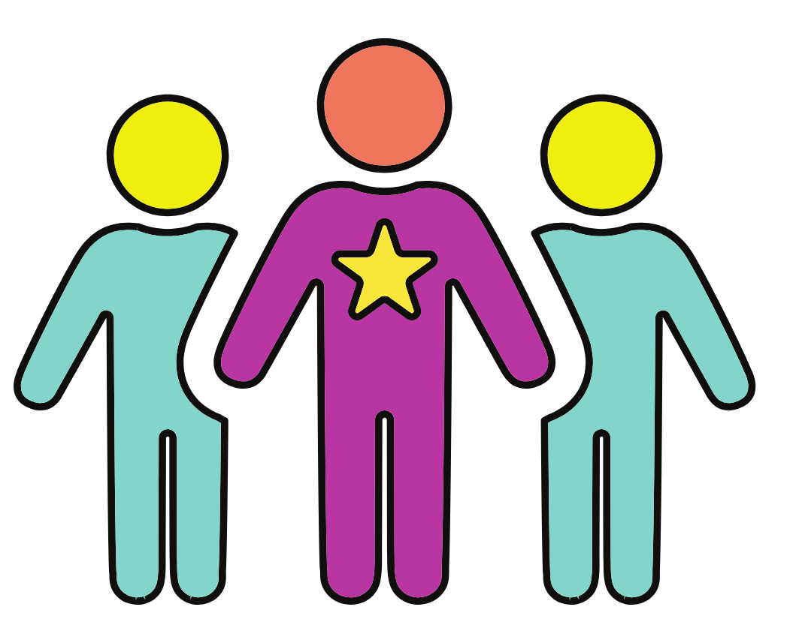
Remember…
Developing positive self-esteem can take time
Being kind to others helps them feel good — and it helps us feel good too!
It is ok to ask for help if you are struggling with your feelings – don’t stay quiet!
Remember, there is no one else in the world like you and that makes you perfectly unique!

Slide 18

Enjoy an amazing RSE day!
Challenge:
Before the end of today, do one brave thing that makes you feel proud of yourself. Here are some ideas:
Say something kind to someone who looks left out
Ask a question in class
Stand up for yourself or someone else in a respectful way
Try again at something you’ve previously found tricky
Share an idea even if you feel shy
Help someone without being asked

