Slide 1

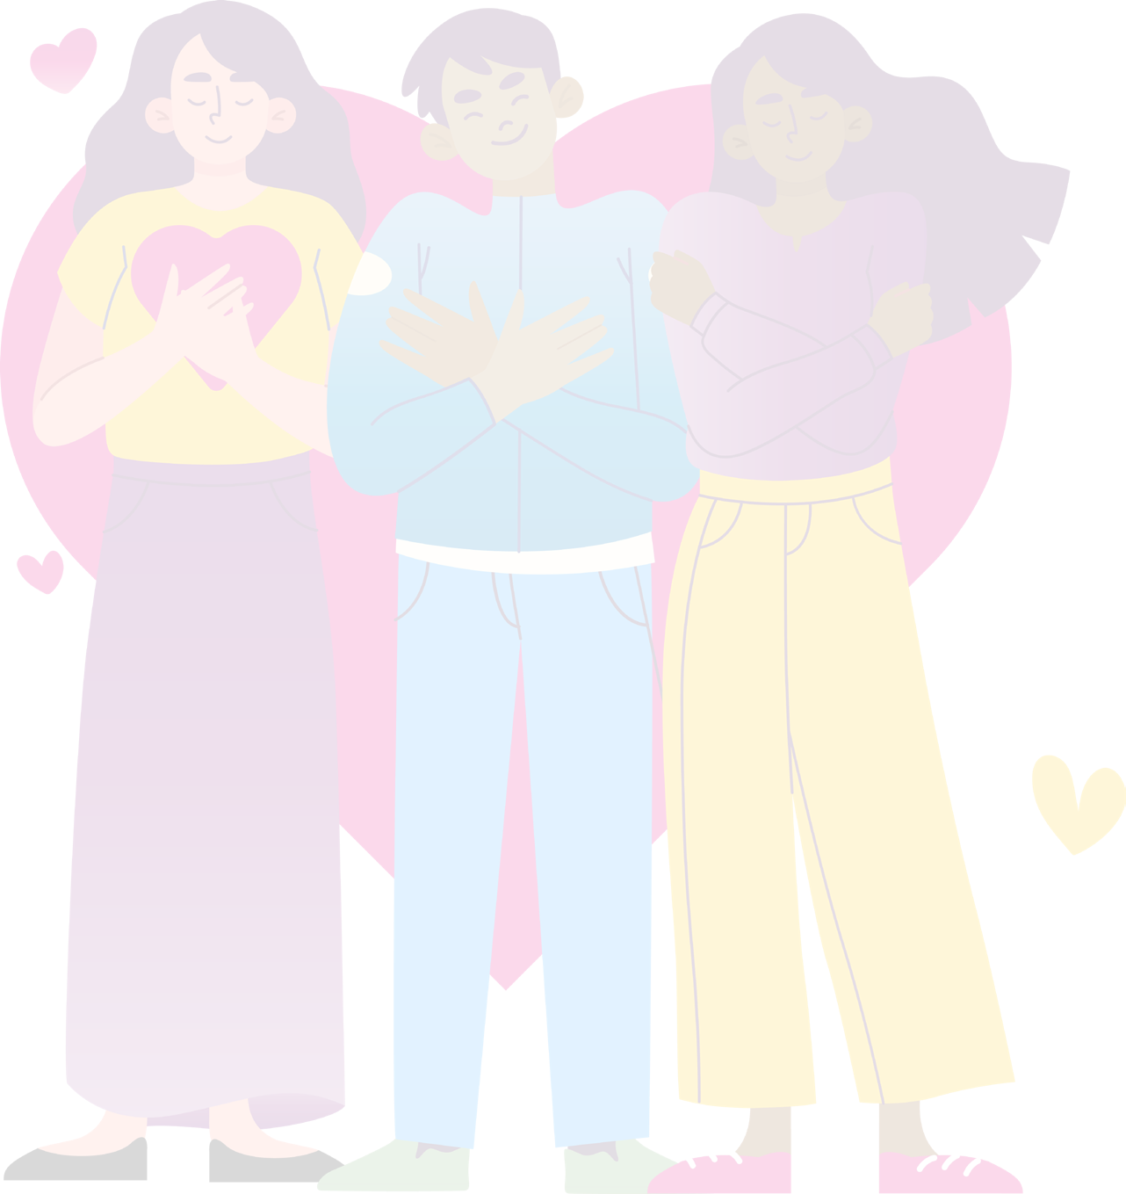

RSE DAY
25 June
2026
It Begins with Me
Secondary Assembly 2026

Slide 2
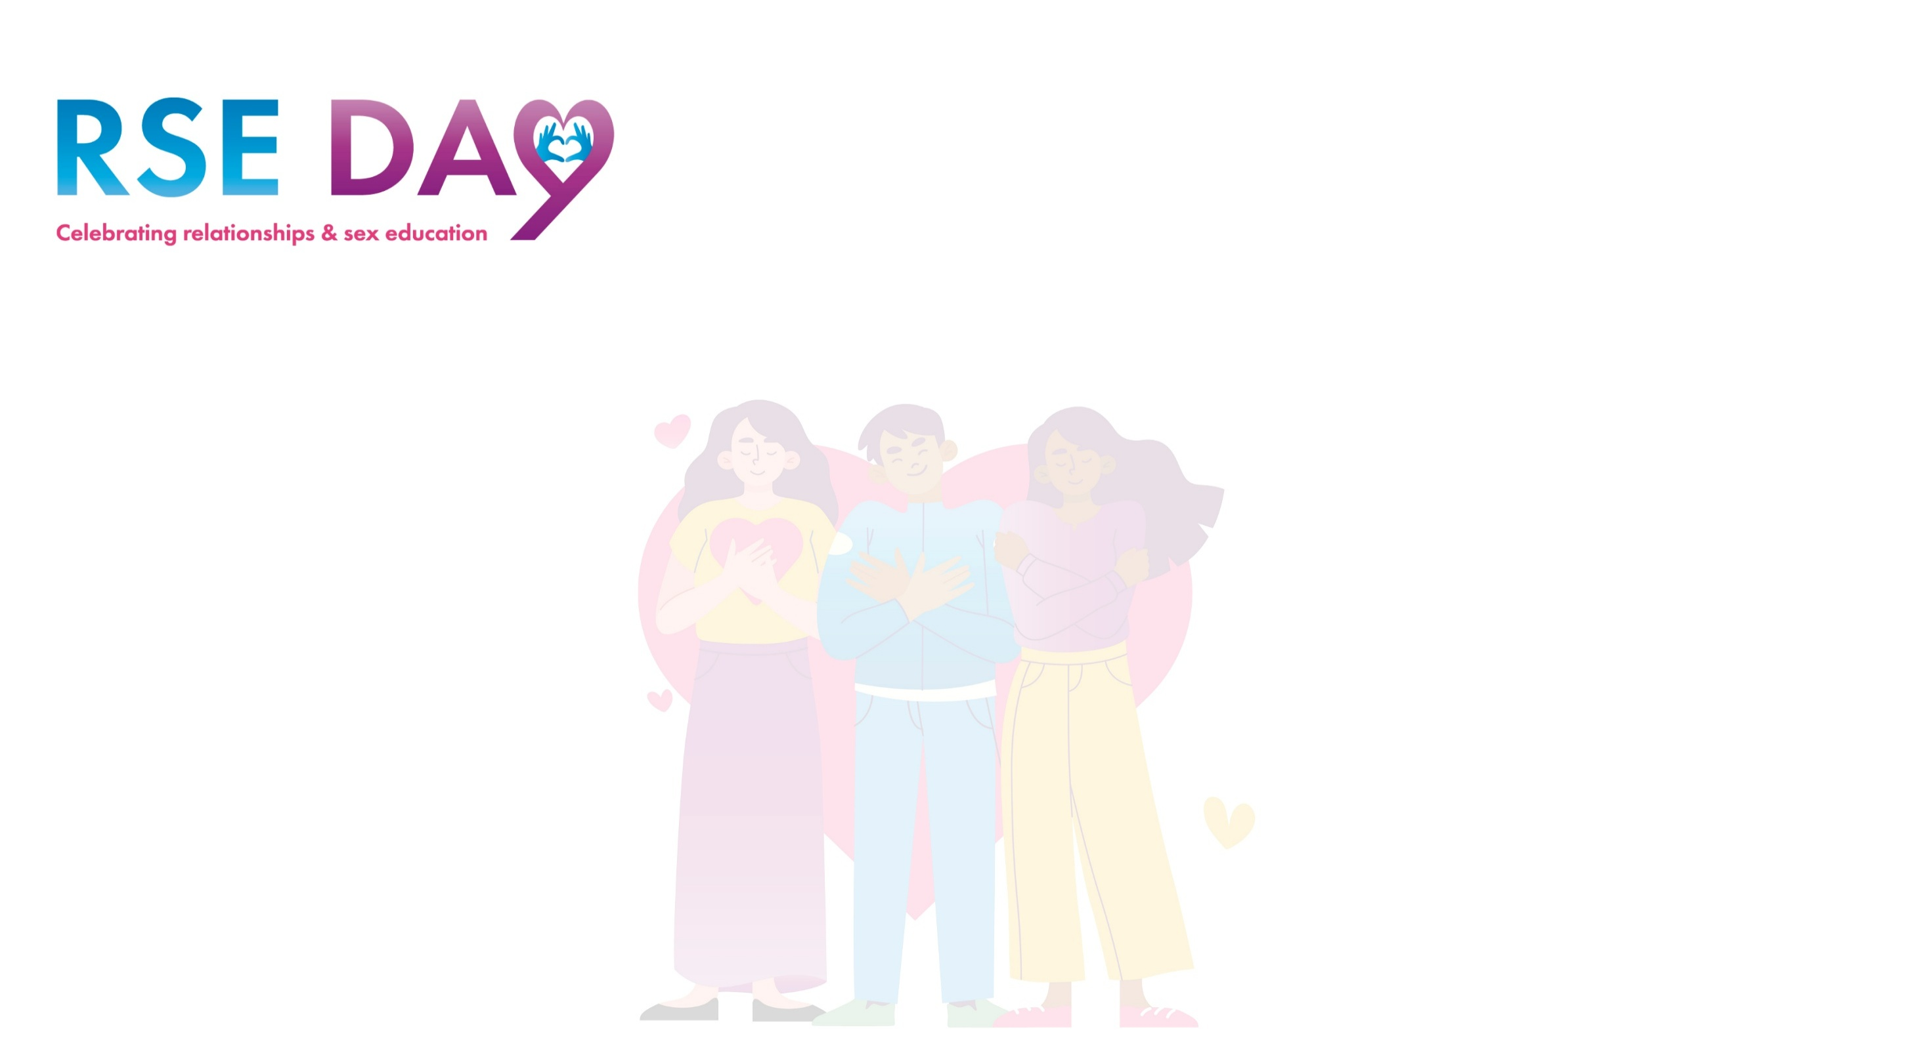
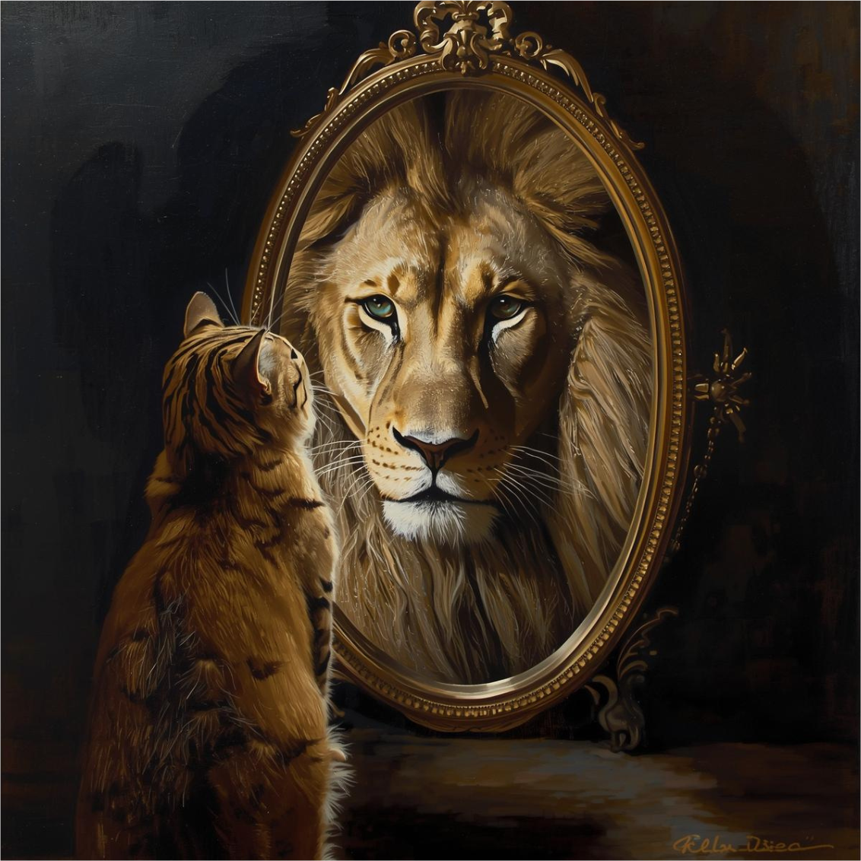
How do we see ourselves?
What do you see when you look in the mirror?
Is it a truth or a lie about your worth ?
What might be a lie you sometimes tell yourself about the way you look or feel?

Slide 3

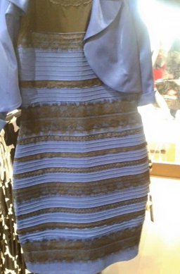
Perception is everything
Sometimes our mind plays tricks on us and we see things very differently to how other people see them. It’s a bit like this dress that once broke the internet…
Other people may see us differently to the way we perceive ourselves.
This can be linked to our self-esteem.
Notes:
https://en.wikipedia.org/wiki/The_dress

Slide 4
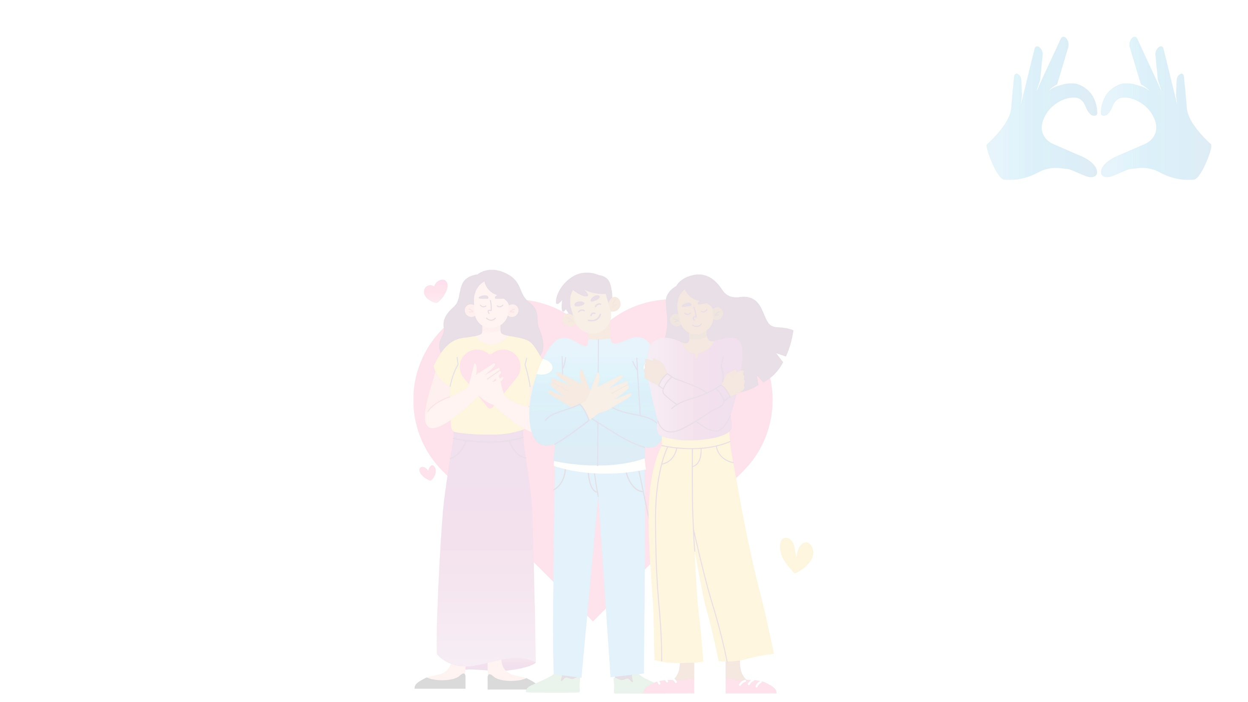
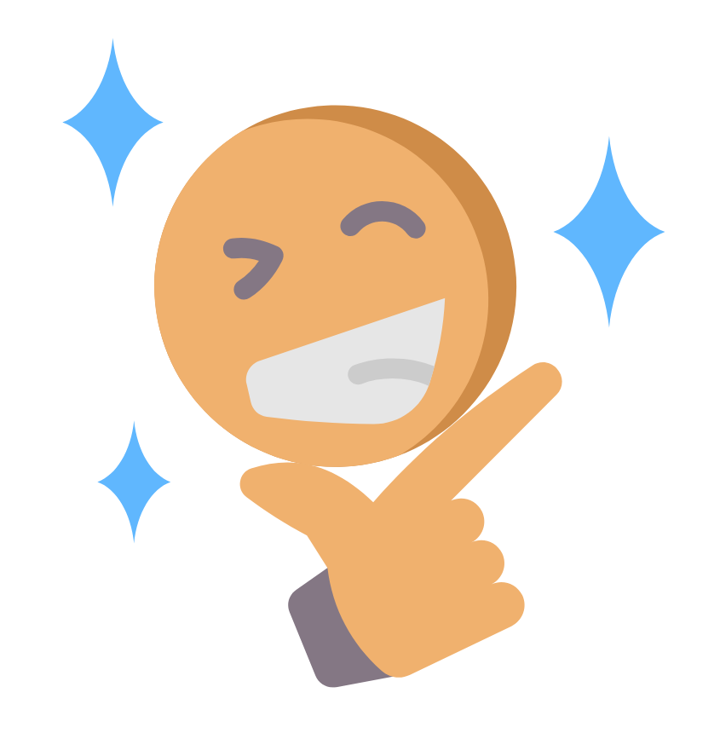
What is self-esteem?
Self-esteem is the way we feel about ourselves
What are some indicators of healthy self-esteem?

Slide 5
The theme of RSE Day 2026 is ‘It Begins With Me’
Healthy relationship behaviours begin with the first person you’ll ever have a relationship with – yourself!
We are going to look at some ways you can develop and grow healthy self esteem, as well as how we can encourage and support others

Slide 6
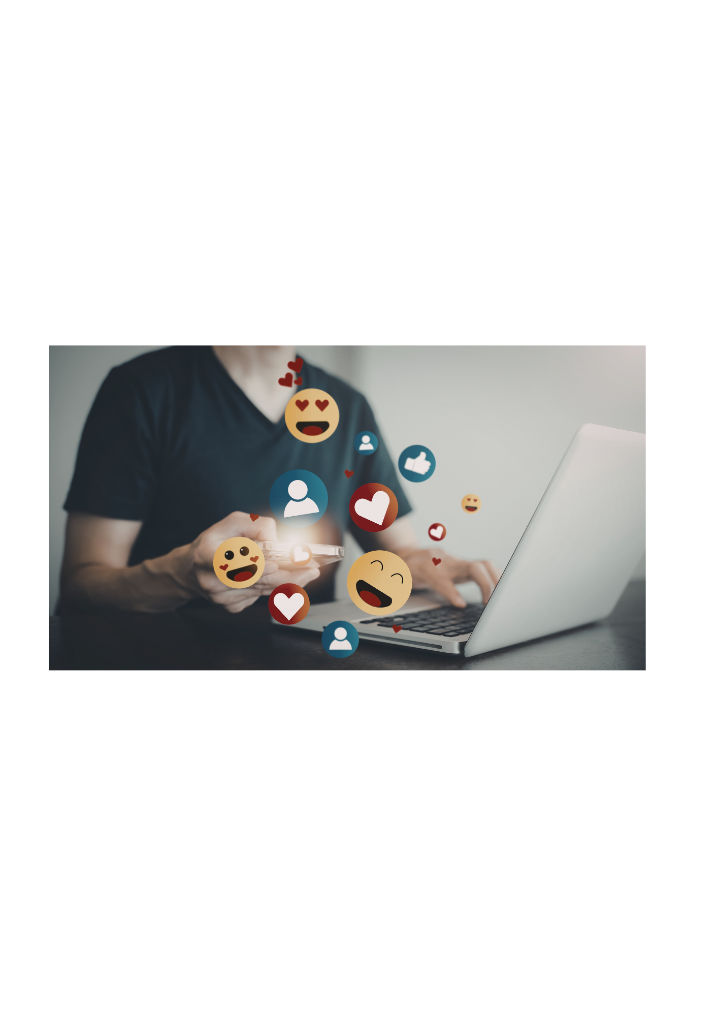

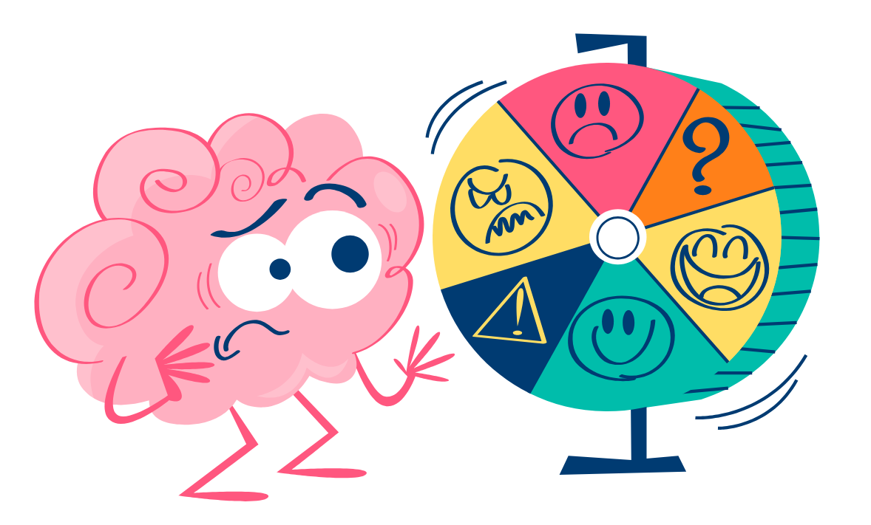
What are some of the factors that affect confidence and self esteem?
Tell the person next to you what might make someone’s self-esteem increase or decline
Notes:
One of the biggest factors that young people say impacts their body image is social media. Ask the students: Do you think this true? Why/why not?
What other kinds of pressures or challenges might young people experience? Ask the students to feedback (academic progress, peer pressure, financial etc)

Slide 7
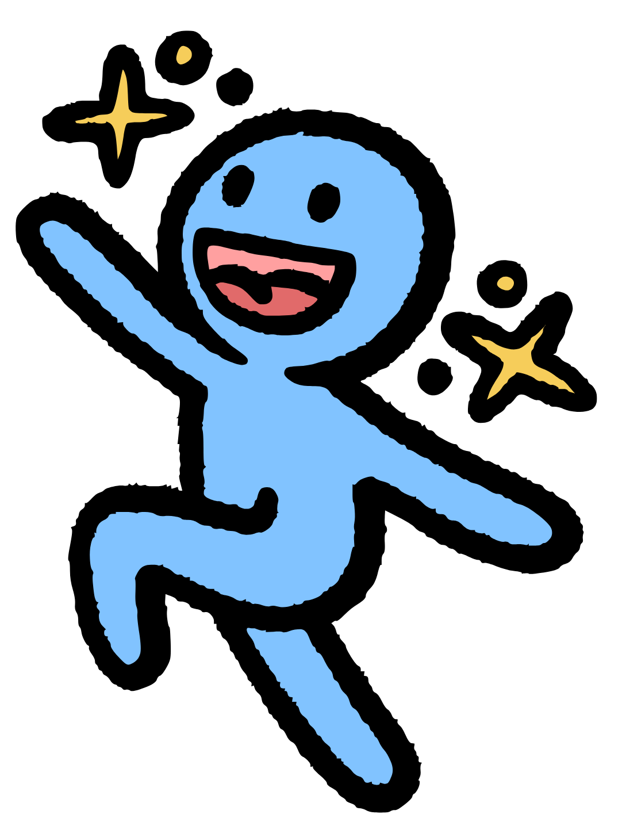
Ways to build confidence and self esteem
Practice positive self-talk and challenge negative thoughts
Focus on your strengths
Surround yourself with people who lift you up
Set small goals
Step outside your comfort zone (try new things)
Start saying ‘no’ and practice assertiveness
Build time for self care and interests

Slide 8
Inspiring figures who never let setbacks define them
This person struggled with low self esteem at school, with anxiety and negative beliefs about their abilities and dyslexia, which arose from bullying.
They stayed away from social situations and activities, making their self esteem even worse. After a friend suggested seeking professional help, this person challenged their negative thought processes and went on to sell over 15 million books, open a number of restaurants and host many tv cooking programmes.
Notes:
https://youtu.be/IZpDoqPaItM Beautiful by Christina Aguilera

Slide 9
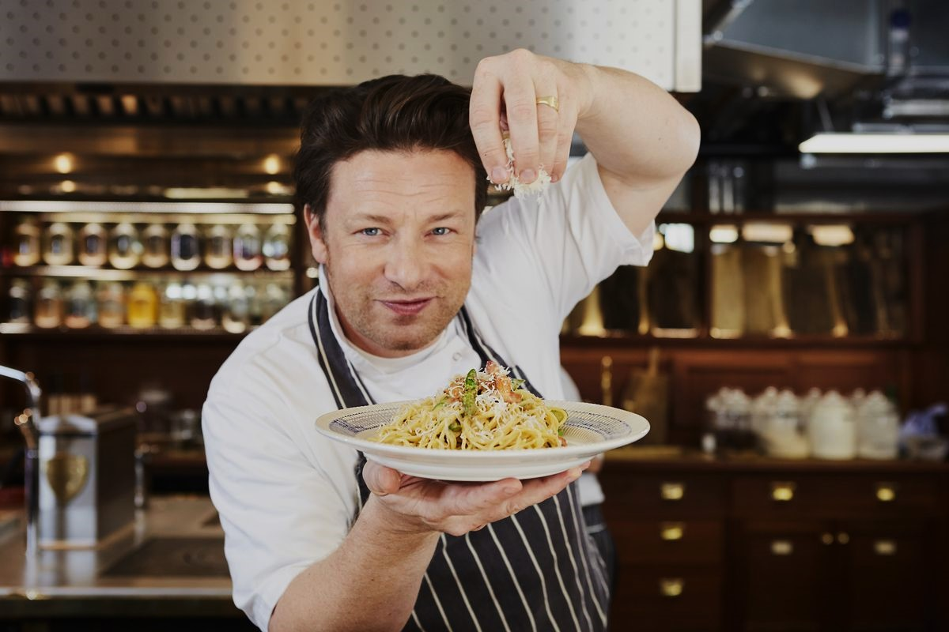
Jamie Oliver – TV chef, author and restaurateur

Slide 10
Inspiring figures who never let setbacks define them
This person was bullied throughout her entire time in school which affected them deeply. Past struggles allowed the singer to draw from these experiences to portray the shy and insecure character Ally in A Star is Born.
They now use their fame to spread messages of empowerment and self-acceptance, advocating for kindness and bravery in the fight against bullying.

Slide 11
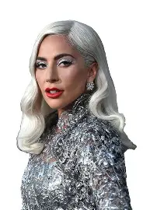
Lady Gaga – singer/performance artist

Slide 12
And a reminder to never give up on your dreams…
After a difficult childhood and losing his dad at age 7, this person had several jobs, including being an insurance salesman and petrol station attendant. Aged 65 they finally opened their first café, using money from state benefits, after previously being rejected from 1000 restaurants. By his death, they had made $3.5 million and set up a pioneering fast-food franchise.
Can you guess who this is?

Slide 13
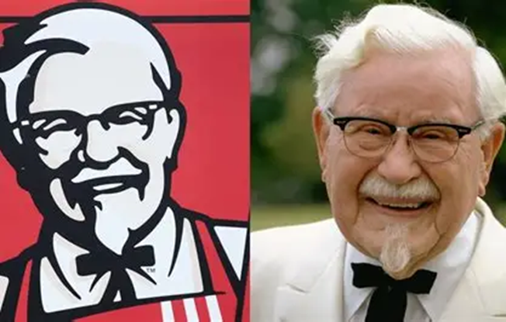
Colonel Sanders - KFC

Slide 14
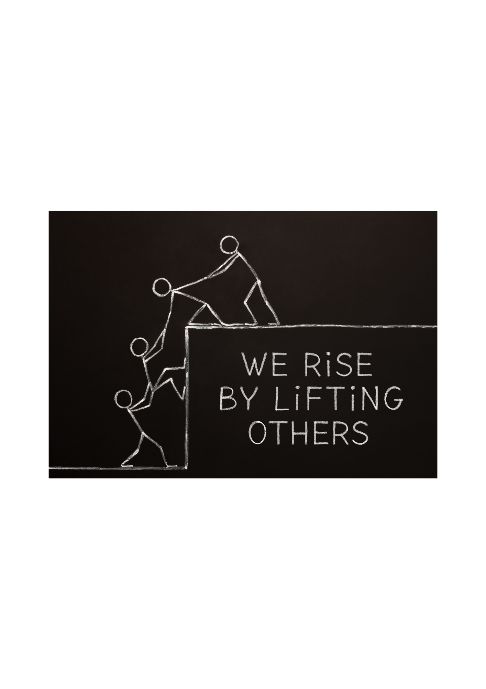
What does this saying mean?
How might having positive self esteem affect the relationships we have with other people?
How can we help others to grow in confidence?

Slide 15

Creating a Positive Web of Kindness
If the ball of string is thrown to you, try to think of a way you can lift someone else up this week. Pass the ball onto someone else.
Every compliment, every kind word and every moment of support connects us. When we lift each other up, we create something strong and beautiful. You are part of that.
Notes:
Have a ball of string or wool ready. Choose one student to start. They hold the end of the string, give a compliment to someone else, and toss the ball to them. That student holds their part of the string, gives a compliment to another person, and tosses it on. Continue until you’ve created a giant web across the hall.

Slide 16
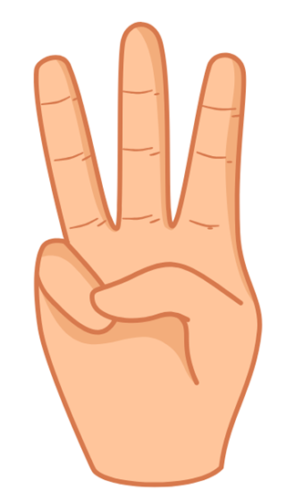
Three people Reflection
Listen to the song and try to think of:
One person who makes you feel good about yourself
One person you can ask for help when needed
One person you could stand up for or encourage today after this assembly
Notes:
https://youtu.be/IZpDoqPaItM Beautiful by Christina Aguilera

Slide 17
Reminder:
The words we say to ourselves matter
Being kind to others helps them and us feel good
It is ok to assert yourself and stand up to behaviour from others that you find unacceptable
Ask for help if you are struggling –it shows strength
Remember, there is no one else in the world exactly like you. Believe in yourself always!

Slide 18
RSE Day Challenge:
Before the end of today, do one small, brave thing that builds your self‑esteem or someone else’s.
Here are some examples to try:
Speak kindly to yourself once when you’d normally be critical
Say something encouraging to someone who might need it
Try something new — a club, a craft, a skill
Give back to your local community (volunteering, donate food, etc.)
Say no to something that doesn’t feel right for you
Sit with a different group or talk to someone new
Self‑esteem isn’t built in a day, but it is built daily. One brave thing today may be the first step to a lifelong positive relationship with yourself and others!

